Slide 1
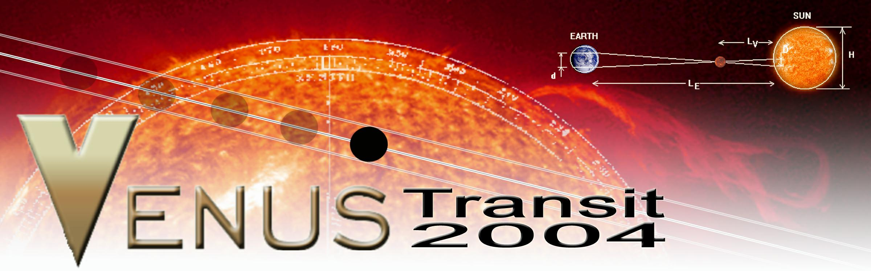
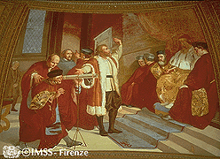
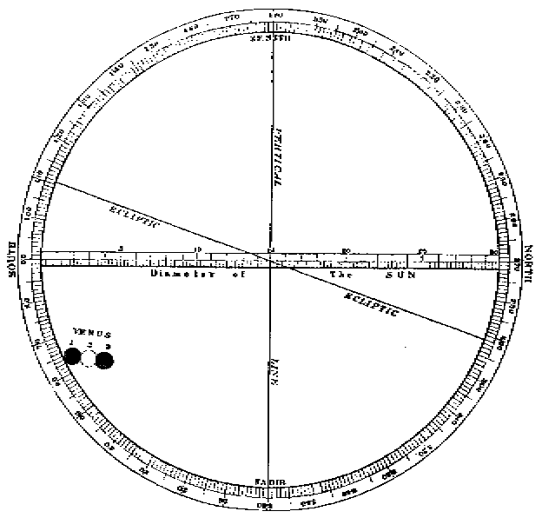
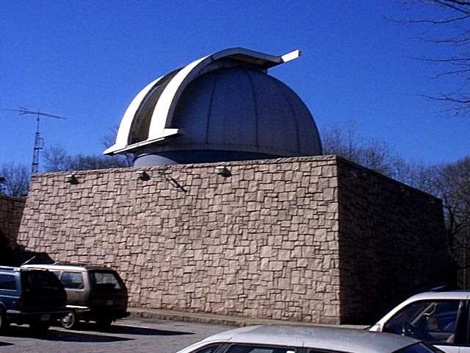
Twice in a Lifetime!
Sligo Creek Elementary School
Family Science Night
Lou Mayo (Raytheon / NASA GSFC)

Slide 2
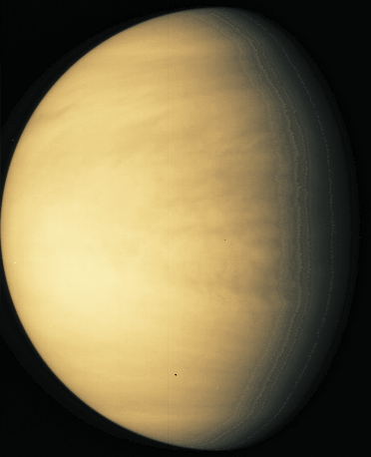
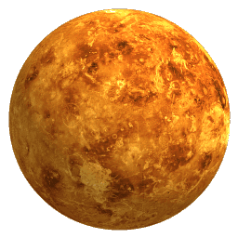
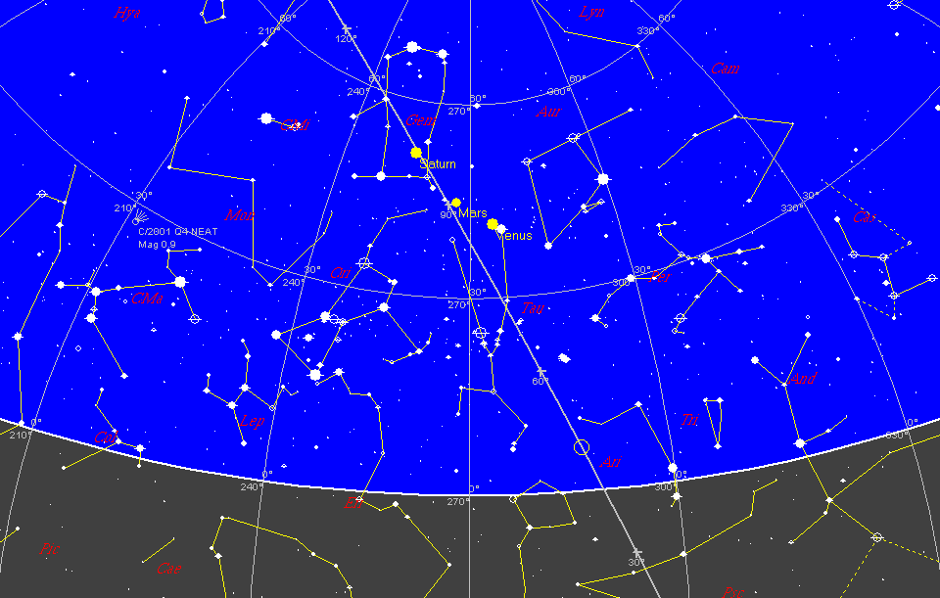
Venus Tonight: 7pm, May 6, 2004

Slide 3
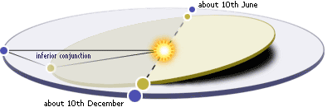

It’s All in the Geometry

Slide 4
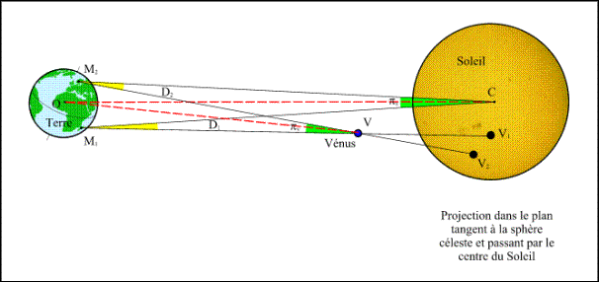
Venus Transit in French

Slide 5
TRANSIT DATES
        December 1631
        December 1639
June 1761
June 1769
        December 1874
        December 1882
June 2004
June 2012
        December 2117
        December 2125

Slide 6
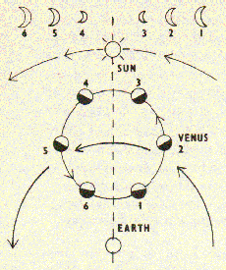
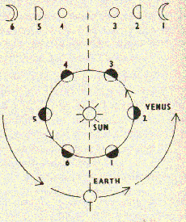
Venus’ Role in History
Copernican System: 1, Ptolemaic System: 0
Earliest records of observation date back to Babalonians ~3000 B.C.
First telescopic observations - Galileo, 1610.
  Venus had a cycle which could not be explained by its rotation around the earth
  Venus exhibited phases
  Venus changed apparent size
Cynthiae figuras aemulatur mater amorum. Translated: "the mother of love [Venus] emulates the figures of Cynthia [the Moon]."
1761 Transit was used to measure
longitude before there were accurate
clocks

Slide 7
Venus’ Role in History
Size of the Solar System - Revealed!
Kepler predicted the transit of December 1631 (though not observed!) and 120 year cycle.
Jeremiah Horrocks (born c.1619) predict that a further transit of Venus would occur on 4th December 1639
1761 transit observations partly successful in determining value of A.U. Russian astronomer Mikhail V. Lomonosov, suggests Venus has an atmosphere.
Captain James Cook et al., observed the 1769 transit from Tahiti.
Local Time D ( % of Sun's Diameter)
3.15 pm 48.06
3.35 pm 45.00
3.45 pm 43.33

Slide 8
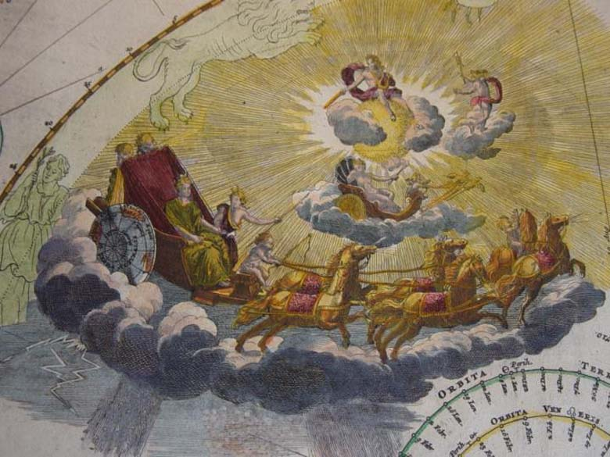
Figure from Johann Doppelmayer's Atlas Coelestis (1742)

Slide 9
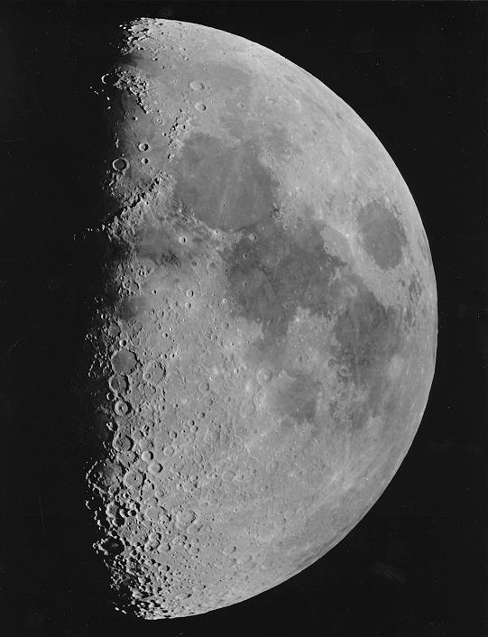
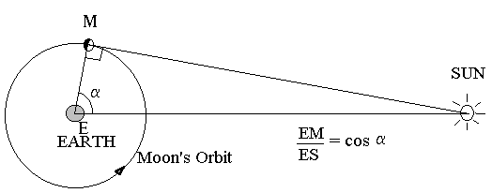
Aristarchus of Samos
(c.310 - 230 BC)
Early Estimate of the Astronomical Unit
δ
Measured α = 87deg. Therefore:
ES/EM = 1 / cos (87 deg) ~ 20 and…δ ∼ 3’

Slide 10
A new Method of determining the Parallax of the Sun
Edmond Halley
PHILOSOPHICAL TRANSACTIONS VOL. XXIX (1716) A new Method of determining the Parallax of the Sun, or his Distance from the Earth; by Dr. Halley, Sec. R. S. N0 348, p.454. Translated from the Latin.
It is well known that this distance of the sun from the earth, is supposed different by different astronomers. Ptolemy and his followers, as also Copernicus and Tycho Brahe, have computed it at 1200 semi-diameters of the earth, and Kepler at almost 3500; Riccioli doubles this last distance, and Hevelius makes it only half as much. But at length it was found, on observing by the telescope, Venus and Mercury on the sun's disk, divested of their borrowed light, that the apparent diameters of the planets were much less than hitherto they had been supposed to be; and in particular, that Venus's semi-diameter, seen from the sun, only subtends the fourth part of a minute, or 15 seconds; and that Mercury's sem-diameter, at his mean distance from the sun, is seen under an angle of 10 seconds only, and Saturn's semi-diameter under the same angle; and that the semi-diameter of Jupiter, the largest of all the planets, subtends no more than the third part of a minute at the sun. Whence, by analogy, some modern astronomers conclude that the earth's semi-diameter, seen from the sun, subtends a mean angle, between the greater of Jupiter and the less of Saturn and Mercury, and equal to that of Venus, viz. one of 15 seconds; and consequently, that the distance of the sun from the earth is almost 14,000 semi-diameters of the latter.

Slide 11

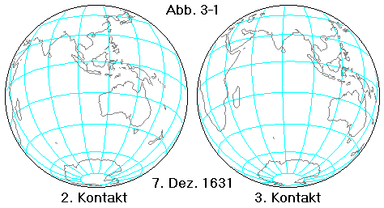
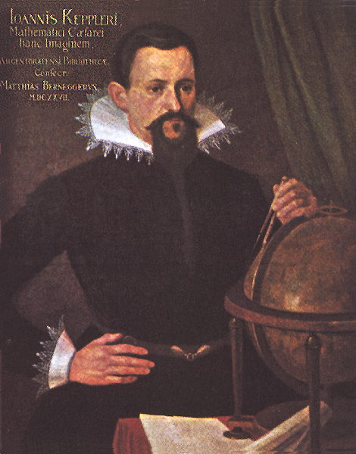
December 6, 1631
Pierre Gassendi
(1592-1655)
There are no records to suggest that anyone ever observed this event.
Kepler predicted it would not be visible in Europe, so he requested that mariners keep a lookout for it.
Pierre Gassendi (1592-1655) tries and fails to observe it
Joannis Kepler
(1571-1630)

Slide 12
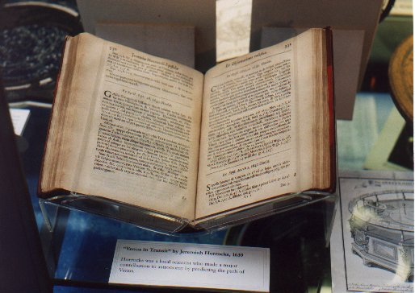
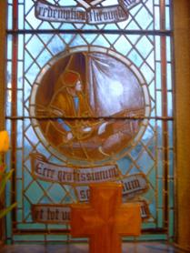
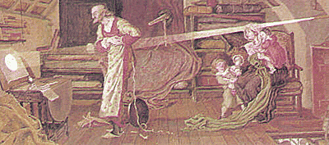
December 4, 1639
Jeremiah Horrocks (1618-1641)
Discovered this transit because Kepler had not allowed for observer parallax. Horrocks completed his calculation in October 1639.
Horrocks was called away from his observations and missed the start of the transit, but observed it until sunset.
His friend William Crabtree observed it for only 30minutes because it happened late in the day from England. There are no other known observers
Horrocks’ record of the 1639 transit
St Michael’s Church
Hoole, England

Slide 13
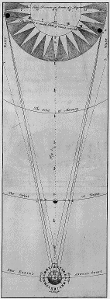

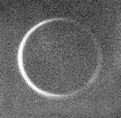
June 6, 1761
Edmond Halley came up with the idea of using the Mercury transit of 1677 to establish the sun-earth distance. He called for the first international multi-station study.
Observed from 70 stations.
The first large-scale international scientific endeavor ever attempted.
First measurement of Venus disk size
Lomonosov detects atmosphere as a luminous ring at first contact
AU = 96.1 to 77.8 million miles
Edmond Halley
(1656-1742)

Slide 14
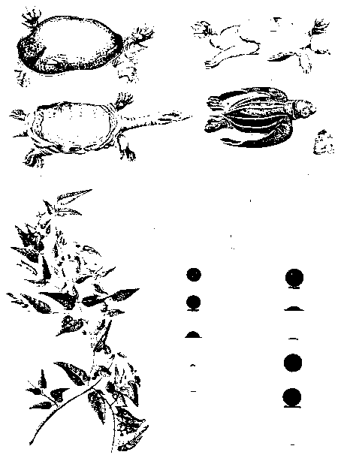
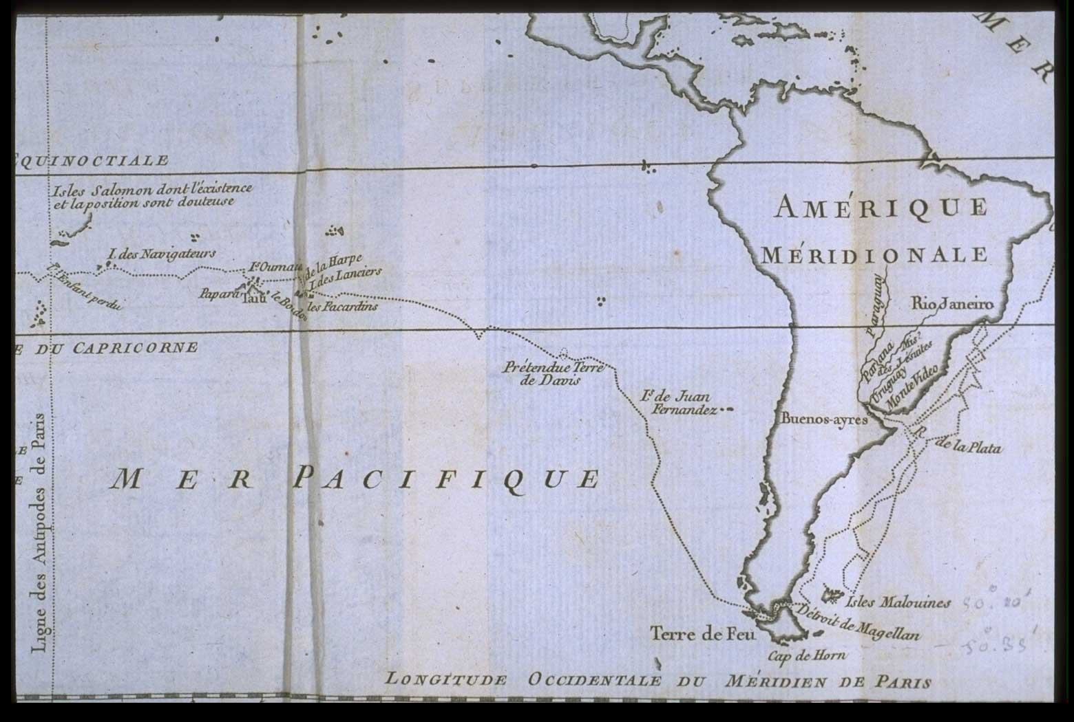
June 3, 1769
Cap’n Cook
Only observable over Pacific Ocean and western half of North America.
Used as pretext for some governments to explore the South Seas and create better maps.
151 official observers, 77 stations, many amateur astronomers,
Captain James Cook headed an expedition to the island of Tahiti
Entire transit was observed under clear skies.
solar parallax = 8.5-8.8” for a distance of 92.0 - 96.1 million miles.
Adopted = 95.37 million.

Slide 15
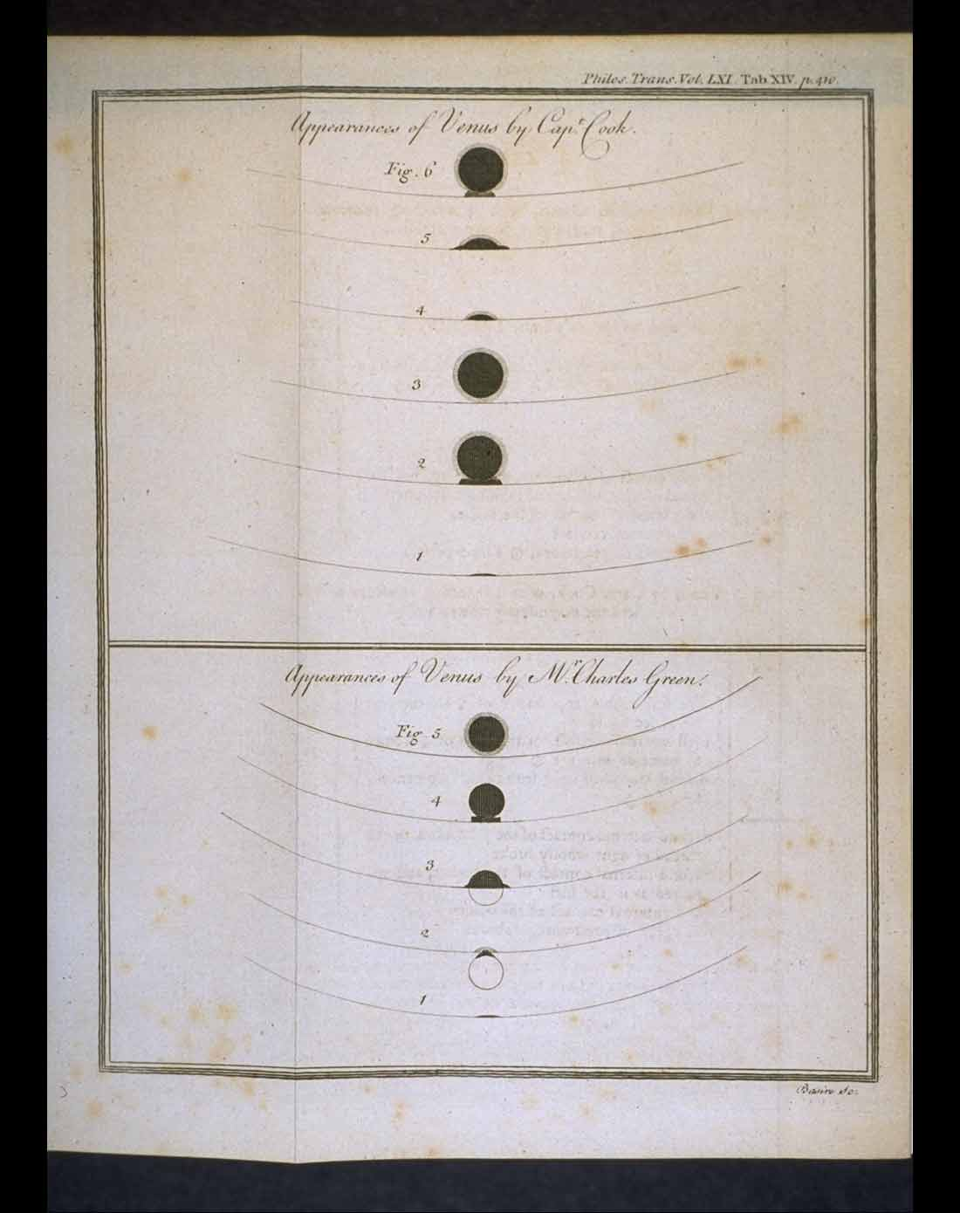
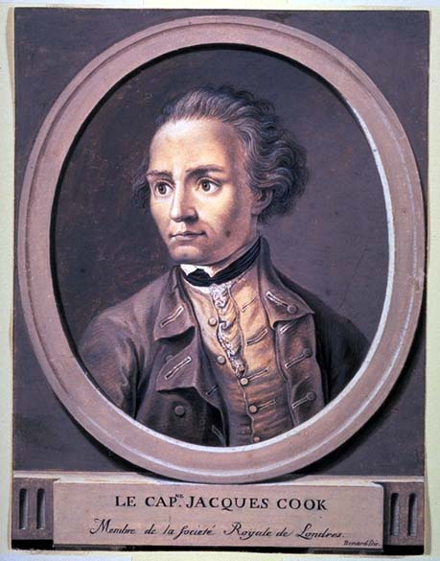
Transit of Venus (detail) from James Cook and Charles Green's "Observations
Made ... at King George's Island in the South Sea" in
Philosophical Transactions of the Royal Society.
Vol. 61, 1771.

Slide 16
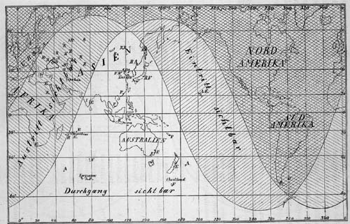
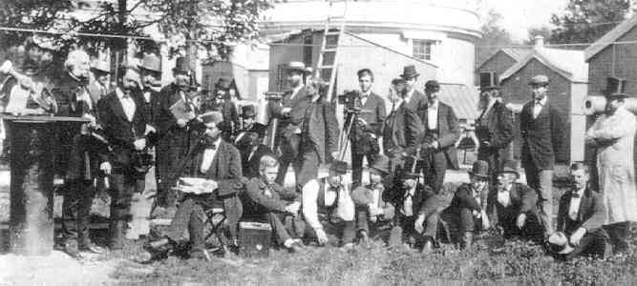
December 9, 1874
“The determination of this distance is one of the capital problems in astronomy” Simon Newcomb
Venus described as identical to earth with animal and plant life.
No natural satellites ever seen during previous transits.
Parallax distances to 20 stars were known
Extensive media coverage generated enormous public interest.
Congress appropriates $175,000 for expeditions.
AU=92.57 - 93.00 M miles

Slide 17
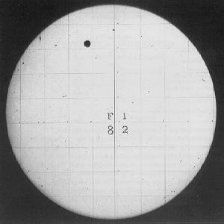
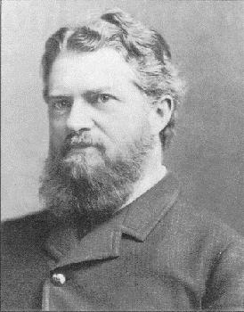
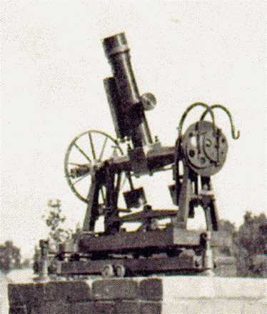
December 6, 1882
Significant decline in scientific interest.
Congress appropriates $85,000 over strong objections by scientists including Simon Newcomb, (Prof of Mathematics, US Navy.)
Newcomb heads expedition to Cape of Good Hope, South Africa. Near town of Wellington (40mi NE of Cape town)
Funding for data reduction was hard to get, and all property had to be turned over to the Secretary of Navy in 1886
Professor Simon Newcomb
“What the present conditions of the work may be, and how much of it is ready for press, I cannot say…All the men who took part in it or understood its details are either dead or on the retired list” Simon Newcomb 1903
The biggest problem for attaining
high-precision parallax measurements
was the blurring effects of the
Venus atmosphere, so the Venus
Transit method was discarded after
the 1882 transit and other methods
sought out.
Solar Telescope used
in 1882 expedition

Slide 18
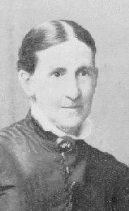
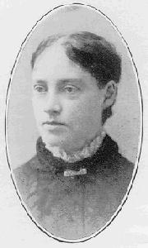
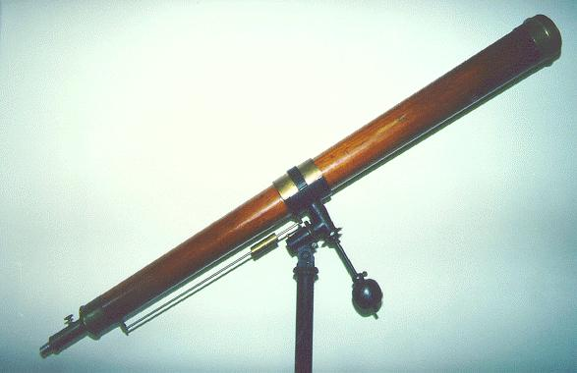
The Huguenot Seminary for Girls, Wellington, South Africa.
Miss Ferguson was always interested in astronomy with "a knowledge of a keen amateur, quite sufficient to infect others with her enthusiasm, and to give them the knowledge they needed to read books intelligently".
Abbie Ferguson
Mary Cummings
6” Fitz Refractor, installed in 1853

Slide 19
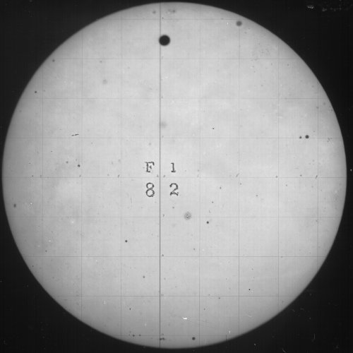
1882 Transit
(USNO)

Slide 20

On April 28, 1883 Harper's Weekly ran a cover that was unusual. It shows a group of children standing outside a cabin in Appalachia. One is holding a piece of smoked glass and watching the transit!

Slide 21
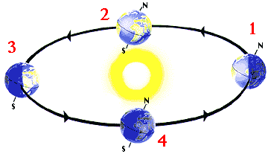
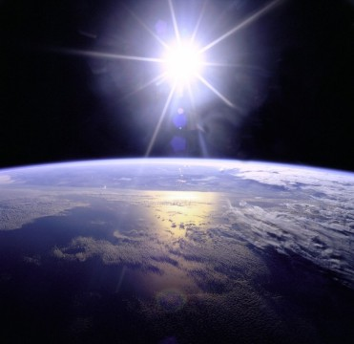
History of Sun-Earth distances
YEAR DISTANCE DISCOVERED BY…
-200 4.2 million Aristarchus of Samos
1543 52 million Copernicus
1672 87,000,000 Mars parallax
1769 92,049,650 - 96,162,840 Venus Transit
1843 95,000,000 Textbook
1874 92,570,000 - 93,000,000 Venus Transit
1877 92,830,000 Photographic parallax of Mars
195x 95,697,000 20 years of Eros radar echo
1960 95,709,000 Pioneer-5
2000 95,741,000 40 years of Venus radar echoes

Slide 22
How to calculate the AU
Step 1: Venus at Greatest Elongation
VS / ES = sin(α)
α ~46.054 deg
VS/1 AU= sin(α)
VS = 0.72 AU
so…
EV = 1 – 0.72 AU
= 0.28 AU
V
S
α
E

Slide 23
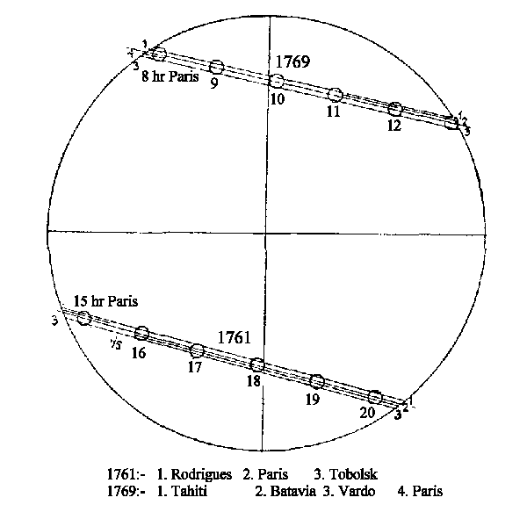
How to calculate the AU
Step 2: Parallax
Earth
Venus
Sun
a/2 = b
Observer 1
2r
a
0.5 degrees
Observer 2
d
d = r / tan(b)

Slide 24
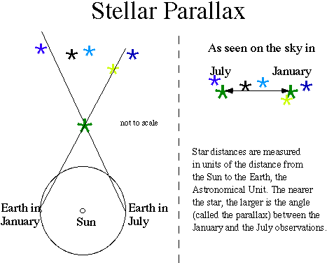

Slide 25
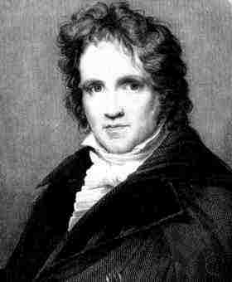
Finding the distance to the stars
The first parallax shift of a star was detected in 1838 by an astronomer named F. W. Bessel at the Konigsberg Observatory in Prussia.
The star was actually a binary called 61 Cygni, a gravitationally bound pair of red dwarf stars.
Bessel found that these stars were making annual loops with a radius of .29 arcseconds, corresponding to a distance of 10.3 light years
Frederick W. Bessel

Slide 26
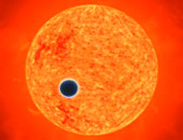
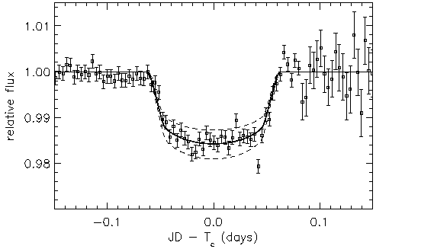
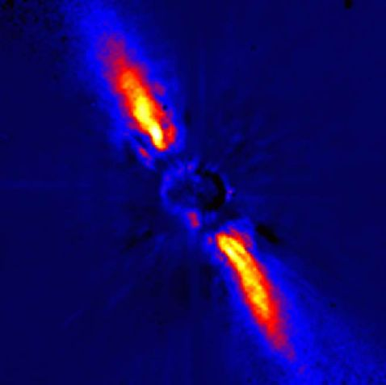

Searching for Extra-Solar Planets
HD 209458 (mv = +7.7) in Pegasus

Slide 27
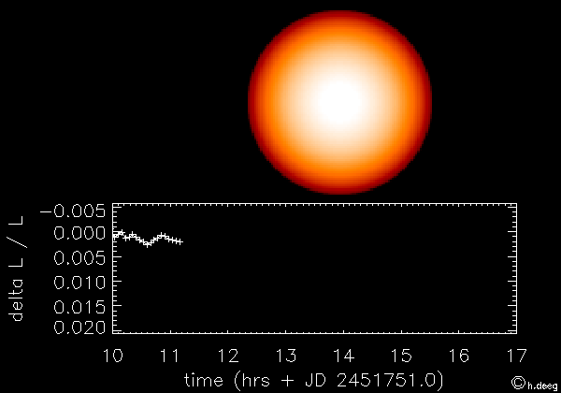

Slide 28
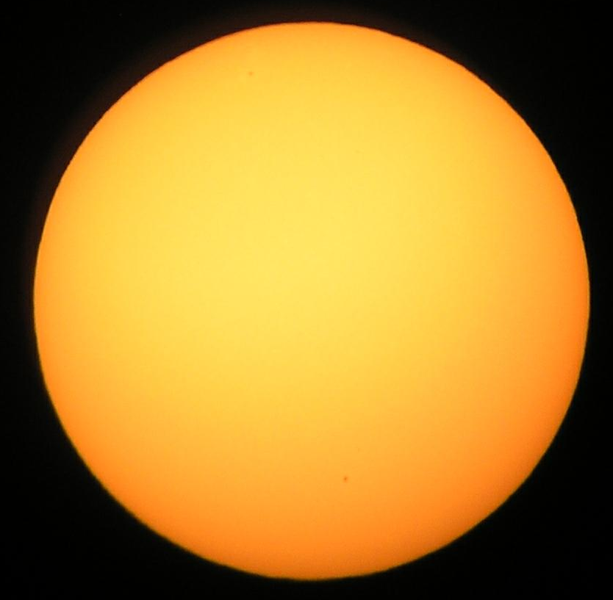
June 8th 2004 !
Transit begins:
05:13:25 UT
(1:13am EDT)
Transit ends:
11:25:56 UT
(7:25am EDT)
Sunrise:
6:05am (EDT)
Diameter of Venus:
58.6 arc seconds

Slide 29
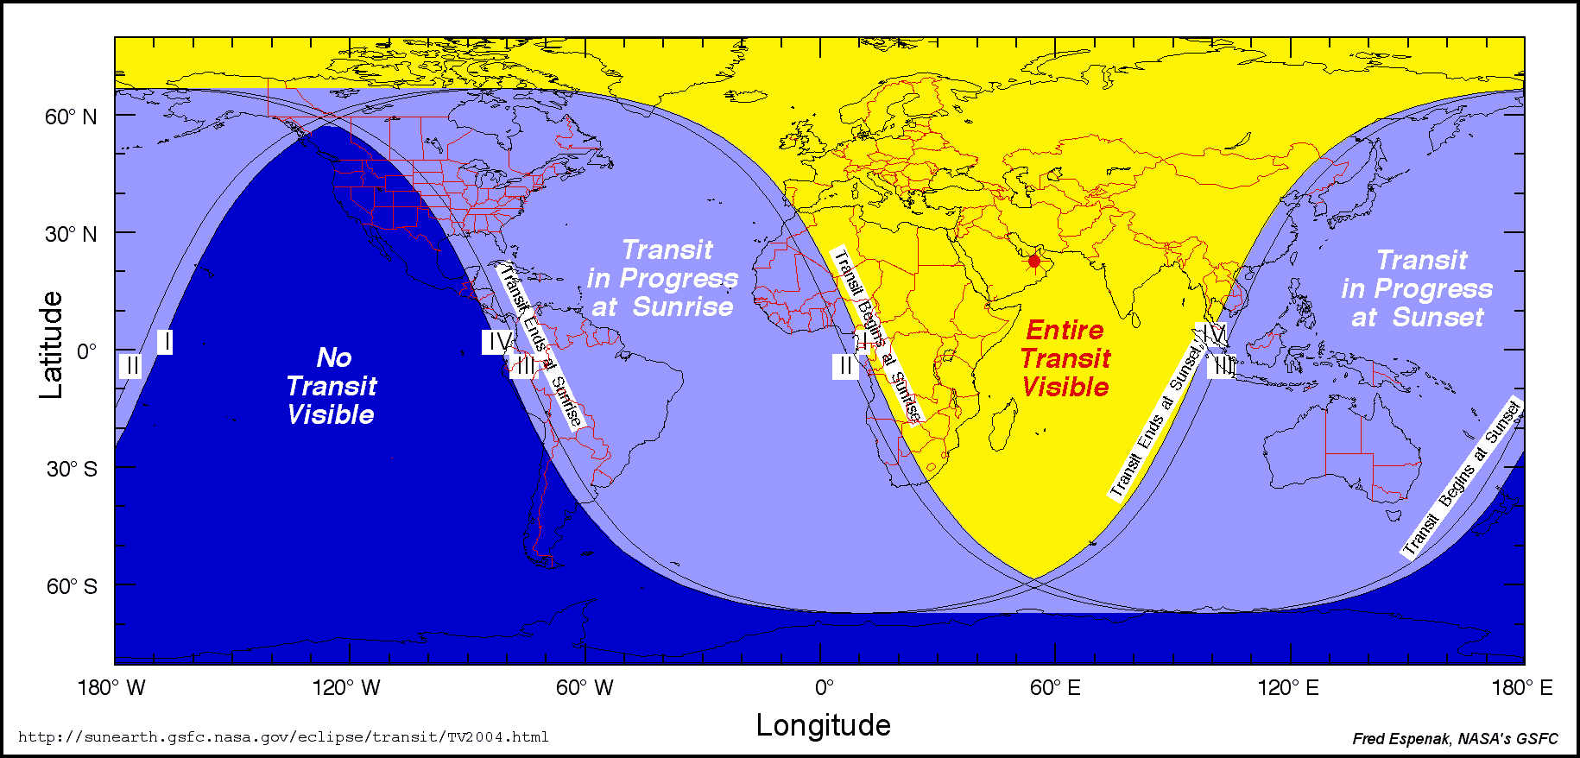
Where will the transit be visible?

Slide 30
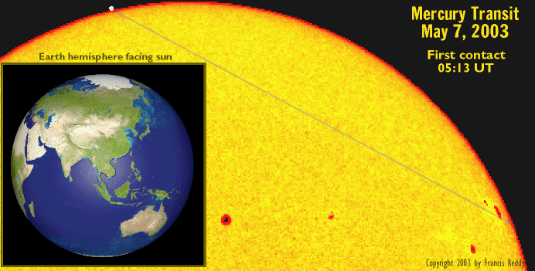
Mercury Transit
(Venus Transit Dress Rehearsal)

Slide 31
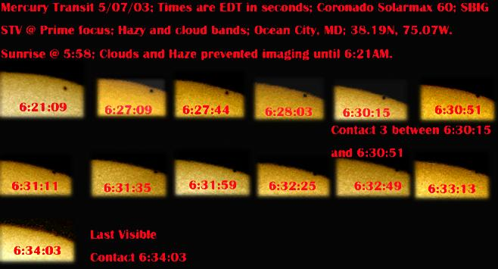
Mercury Transit – May 2003

Slide 32
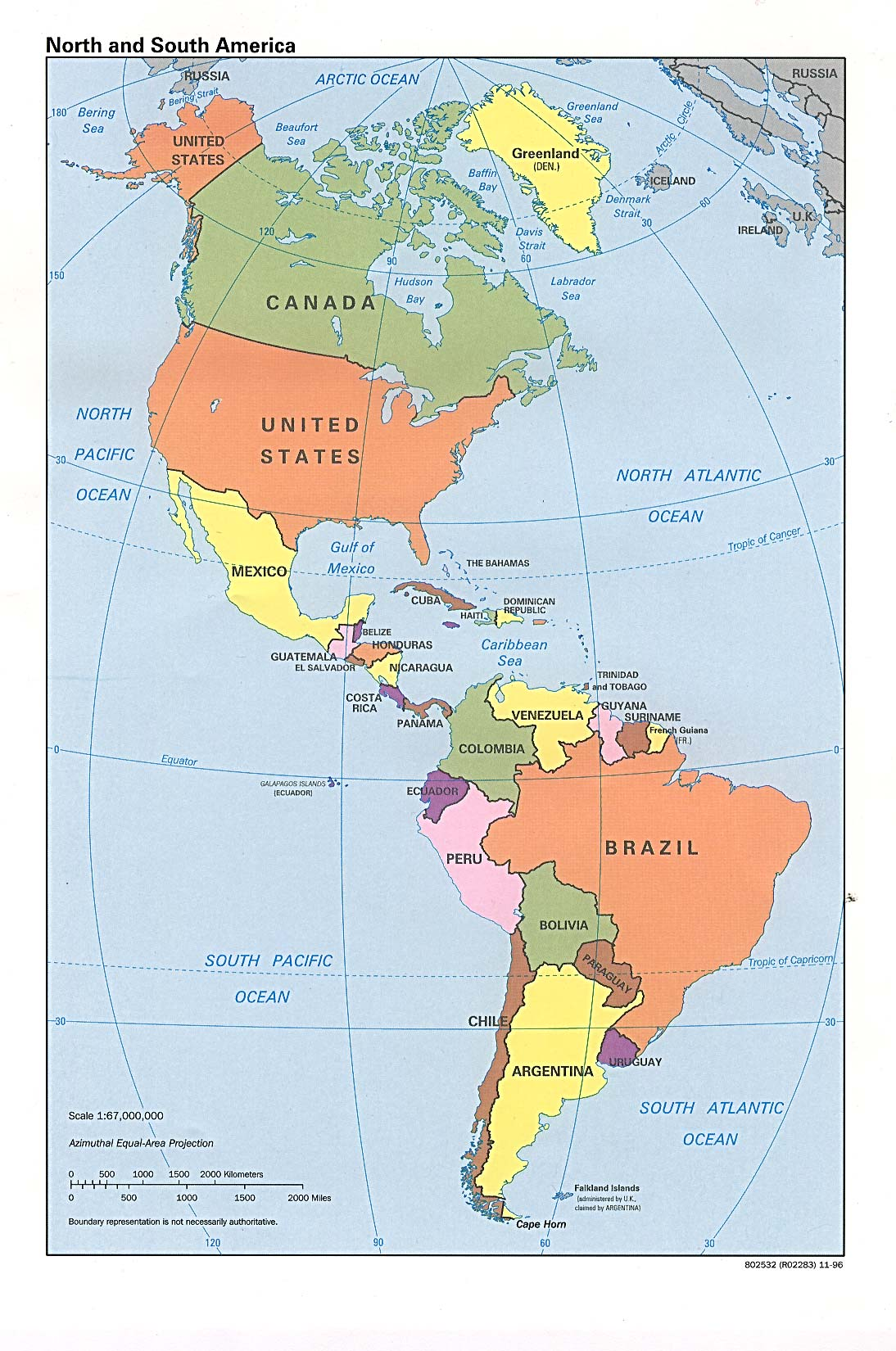
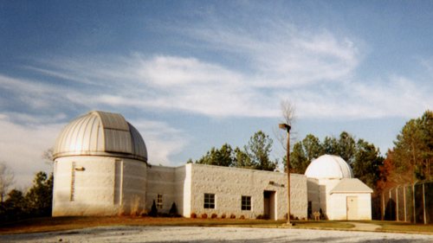
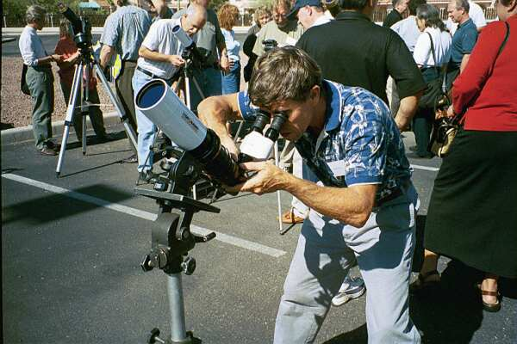



Viewing the Transit
Observe a live webcast from Athens Greece for the full 6+ hour transit
See images taken from observatories spaced over 4000 miles apart
Go to local events such as Maryland Science Center and Montgomery College
Contact your local astronomy club
Make a pin hole camera
Project an image with binoculars or a properly filtered telescope

Slide 33
VT Observatories
~4000 miles
Burke Gafney Observatory Halifax, NS Lat=44deg 38’ N
Bowman Observatory Greenwich, CN Lat=41deg 1’ N
Maryland Science Cntr Baltimore, MD Lat=39deg 17’ N
Howard University Obs Beltsville, MD Lat=39deg 00’ N
Vanderbilt ISS-AT Solar Sta Nashville, TN Lat=36deg 03’ N
Fernbank Observatory Atlanta, GA Lat=33deg 45’ N
Hard Labor Creek Obs. Atlanta, GA Lat=33deg 45’ N
Coca Cola Space Center Columbus, GA Lat=32deg 28’ N
Highland Road Park Obs. Baton Rouge, LA Lat=30deg 27’ N
Observatario Astronomico Minas, Uruguay Lat=34deg 37’ S
De Minas

Slide 34
1882, the date of the last Venus transit, quote by William Harkness of the U.S. Naval Observatory (from Sky and Telescope, Feb. 1995):
We are now on the eve of the second transit of a pair, after which there will be no other till the twenty-first century of our era has dawned upon the earth, and the June flowers are blooming in 2004.
When the last transit season occurred the intellectual world was awakening from the slumber of ages, and that wondrous scientific activity which has led to our present advanced knowledge was just beginning. What will be the state of science when the next transit season arrives God only knows. Not even our children's children will live to take part in the astronomy of that day. As for ourselves, we have to do with the present

Slide 35


Transit of Earth:
November 10, 2084

Slide 36
Twice in a Lifetime
Experience the wonder of one of the rarest events in astronomy!!
Montgomery College, Takoma Park Campus
Roof of the Parking Garage at Fenton and King Street
Tuesday June 8th , 5:30 – 7:15am
http://www.montgomerycollege.edu/Departments/planet
http://sunearthday.nasa.gov
Lou Mayo
astronomertogo@verizon.net

Slide 37

http://sunearthday.nasa.gov

Slide 38



Paper Plate Astronomy http://analyzer.depaul.edu/paperplate/
Venus: 13 Earth: 8
Each time Earth completes 1.6 orbits, Venus catches up to it after 2.6 of its orbits
Earth Year: 365.256 d
Venus Year: 224.701 d

