Slide 1
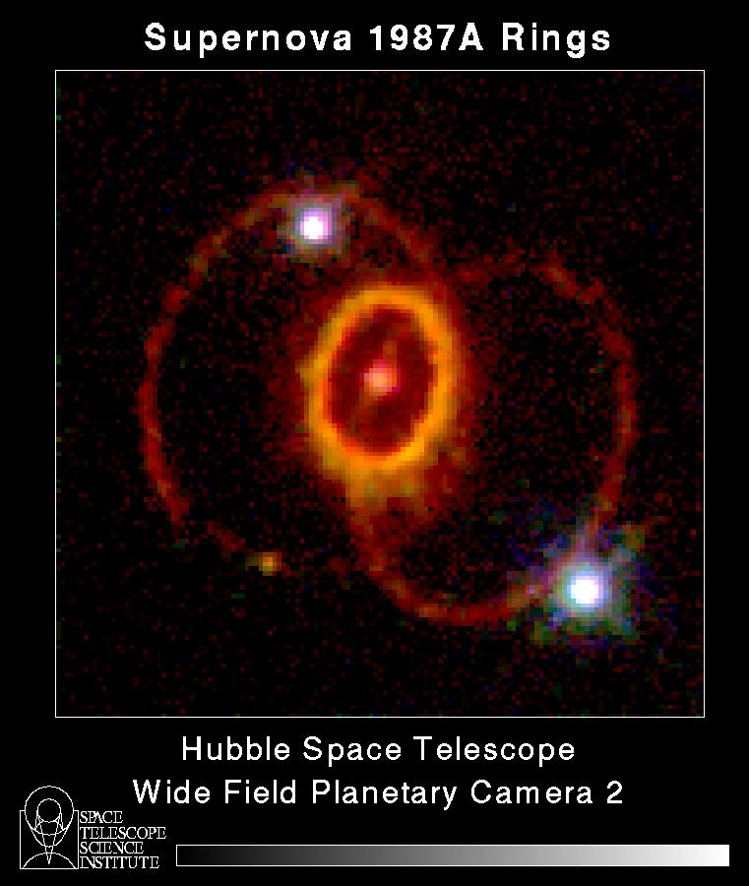
What you’ll learn
This learning experience will take about 15 minutes.
In addition to estimating brightness, you’ll learn how to find variable stars with AAVSO charts.
Supernovae are Variable Stars too!

Slide 2
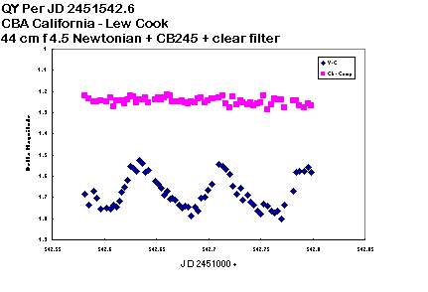
What you’ll learn
We’ll also cover how scientific data can be useful even when it contains “noise”.
You’ll learn that your observations can be very valuable, even while you’re learning to make better and better estimates.
Constant (comparison) star
Variable star
CCD brightness data from long time AAVSO
Member Lew Cook

Slide 3
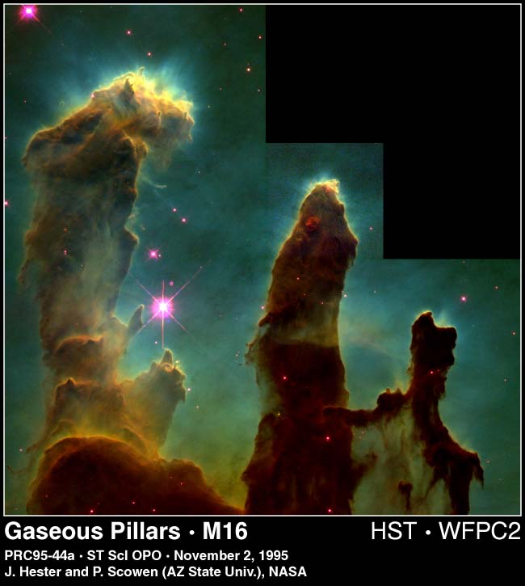
Astronomy needs data!
The sky is full of wonderful things to see.
But, just looking at its beauty often doesn’t provide answers to the riddles of the universe.
Hubble Space Telescope

Slide 4
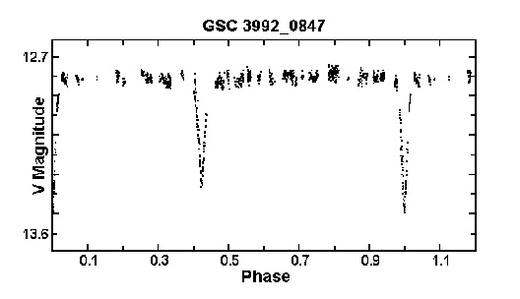
Astronomy theories need data!
Most of the discoveries astronomers have made about the universe needed light measurements to confirm or suggest theories.
(Time)

Slide 5
Data is information from instruments
There are all kinds of instruments astronomers use to make measurements of star brightness.
We call these measurements photometric data.
Photometric means light-measuring.

Slide 6
Your eyes are your instruments
You are going to use your own eyes and a special technique for making photometric measurements.
The technique is called: Interpolation of Magnitude.

Slide 7
What is interpolation?
Interpolation is a word scientists use when a measurement is estimated between two known values.
People interpolate all the time!

Slide 8
Interpolation
Your car’s gas gauge needle is half way between empty and 1/4 tank.
You interpolate you have 1/8 of a tank left--time to get gas!
1/2
1/4
3/4
E
F

Slide 9
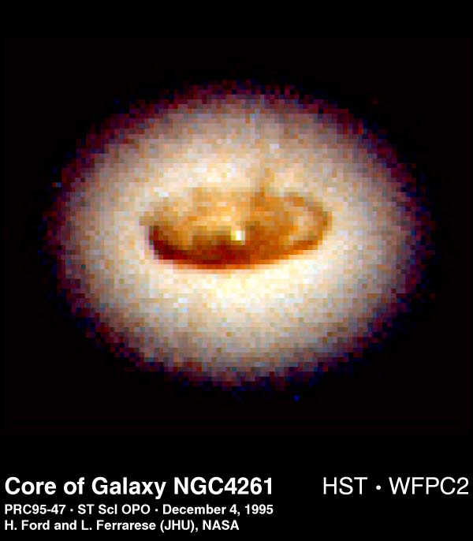
Interpolating star magnitude
Making a brightness estimate is easy in theory but requires some practice.
We call the measurement of brightness the star’s magnitude.

Slide 10
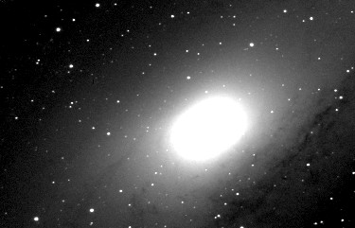
Interpolation of magnitude
We estimate the brightness of the variable star by using at least two stars of known brightness; one brighter than the variable, one fainter.
Andromeda Galaxy (C. Pullen)

Slide 11
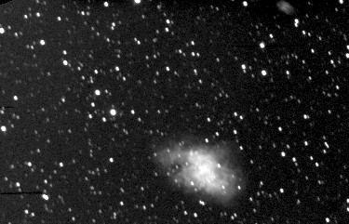
Interpolation of magnitude
Just like the gas tank example, if a star’s brightness seemed about half way between two stars that were known to be magnitudes 5.0 and 6.0, what is the magnitude of the variable star?
Crab Nebula (C. Pullen)

Slide 12
Interpolation of magnitude
That’s right -- half way between 6.0 and 5.0 is
5.5!

Slide 13
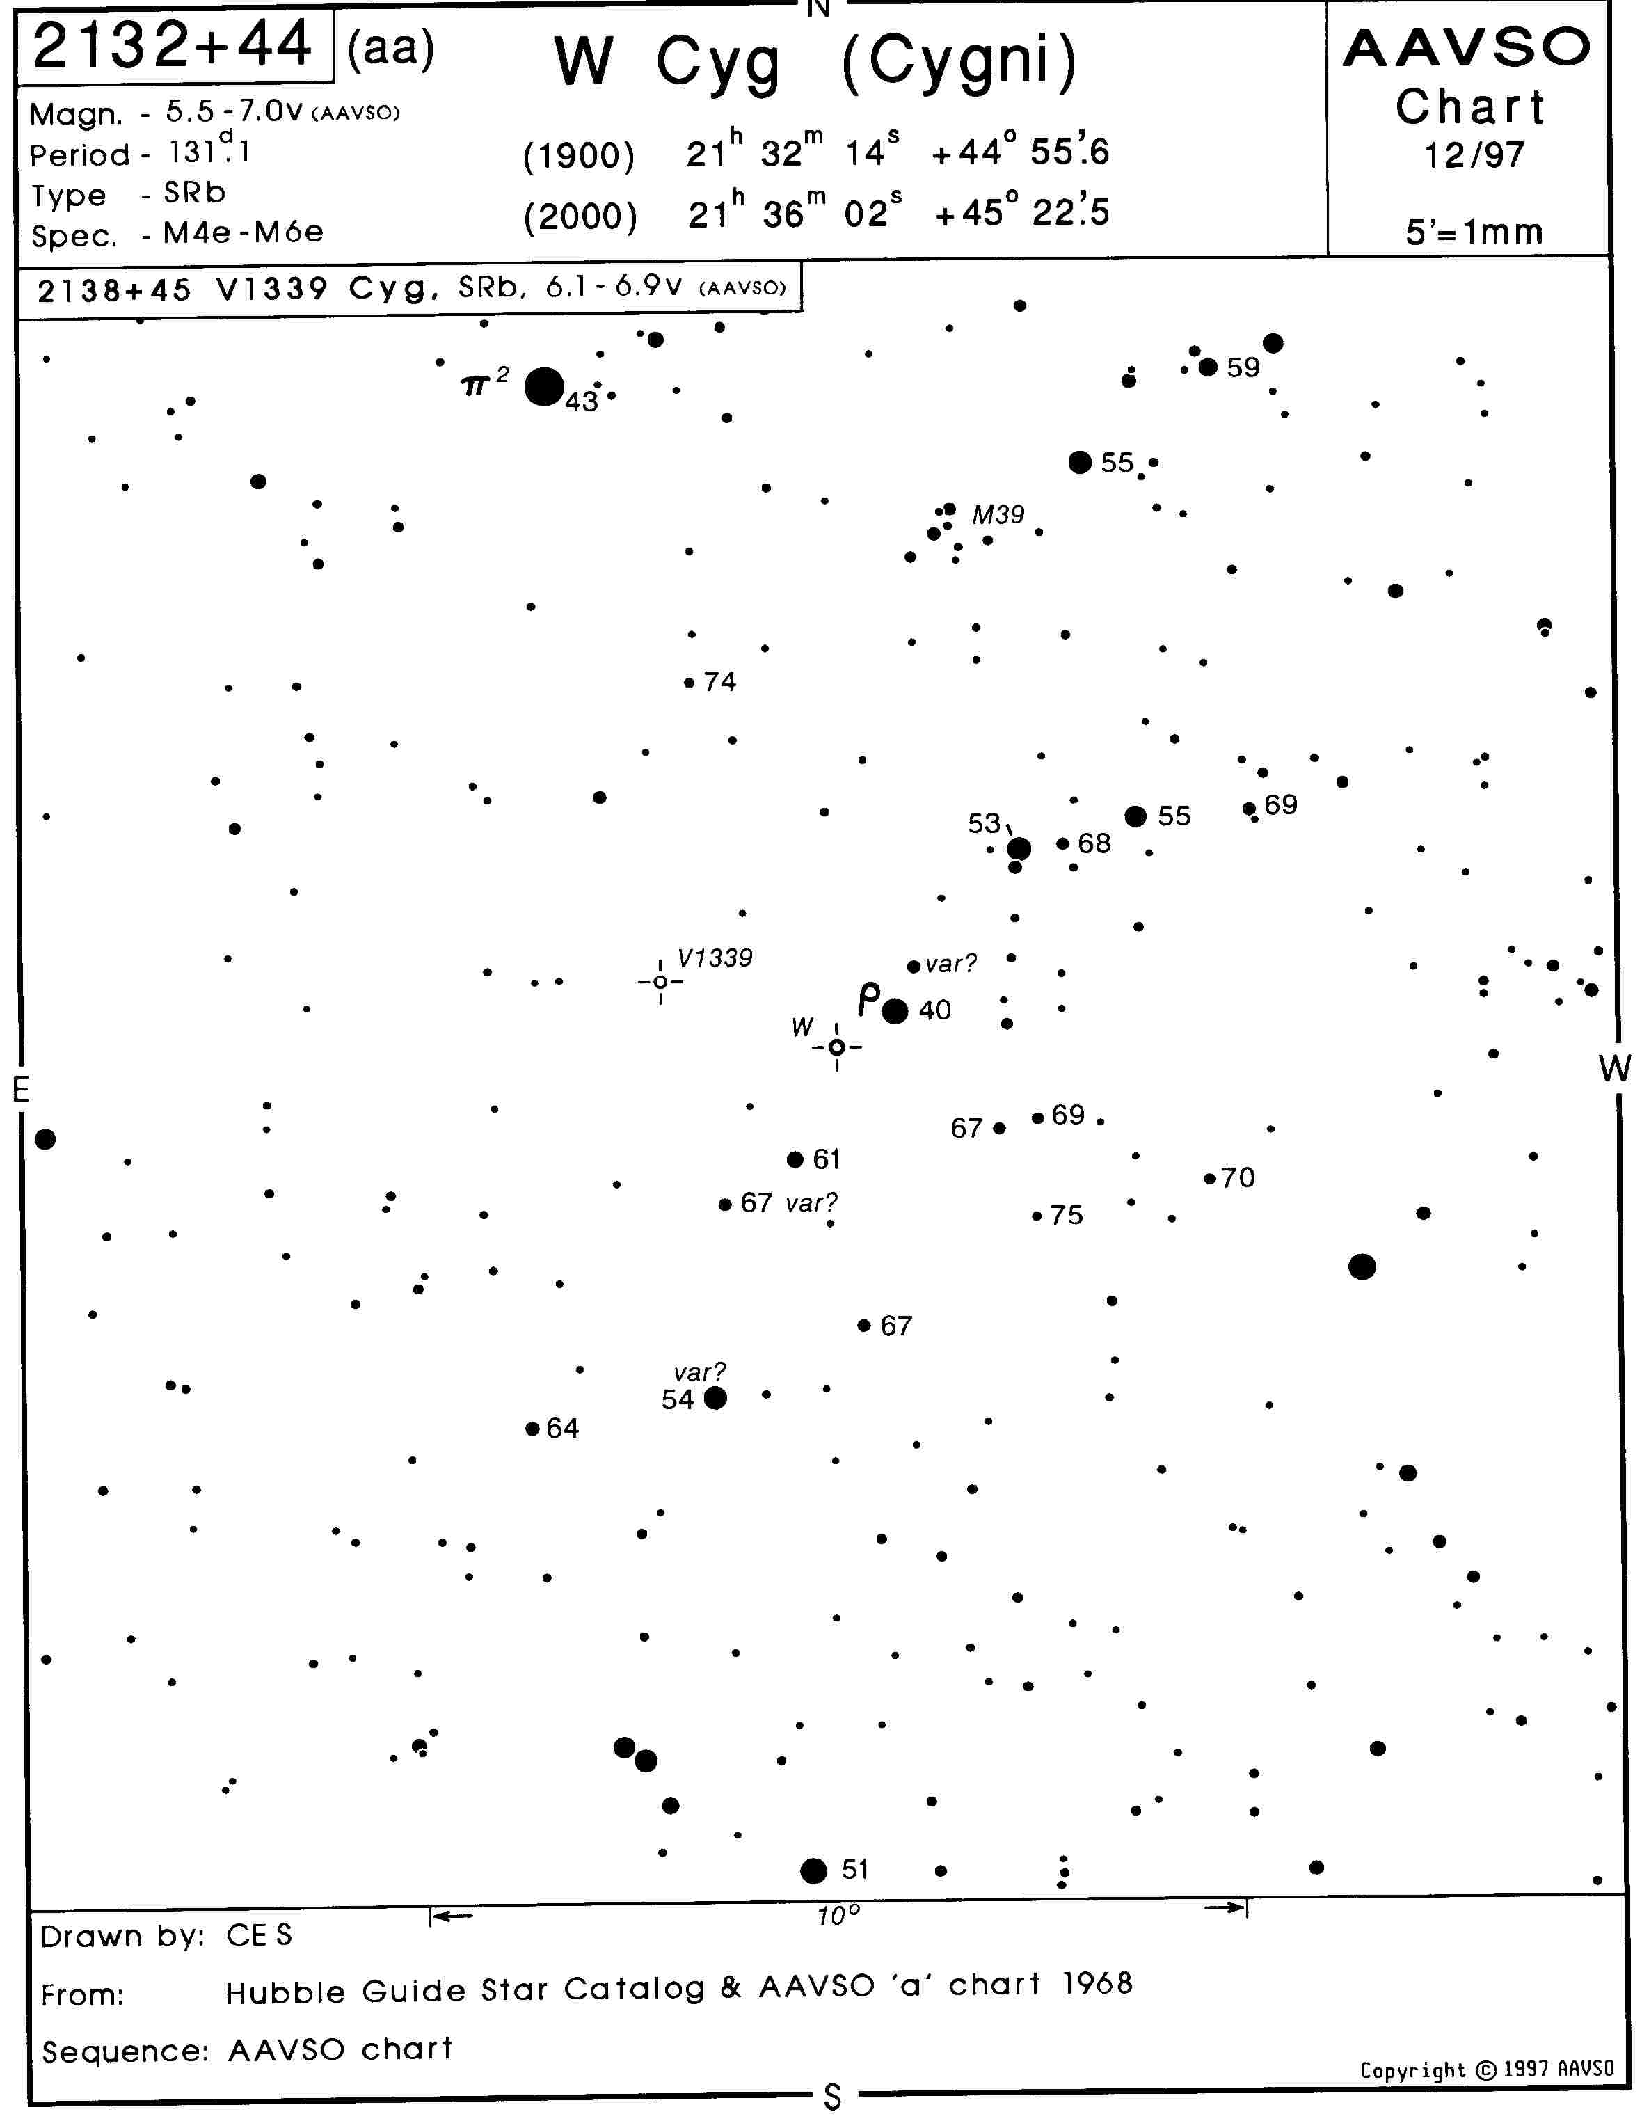
How to find a variable star
The AAVSO makes thousands of star charts (sky maps, like road maps) used to find and estimate the magnitude of variable stars.
Because all AAVSO observers use the same charts, our results can very good, and can be compared with each other’s.

Slide 14
How to find a variable star
You have a copy of this AAVSO chart. It is for W Cygni, a star you can find with binoculars from you own yard.
But, first let’s try a simple lesson in interpolation and using star charts.

Slide 15
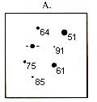
Variable and comparison stars
Look at the example below. The variable is shown
between the four focus lines. The magnitudes of the
comparison (“comp”) stars are shown on the chart
next to the stars (64,51,91, etc.).
Variable

Slide 16
Decimal points can be confusing
Note that the star magnitudes are actually decimals but we
don’t show the decimal point because it could be confused
as a star. So, the magnitudes below are really 6.4, 5.1, 9.1, etc.
Variable

Slide 17
A big magnitude number is faint, a big dot is bright!
The brighter the star is, the smaller its magnitude number.
5.1 is brighter than 6.4.
On the chart, notice that the dot is bigger (brighter) for the 5.1 star than the 6.4 star to its left.
Variable

Slide 18
Making your first estimate
Is the variable brighter or fainter than the brightest (5.1) star?

Slide 19
Making your first estimate
Is the variable brighter or fainter than the brightest (5.1) star?
Fainter!

Slide 20
Making your first estimate
Is the variable brighter or fainter than the next brightest
star (6.1)?
Variable

Slide 21
Making your first estimate
Is the variable brighter or fainter than the next brightest
star (6.1)? Fainter!
Variable

Slide 22
Making your first estimate
Is the variable brighter or fainter than the next brightest
star (6.4)?
Variable

Slide 23
Making your first estimate
Is the variable brighter or fainter than the next brightest
star (6.4)? Brighter!
Variable

Slide 24
Here comes the gas gauge!
So, the variable is brighter than 6.4 but not as bright
as 6.1. What are you going to do with those numbers?
Interpolate!
Variable

Slide 25
Interpolation is an educated guess
Is it about half way between 6.4 and 6.1?
Then, your estimate would be 6.2 or 6.3.
But, which one?
Variable

Slide 26
Use your feelings
Maybe you think it is just a little brighter than midway.
Your estimate would be 6.2! A little fainter, your estimate
would be 6.3.
Don’t try to think
what it should be,
just go with the
flow.
Your ability to
feel the best
answer will
get better
with practice.

Slide 27
Making your first estimate
But, whatever your estimate, congratulations on your first variable star observation!
Write your result on the back of the star chart you were given.

Slide 28
Why do we call it an
Estimate?
Different people will make different estimates of brightness using this method. We all see the world differently.
Yet, all the estimates are “right”! There is no one correct answer.
All scientific measurements have variation. We call it error or noise.

Slide 29
I thought scientists only used exact numbers!
Well, a number can never be too exact in science, especially astronomy. But, all measurements are really estimates to a certain precision. The trick is understanding what that precision is.

Slide 30
Precision in data
The graph on the right is a portion of the AAVSO data that show the change in brightness over time of a star called SS Cygni.
We call this a light curve.
SS Cygni is located in the constellation of Cygnus the Swan.
Brightness
Time

Slide 31
Precision in data
SS Cygni brightens dramatically every few months.
Each dot represents a measurement made by an AAVSO observer somewhere in the world. We have records on some stars back to 1911!
You can make measurements like these too!
Brightness
Time

Slide 32
Precision in data
The magnitude is plotted on the Y axis (up and down)
The day and time of the observation is plotted on the X axis (left and right)
Brightness
Time

Slide 33
Precision in data
You can see the noise in the data.
Note that the curve is not a nice straight line.
Rather, it is a wide band of individual observations.
Brightness
Time

Slide 34
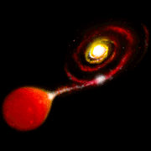
Every estimate is needed
Astronomers and physicists can use even noisy data to learn many things about how stars work.
With practice, AAVSO visual observers can estimate brightness to a precision near 0.1 magnitude.
Artist’s Conception - SS Cygni (AAVSO)

Slide 35
There is no perfect estimate
Your observations are estimates because everyone gets a little different result.
You don’t have to be perfect--just do the best job you can.
Practice will help a lot!

Slide 36
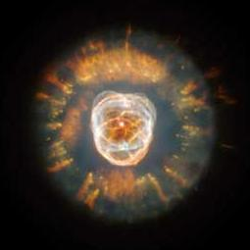
Want to try again?
Let’s Do It!
Cat’s Eye Nebula (Hubble Space Telescope)

Slide 37
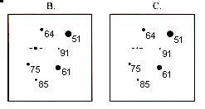
More practice
This time, estimate the same variable but in frames B and C. These frames could be the variable star at different times in its light curve.
Write your answers on the form.

Slide 38
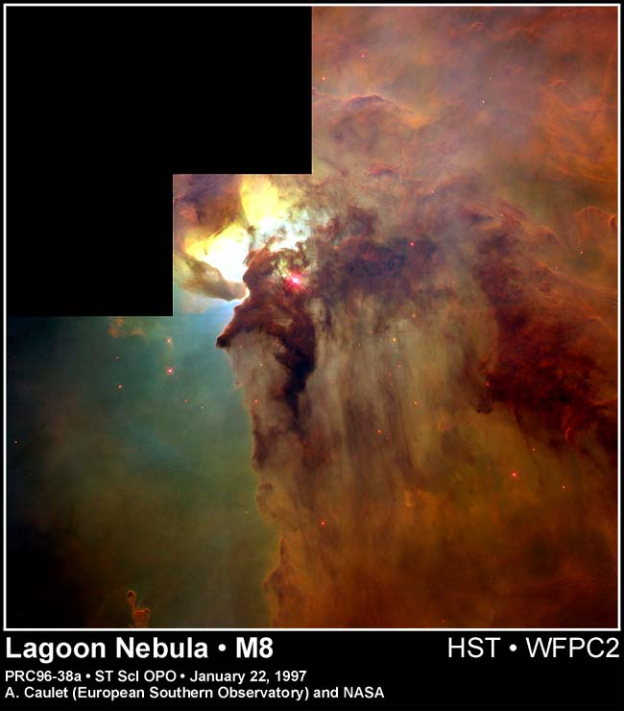
How did it go?
Was it easier the second
and third time?
I bet you are ready for a real star.
Let’s try one!

Slide 39
W Cygni
We are now going to make two estimates of a semi- regular star called W Cygni (W Cyg). You should have its chart in front of you.
Click and it will be the next picture.

Slide 40
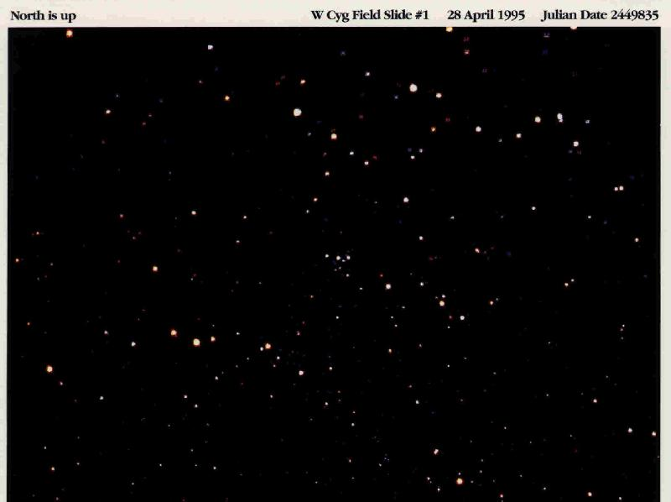
Are you able to find it?
(Click for a little help!)

Slide 41
You’re kidding!
OK, there are lots of stars in the picture...
You will need to learn to “star hop” to the star you want. But it’s easy.
Here’s how!

Slide 42
W Cyg first estimation
Take a look at the AAVSO W Cyg (size aa) chart.
Hold it so that it is tilted about 45 degrees clockwise (to the right). It will better match the picture if tilted a little.

Slide 43
Why tilt the chart?
The way a group of stars looks in a telescope can vary because of the type of telescope, how you look into it, and the season or time of night.
?

Slide 44
Why tilt the chart?
Learning how to match the telescope view to the chart is something you’ll learn when actually observing.
But, back to our estimate!

Slide 45
Finding landmarks
Find the following things on your chart in this order:
1) M39 (star cluster)
2) Comp star 53 and a line of stars pointing from it to the south
3) Rho (pronounced “row”) Cyg, a Greek letter that looks like a “p”
4) W Cyg

Slide 46
I’ll give you some help.
M39
5.3 Comp star with
line to the south
Rho Cyg
W Cyg

Slide 47
Finding landmarks
This is how you star hop--from the easiest thing to see to the variable star.
Now, let’s try it on the photo!
We’ll go full screen and I’ll show you the landmarks we just found on our chart.

Slide 48
M39
W Cyg
53 comp with line of stars
Rho Cyg

Slide 49
Can you find
the landmarks
on your own?
See if you can
find the comp
stars as well.
Did you find
them?

Slide 50
Here are some
of the comp
stars.
74
55
59
67
Can you find
any more?

Slide 51
Now that you have found the comp stars, try to
estimate W Cyg.
Write your estimate on the form.
We’ll keep a
pointer on W in case you get lost.

Slide 52
How did you do?
Were you able to do it?
If not, or if you had a lot of trouble finding things, ask now before the next (and last) estimate.

Slide 53
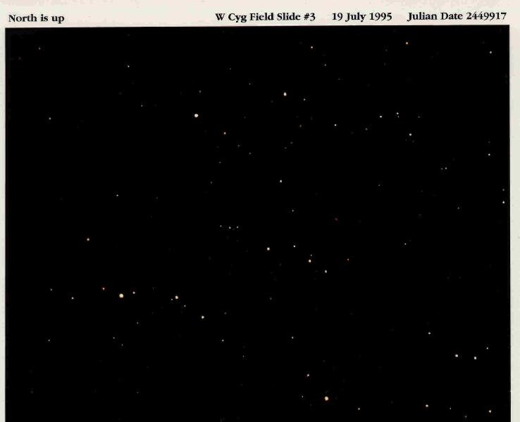
Here is a photo of W Cyg taken 82 days later.Try another
estimate.
Write the result on your form.
If you need help finding it, click to the next slide.

Slide 54
Does that help?

Slide 55
Note that the
photo doesn’t
look like the
one in April.
This is because the sky changes
appearance from season to season and even night
to night. This
change is one of the challenges of variable star observing!

Slide 56
How did you do?
Is it getting easier to make the estimates?
Did you have less trouble finding W Cyg and the comparison stars?
Practice really helps, doesn’t it!

Slide 57
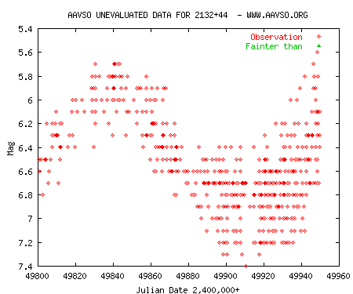
Is that your final answer…?
On the right is a section of the light curve of W Cyg from the AAVSO data base.
The two dates on which you made estimates are shown with dashed lines.
April 28
July 19

Slide 58
Is that your final answer…?
On April 28 the observations were between about 6.3 and 5.7 magnitude.
On July 19, the observations were between about 7.3 and 6.4 magnitude.
April 28
July 19

Slide 59
Is that your final answer…?
How did you do compared to other AAVSO observers?
If one or more of your estimates are outside of the band of results, why?
April 28
July 19

Slide 60
If your results were different from AAVSO observers’...
Practice helps. Some AAVSO observers have made thousands of measurements.
You were looking at a computer, not the sky.
You are still learning!
Variable star observing can be very
challenging sometimes!

Slide 61
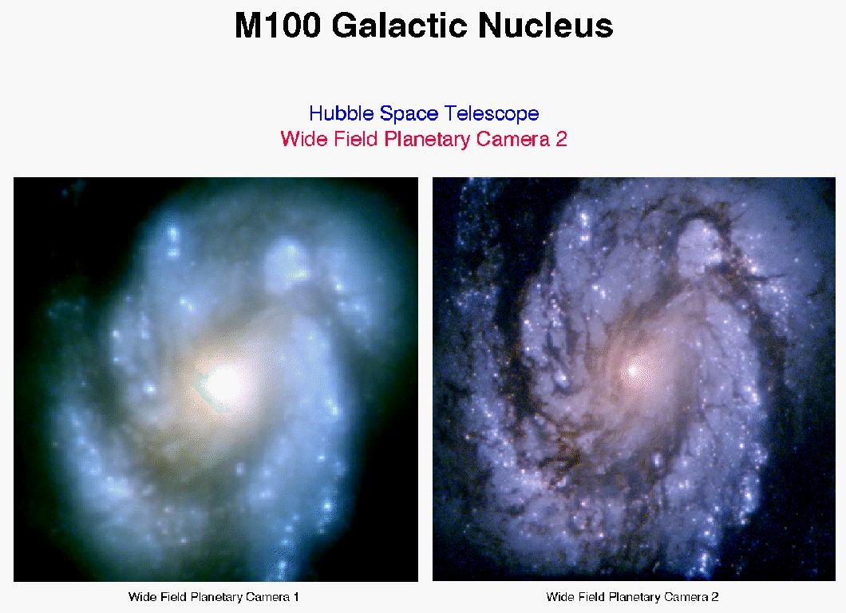
You are teaching your eyes to see the world differently!
Many new observers need time before they can see fine differences in brightness. This takes practice but is a skill that can help you enjoy all the beauty in the night sky.

Slide 62
You are a winner!
Now we will plot your results today along with everybody else’s.
I bet you did pretty well!
While it’s not a contest, look at the class data and see how you did.
Be it Known that
on This Day...
I learned how to
measure the
brightness of a
variable star!

