Slide 1
The Great North American Eclipse of 2024 Part 1 An Amateur Astronomer’s Guide to Solar Eclipses
Jim Johnson HAL General Meeting June 17, 2021
Derived for HDR image captured by Ken Everhart on August 21,2017

Slide 2
Purpose of this Presentation:
The Great North American Eclipse of 2024 is our next readily accessible opportunity to witness first-hand one of the most grand of all astronomical phenomena, a total solar eclipse
As it is less than three years away and careful planning is required for a successful experience, now is a great time to start getting ready
As April 8, 2024 approaches there will be much said about the eclipse in the press, on social media and in discussions among amateur astronomers like us
This talk will provide the foundational material for interpreting this coverage and for formulating travel and observing plans by exploring how and why solar eclipses occur, and what an observer can expect to see

Slide 3
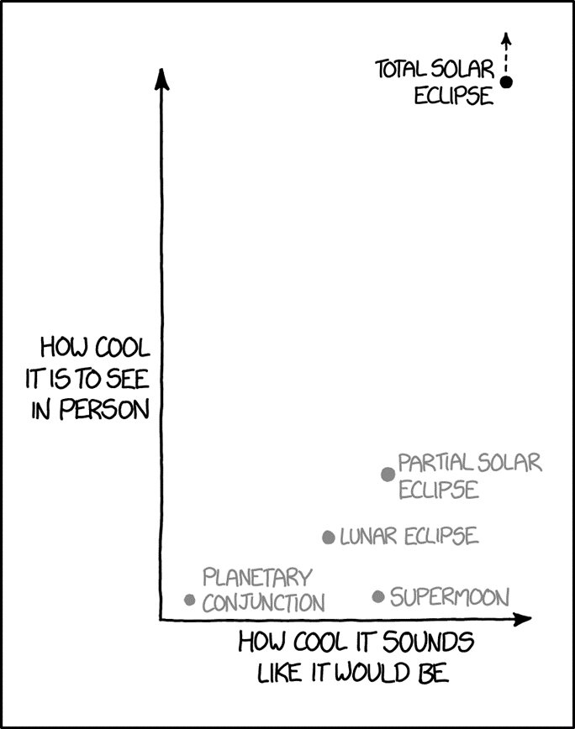
Bottom Line Up Front:
A total solar eclipse could be a great bucket list item for anyone, especially amateur astronomers and astronomy enthusiasts!
All one must to do see a total solar eclipse is to be in the right place and at the right time and look up.

Slide 4
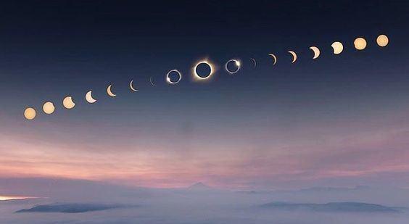
Solar Eclipse Sequence
John McKinney

Slide 5
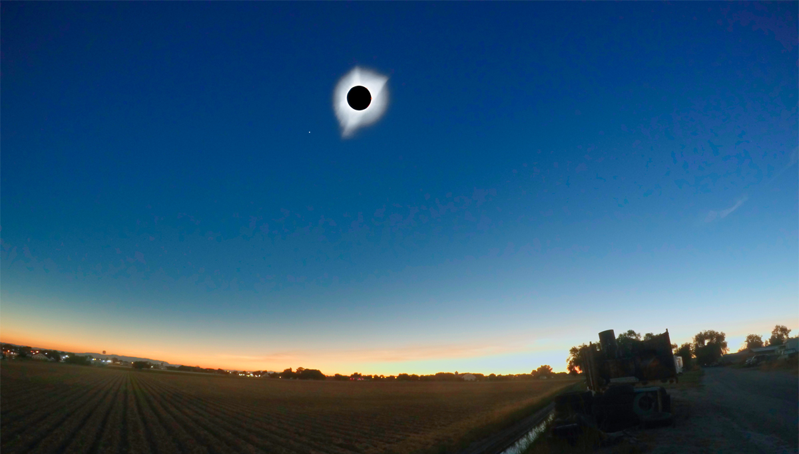

Slide 6
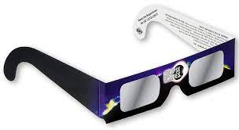
A Word of Caution
Observing the Sun without proper filtration and especially with magnifying optics will cause permanent eye injury and damage to equipment almost immediately
Expect information about proper filtration and sources to be published in the months prior to the eclipse
Do not wait until the last minute to acquire filters and solar glasses, because they are likely to be scarce in the final weeks and day preceding the eclipse

Slide 7
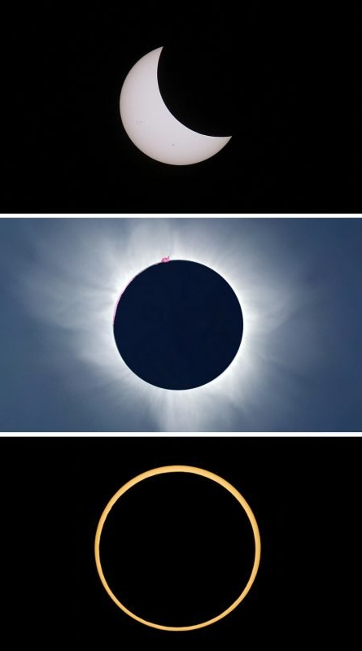
Solar Eclipse Fundamentals:
New Moon is always the lunar phase at the time of an eclipse
The Sun, Earth and Moon align so that the Moon’s disk covers the Sun’s disk as viewed from the Earth
The eclipse can be partial, total or annular (aka ring of fire)
All solar eclipses begin as partial, and may become total or annular

Slide 8
Eclipse Components and Key Characteristics: The Sun
Solar atmosphere components (from the inside out)
Photosphere – emits huge amounts of white light that illuminates the day
Chromosphere – emits light in Hydrogen Alpha – normally lost in the glare of the photosphere, but can be seen when the photosphere is obscured by a total eclipse or with a properly equipped telescope that filters out all wavelengths of light except Hydrogen Alpha
Corona – diffuse streamers that are too dim to be seen until the bright photosphere is obscured during a total eclipse
Apparent diameter of the photosphere: About 1/2°

Slide 9
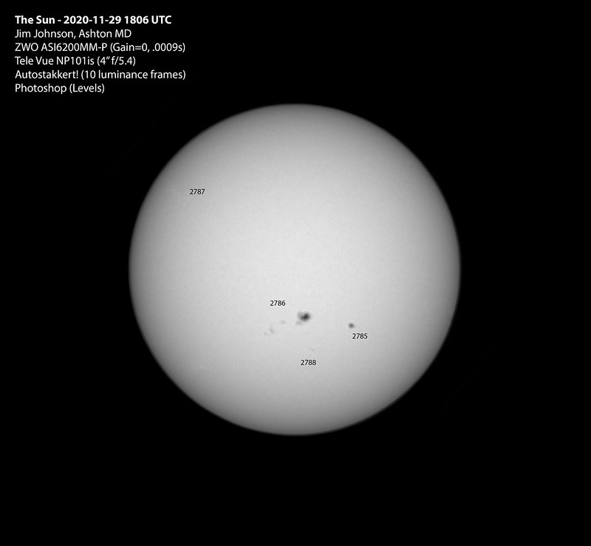
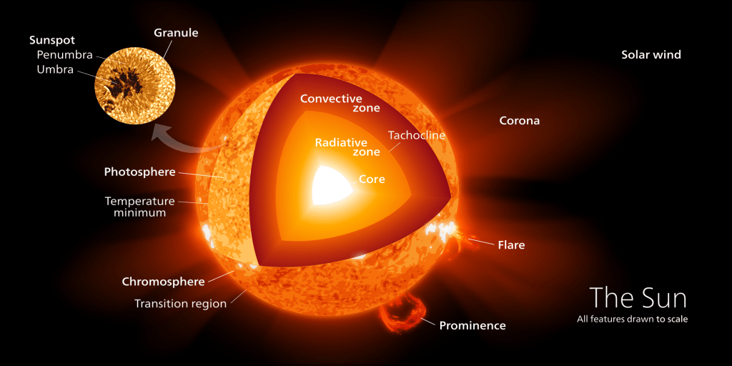
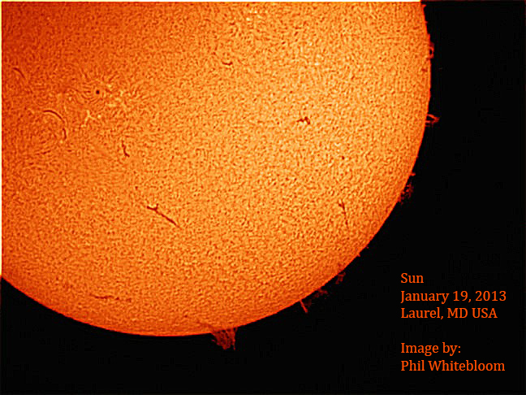
The Sun’s Atmosphere
Ken Everhart

Slide 10
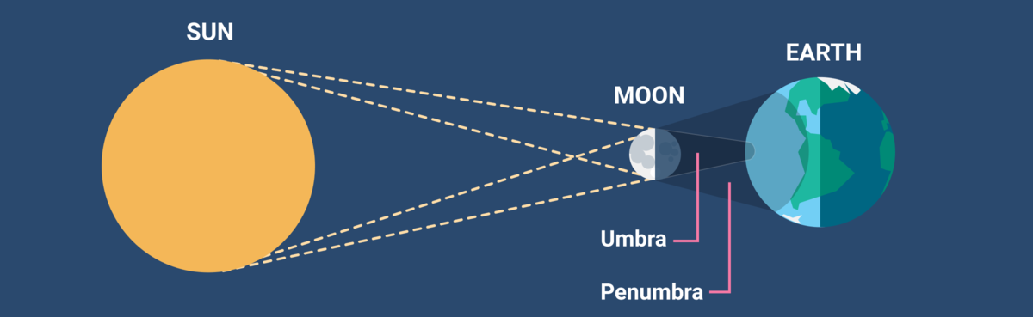
Eclipse Components and Key Characteristics: The Moon
Apparent Diameter: 1/2°
Casts a two-part, cone-shaped shadow, because the Sun’s actual size is larger than the Moon’s
Penumbra – part of the Sun’s light is blocked by the Moon
Umbra – all the Sun’s light is blocked by the Moon
Timeanddate.com

Slide 11
Solar Eclipse Geometry and Orbits
The Sun and Moon are roughly the same apparent size (about 1/2°) as viewed from Earth, because:
The Sun is about 400x larger than the Moon
The Sun is about 400x farther from Earth than the Moon
Adhering to Kepler’s 1st Law of Planetary Motion
The Earth follows an elliptical orbit about the Sun, which causes the Sun to appear larger from Earth when it is at perihelion and smaller when it is at aphelion
The Moon follows an elliptical path about the Earth, which causes the Moon to appear larger from the Earth when the Moon is at perigee and smaller at apogee – Moon’s apparent size varies by about 6% as it over the course of a lunar orbit

Slide 12
Three Types of Solar Eclipse
Related to the lunar shadow components, apparent sizes of the Sun and Moon, and orbits of the Earth and (primarily) the Moon
A partial solar eclipse is visible to an observer from within the Moon’s penumbral shadow
An annular eclipse occurs when the observer, Sun and Moon centers are perfectly aligned, and apparent size of the Moon is smaller than the apparent size of the Sun
- A total solar eclipse occurs when the observer, Sun and Moon are perfectly aligned, and the observer is within the umbral shadow

Slide 13
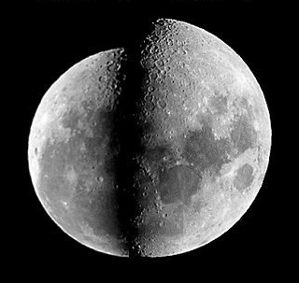
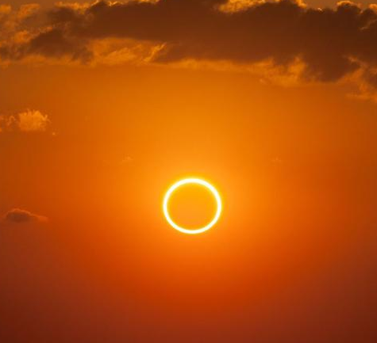
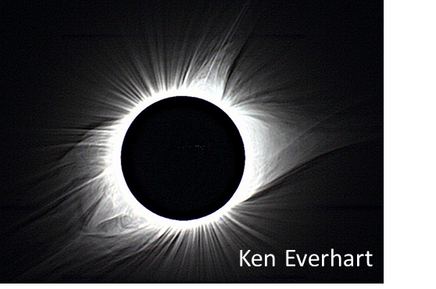
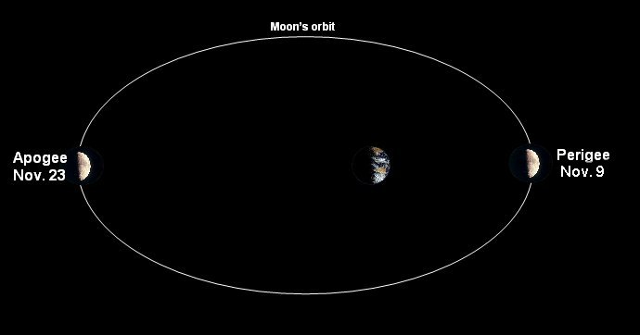

Slide 14
Why are eclipses so rare?
Why is there not an eclipse at every New Moon?

Slide 15
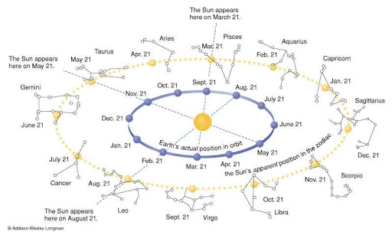
The Ecliptic
A closed circle that is the apparent path that the Sun traces among the fixed stars on the celestial sphere as the Earth orbits the Sun
Also, the orbital plane of the Earth
Also, a celestial circle upon which eclipses occur, hence the name ecliptic

Slide 16
The Moon’s Orbit
Orbital plane is inclined to the ecliptic by about 5.15 degrees.
As a consequence of its orbital plane being inclined to the ecliptic, the Moon crosses the ecliptic twice in each of its ~28 day orbits
Ascending node – Moon crosses the ecliptic from south to north
…and half an orbit or 14-ish days later…
Descending node – Moon crosses the ecliptic from north to south

Slide 17
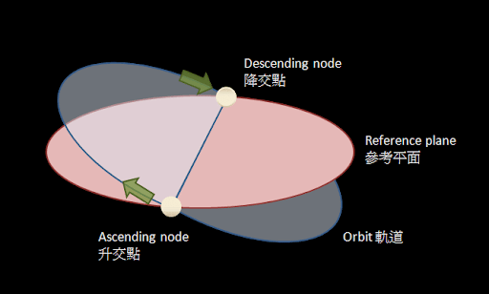

Slide 18
Total Solar Eclipse Path
Often a long (hundreds of miles) but narrow (tens of miles) swath across a very limited portion of the Earth’s surface – larger apparent size of the Moon compared to the Sun creates a wider path of totality.
The Moon’s shadow may take an hour or more to move from the beginning to the end of this path.
Duration of totality at any point on the path is very short (seconds to minutes) – larger apparent size of the Moon compared to the Sun creates a longer duration of totality.
Must be on the totality path to experience a totality
Greatest duration of totality is observed on the centerline of the path

Slide 19
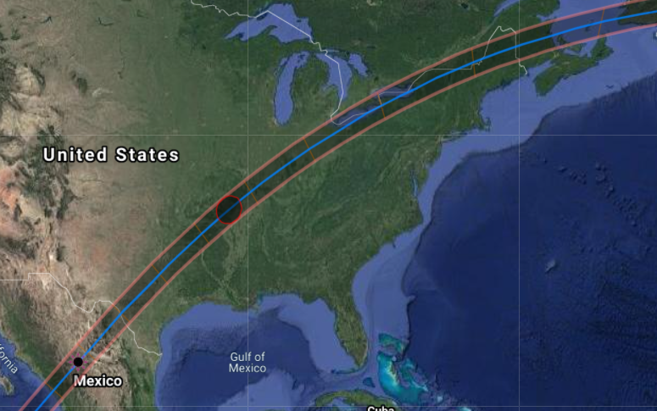

Slide 20
Conditions necessary for a total solar eclipse:
A total solar eclipse is an exceedingly rare event because:
Moon phase must be New Moon, and;
Moon must be crossing the ecliptic on the ascending or the descending node of its orbit, and;
Moon apparent size must be larger than Sun, and;
Observer must be on the path of totality.

Slide 21
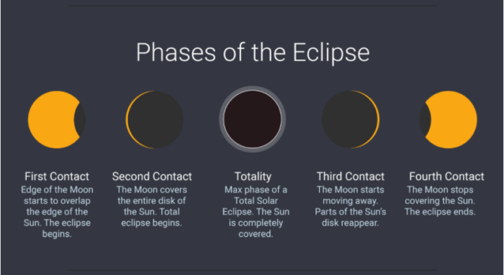
Eclipse Phases
Note: Accurate start and end times of each eclipse phase for a specific observing location can be determined using resources at the end of this presentation

Slide 22
Astronomical Observables: First Contact
Begins as lunar disk takes “first nibble” of solar disk
Sunspots, if present, are visible
The eclipse is said to be partial during the lunar disk ingress between first contact and second contact
From very high ground, the Moon’s shadow can be seen approaching across lower ground (usually from the west) as near the end of this phase as Second Contact approaches
Diamond Ring effect – just before the last of the photosphere is covered by the lunar disk
Bailey’s Beads – photosphere visible in valleys on the lunar limb

Slide 23
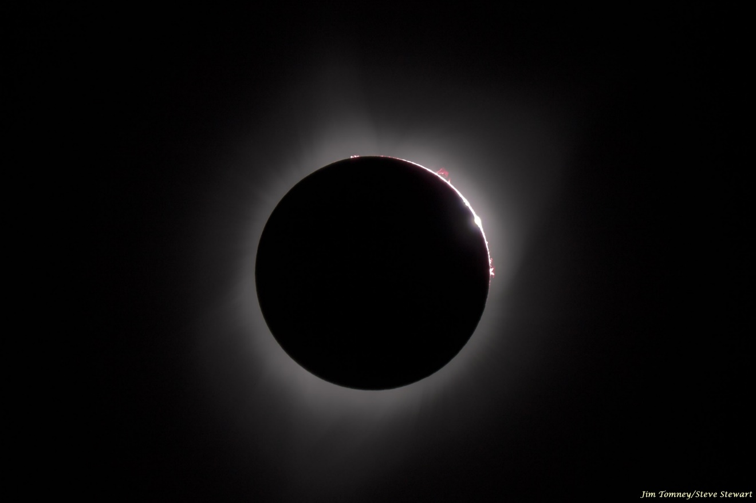
Jim Tomney and Steve Stewart, Fiery Prominences

Slide 24
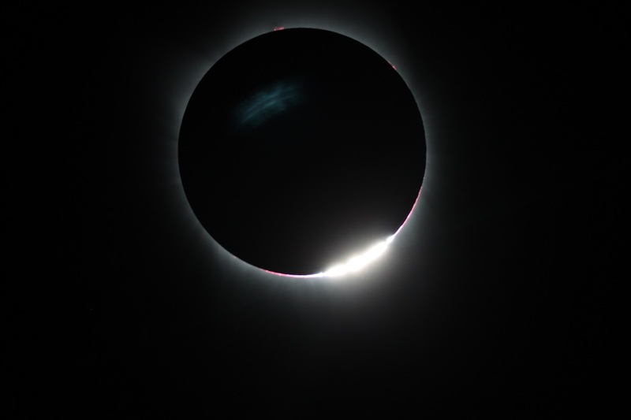
Wayne Baggett, Bailey’s Beads

Slide 25
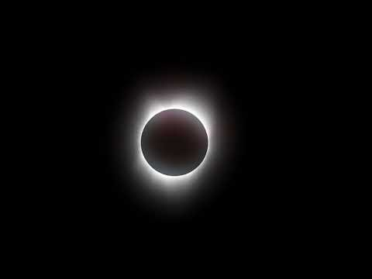
Joe Bohannon, Eclipse Totality Diamond Ring

Slide 26
Astronomical Observables: Second Contact
THIS IS THE MAIN EVENT!! The difference between a partial and total eclipse must be seen to appreciate. Be aware that you might scream, or at least squeal. Don’t worry, you will not be consumed by the impossibly dark lunar abyss at the center of the corona
Corona
As the solar maximum of the current 11-year solar cycle will be approaching, the corona is likely to be substantially large
The sky is much brighter than the corona – all the way up to 2nd contact – so only during totality is the corona visible
Seems to burst forth brightly as the last of the photosphere is obscured by the Moon
The Moon appears almost “impossibly” dark at the center of the corona. Lunar features illuminated by sunlight reflecting off the Earth (earthshine) can be seen in long photographic exposures
Observe the direction of the longest streamers (east-west aligned with the solar equator) and coronal holes (aligned with the solar poles). Some streamers might be looped along magnetic flux lines
Solar prominences and flares, if present, can be seen around the lunar limb
Stars and Planets – consult planetarium software and have a list
Face of the Moon lit by earthshine (long photographic exposures)

Slide 27
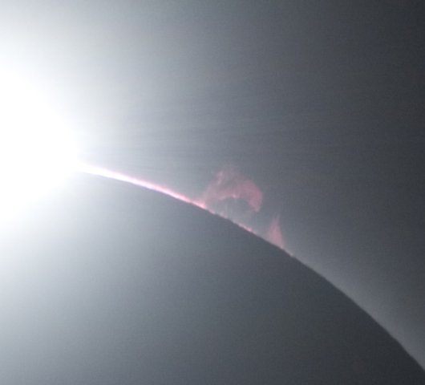
James Willinghan, Eclipse Dolphin

Slide 28
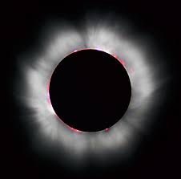
Shared by Keith Evans. Photosphere,
Chromosphere, and Prominences

Slide 29
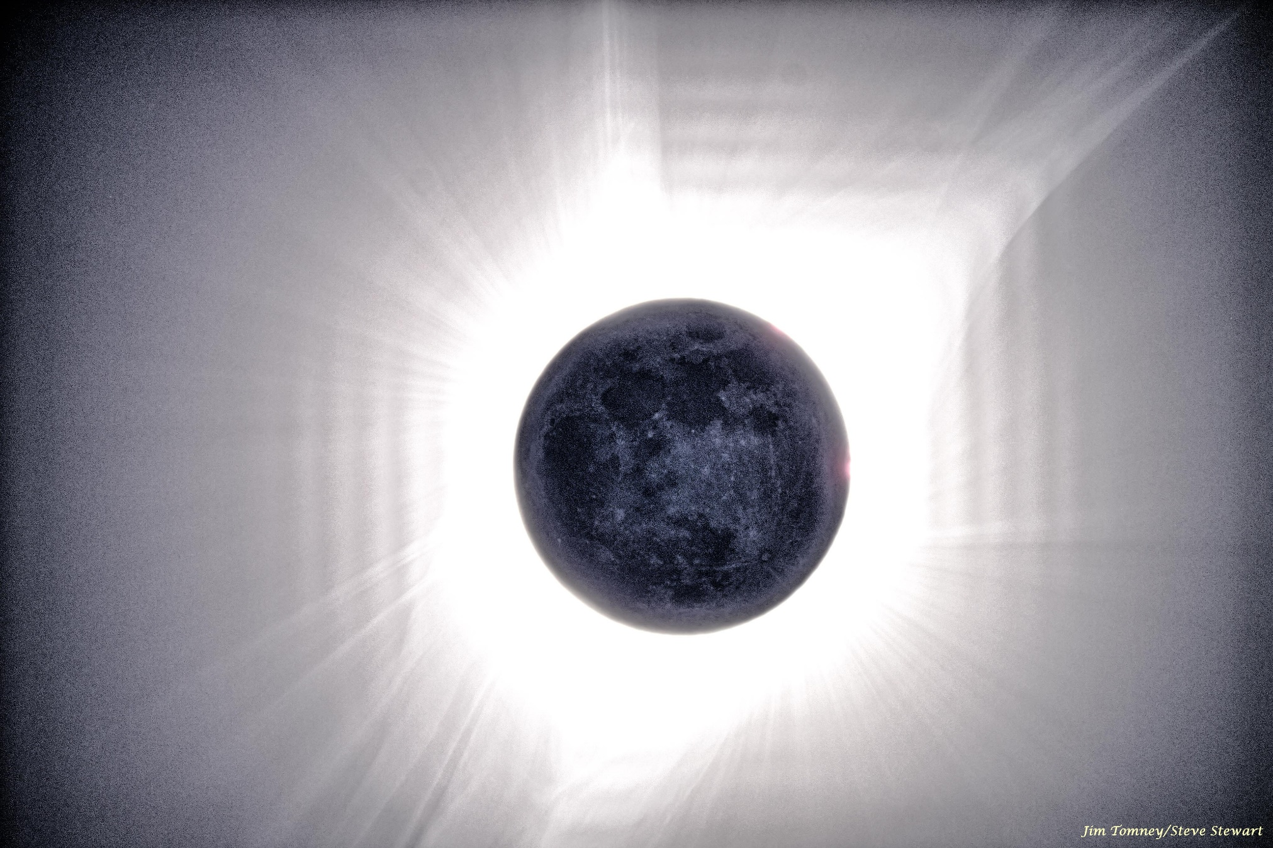
Jim Tomney and Steve Stewart, Earthshine

Slide 30
Astronomical Observables: Third and Fourth Contact
Totality ends at 3rd contact
The eclipse will be partial again during lunar disk egress between 3rd and 4th contacts
Bailey’s Beads and the Diamond Ring effects appear again
The eclipse is over at 4th contact

Slide 31
Terrestrial Observables
Darkening of the sky
Dropping temperatures
Sharpening shadows – because the Sun is about .5 degrees in apparent diameter as viewed from Earth, shadows are blurred by about ½ of a degree over the transition from full sunlight to full shadow. The .5-degree apparent size of the Sun and of the shadow blur is decreased and therefore sharpened at the eclipse progresses
Animals preparing for nightfall
360 degree sunset on the horizon (if positioned on or near the eclipse centerline) during totality
Shadow bands shimmering on the ground just before and just after totality

Slide 32
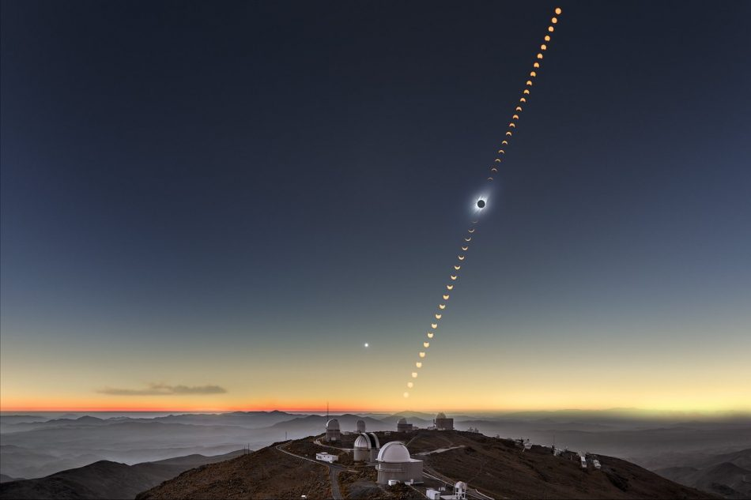
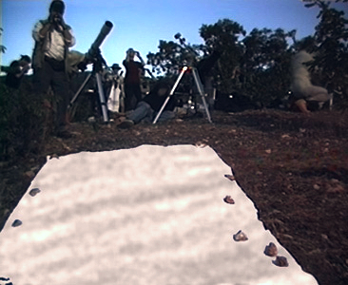
Dark sky and 360 degree sunset
Shadow bands

Slide 33
Observation Methods
Pinhole projection during partial phases – safest and easiest no filter required. Sunspots visible too!
Telescopic with a proper filter
Photographic
Various filters and equipment are used depending upon the effects to be captured
Recommend leaving photography to the experts so that fiddling with equipment balky equipment does not interfere with a single second of observing the eclipse.
Direct/unfiltered observation during totality. Yes, remove filters at second contact, but be aware of time (set an alarm) so that you are not surprised by unfiltered sunlight at 3rd contact

Slide 34
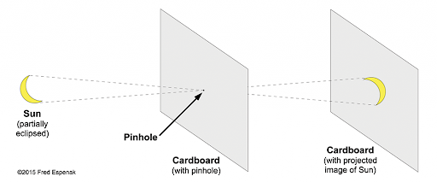
Pinhole Projection

Slide 35
Follow on Presentations:
Part 2: A review of The Great American Solar Eclipse of 2017: The Collective Experience of the Howard Astronomical League with an emphasis on many facets of a real-world eclipse experience, and lessons learned that can help prepare for the 2024 eclipse
Expect reminder emails as the eclipse approaches asking members and guests to record the various aspects of their experience, and to forward for inclusion in presentation that documents HAL’s collective 2024 eclipse experience
Part 3: HAL’s Collective 2024 Eclipse Experience – a curation of HAL members’ and guests’ solar eclipse experience

Slide 36
Additional Resources:
NASA Eclipse Web Site, Goddard Space Flight Center
The Great American Solar Eclipse of 2017: The Collective Experience of the Howard Astronomical League, Presented to the Howard Astronomical League by Jim Johnson on September 21, 2017.
The Solar Eclipse Experience, American Astronomical Society
Solar Eclipse of April 8, 2024, Wikipedia
2024 Eclipse Maps, National Eclipse (state-by-state maps!)
Total Solar Eclipse of 2024 April 8, Xavier M. Jubier (The best resource for eclipse timings for any specific location on the map)

