Slide 1

James Webb Space Telescope – An Introduction

Slide 2
Who was James Webb?
James Edwin Webb was the second NASA Administrator, Feb 1961 – Oct 1968, and initiated the science program at NASA

Slide 3
JWST: History

Slide 4
1990: HST Launched
2001 NAS Decadal Survey:
The Next Generation Space Telescope (NGST), the committee’s top-priority recommendation, is designed to detect light from the first stars and to trace the evolution of galaxies from their formation to the present. It will revolutionize understanding of how stars and planets form in our galaxy today.
Mid-1990's: Astronomers start thinking beyond HST
1997: NGST Study report
1997: STScI selected to operate NGST
2001: Decadal Survey
2002: Northrop Grumman prime contractor, NGST renamed JWST
2011: Congress threatens cancellation
2012: First science instruments delivered

Slide 5
JWST: Science Goals

Slide 6
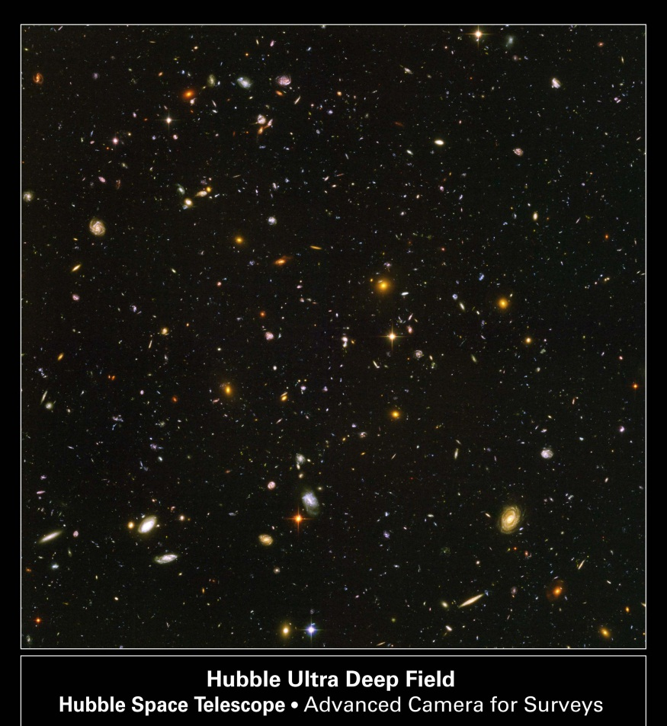
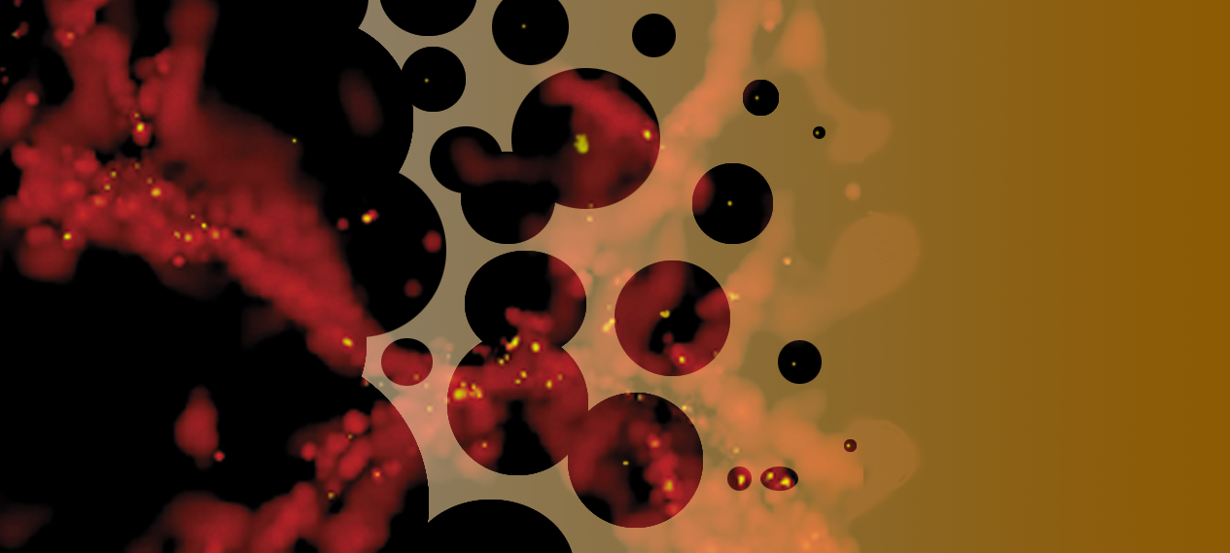
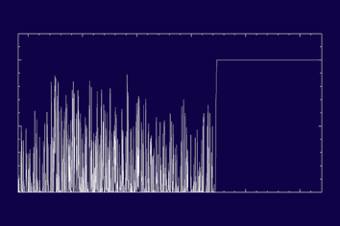
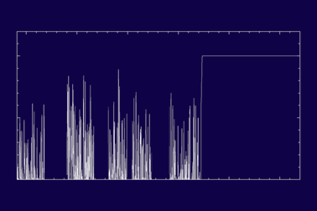
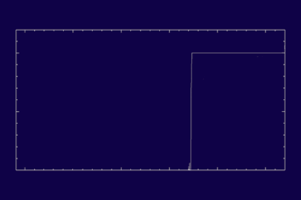
End of the dark ages: first light and reionization
What are the first galaxies?
When did reionization occur?
  Once or twice?
What sources caused reionization?
Redshift
Neutral IGM
z~z_{i}
z>z_{i}
.
z<z_{i}
Ultra-Deep NIR survey (1.4 nJy), spectroscopic & Mid-IR confirmation.
QSO spectra: Ly-α forest
Galaxy spectra: Balmer lines (2x10⁻¹⁹ ergs/cm²/sec)
Wavelength
Wavelength
Wavelength
Lyman Forest Absorption
Patchy Absorption
Black Gunn-Peterson trough

Slide 7
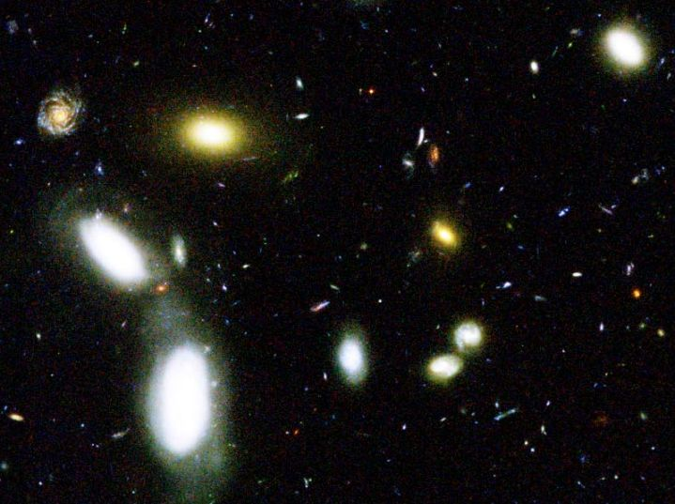
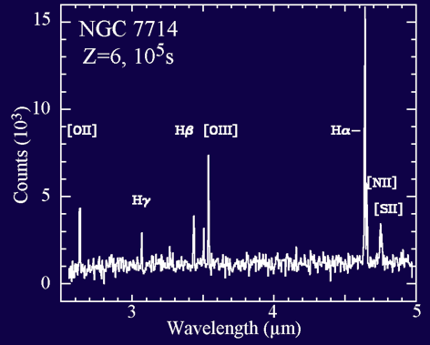
The assembly of galaxies
Where and when did the Hubble Sequence form?
How did the heavy elements form?
Can we test hierarchical formation and global scaling relations?
What about ULIRGs and AGN?
Galaxies in GOODS Field
Wide-area imaging survey
R=1000 spectra of 1000s of galaxies at 1 < z < 6
Targeted observations of ULIRGs and AGN

Slide 8
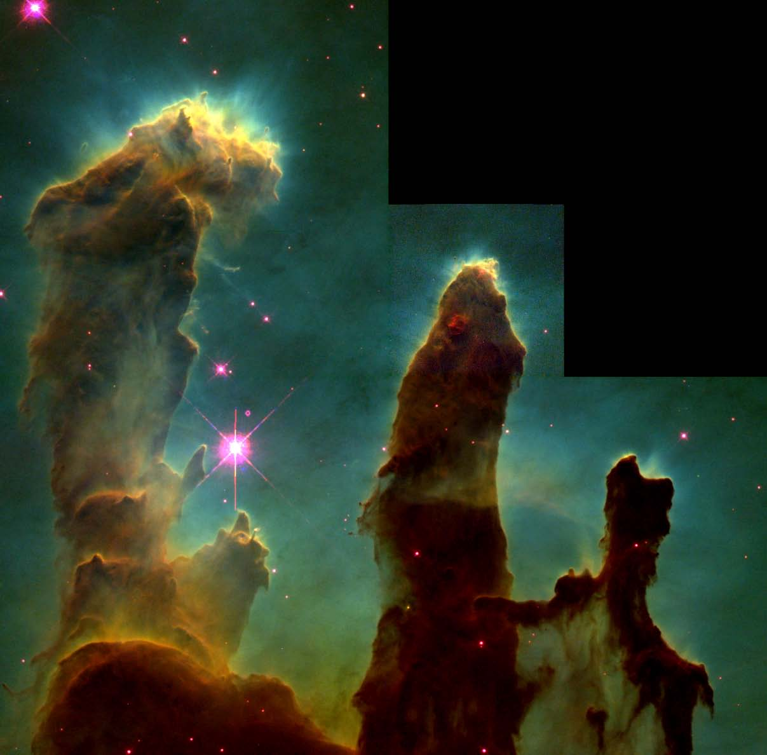
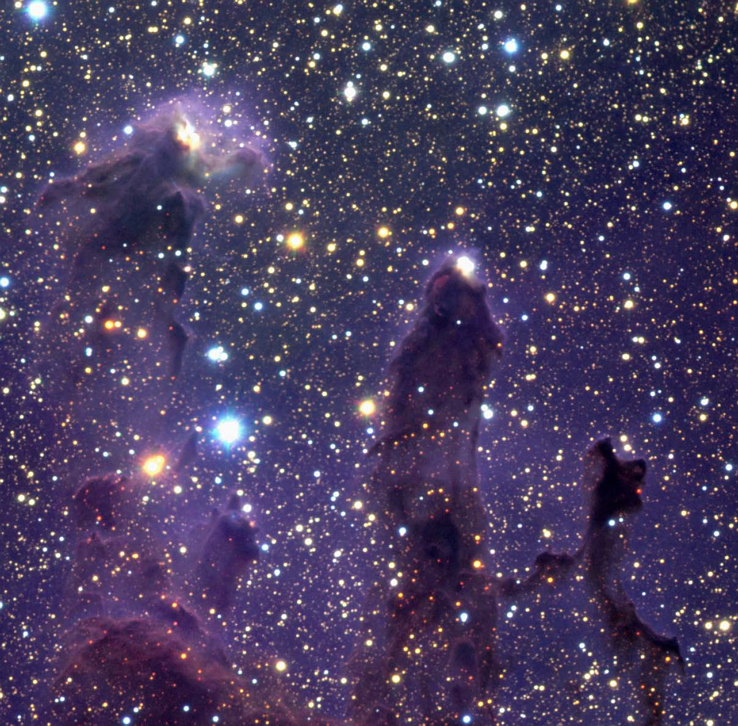
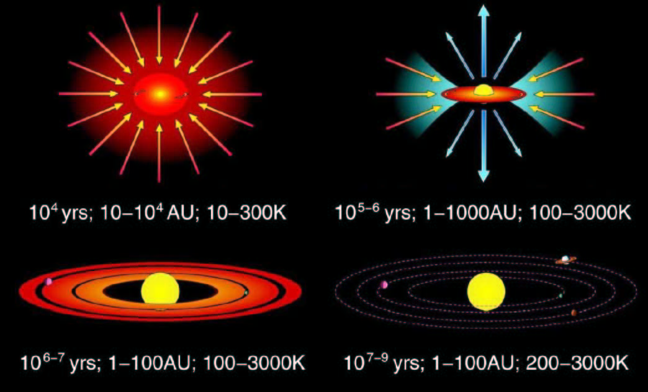
Birth of stars and protoplanetary systems
How do clouds collapse?
How does environment affect star-formation?
  Vice-versa?
What is the low-mass IMF?
Deeply embedded protostar
Circumstellar disk
The Eagle Nebula
as seen in the infrared
The Eagle Nebula as seen by HST
Imaging of molecular clouds
Survey “elephant trunks”
Survey star-forming clusters
Agglomeration & planetesimals
Mature planetary system

Slide 9
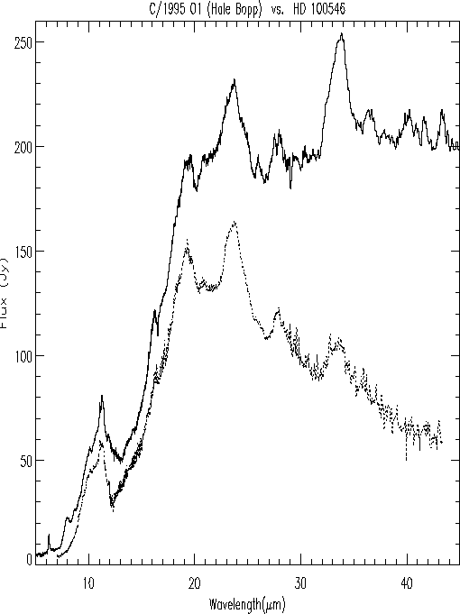
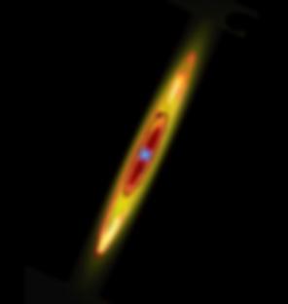
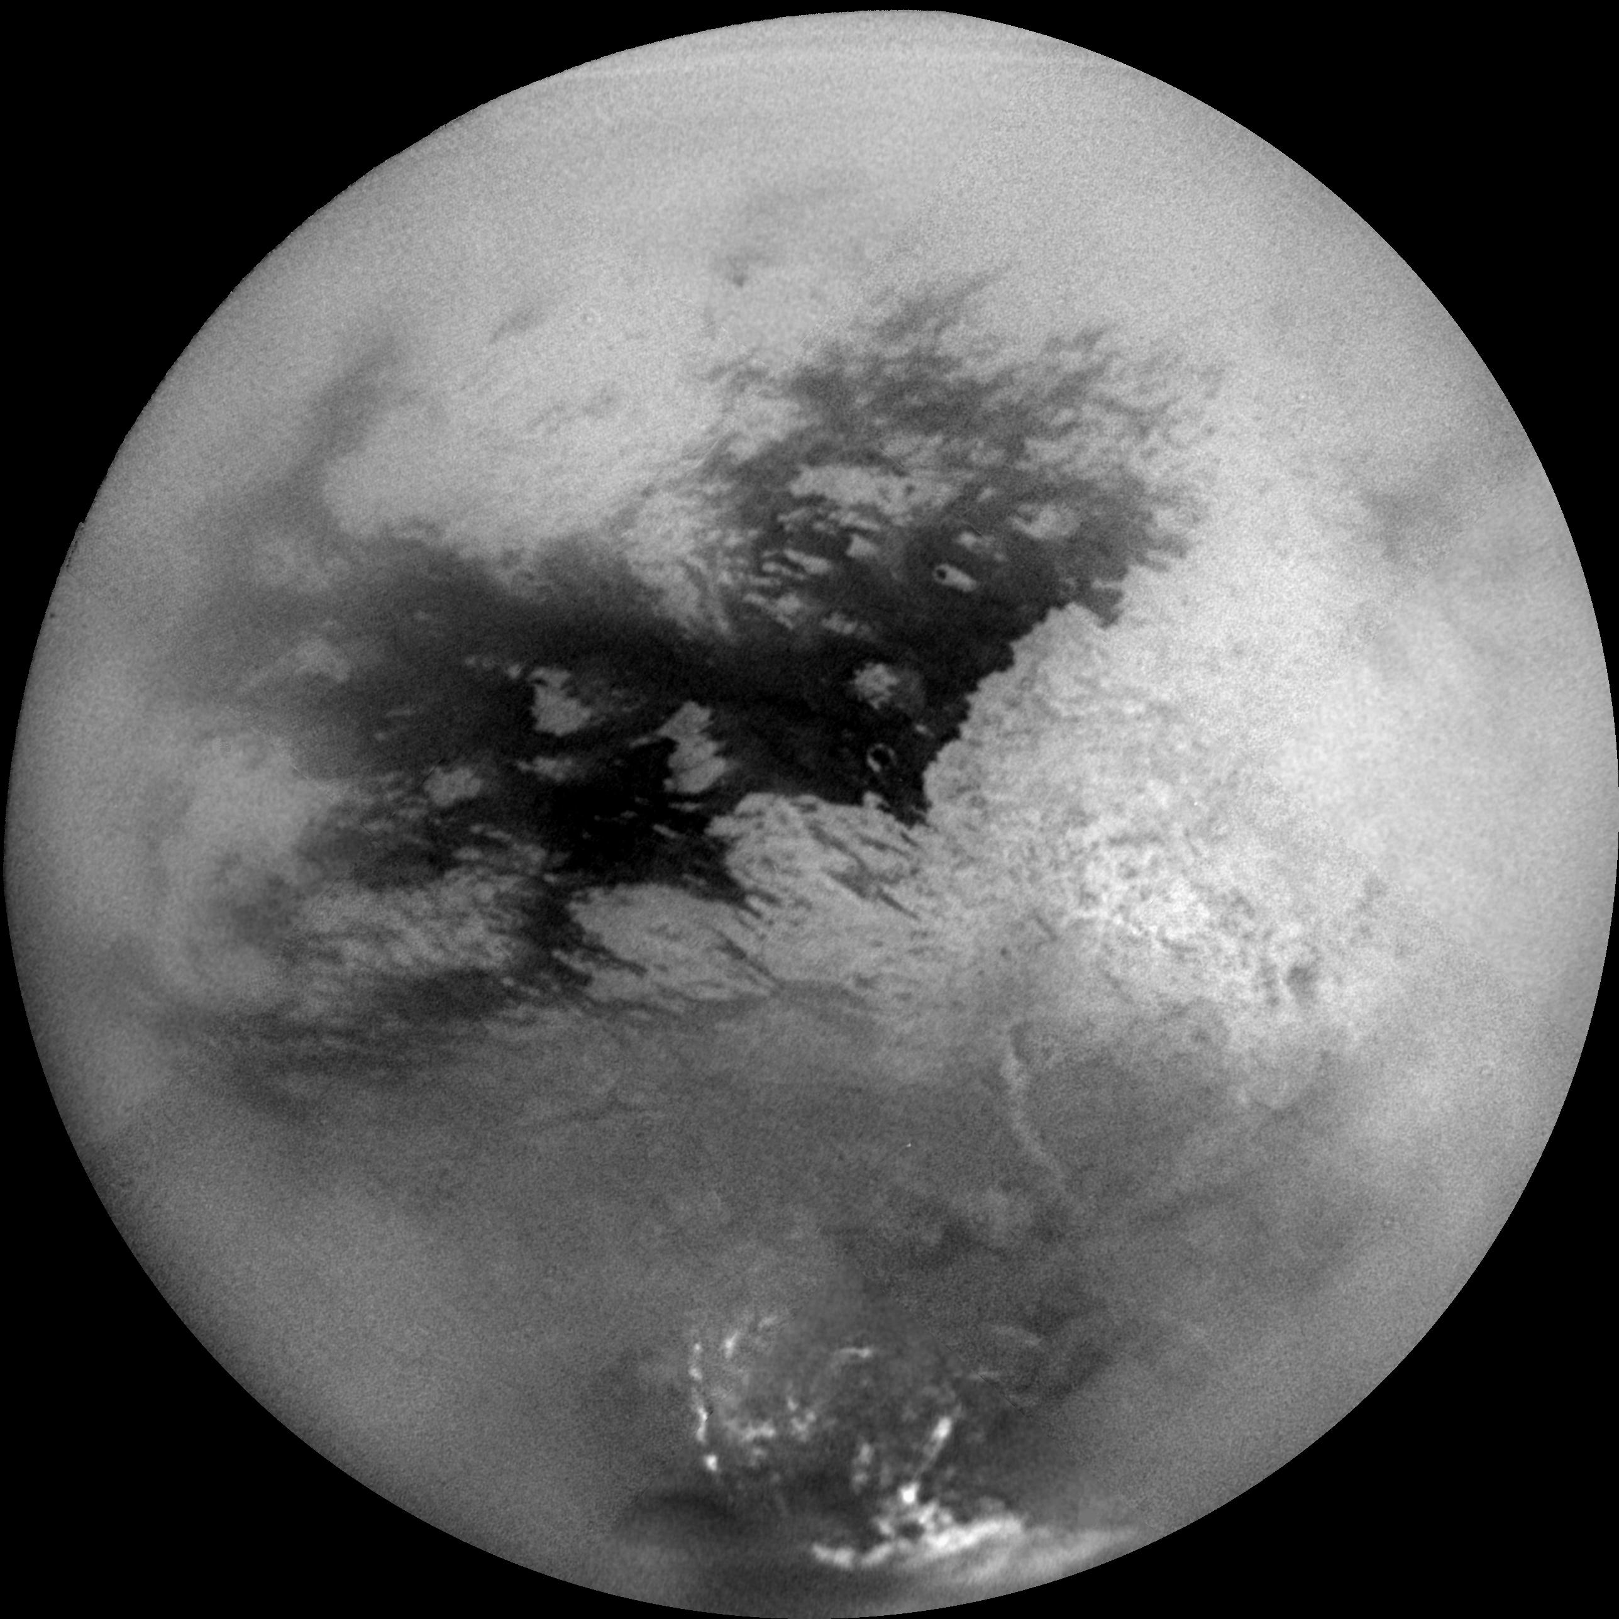
Planetary systems and the origins of life
How do planets form?
How are circumstellar disks like our Solar System?
How are habitable zones established?
Spitzer image
Malfait et al 1998
Extra-solar giant planets
  Coronagraphy
Spectra of circumstellar disks, comets and KBOs
Spectra of icy bodies in outer Solar System
Simulated JWST image
Fomalhaut at 24 microns
Titan

Slide 10
JWST: Observatory Design

Slide 11
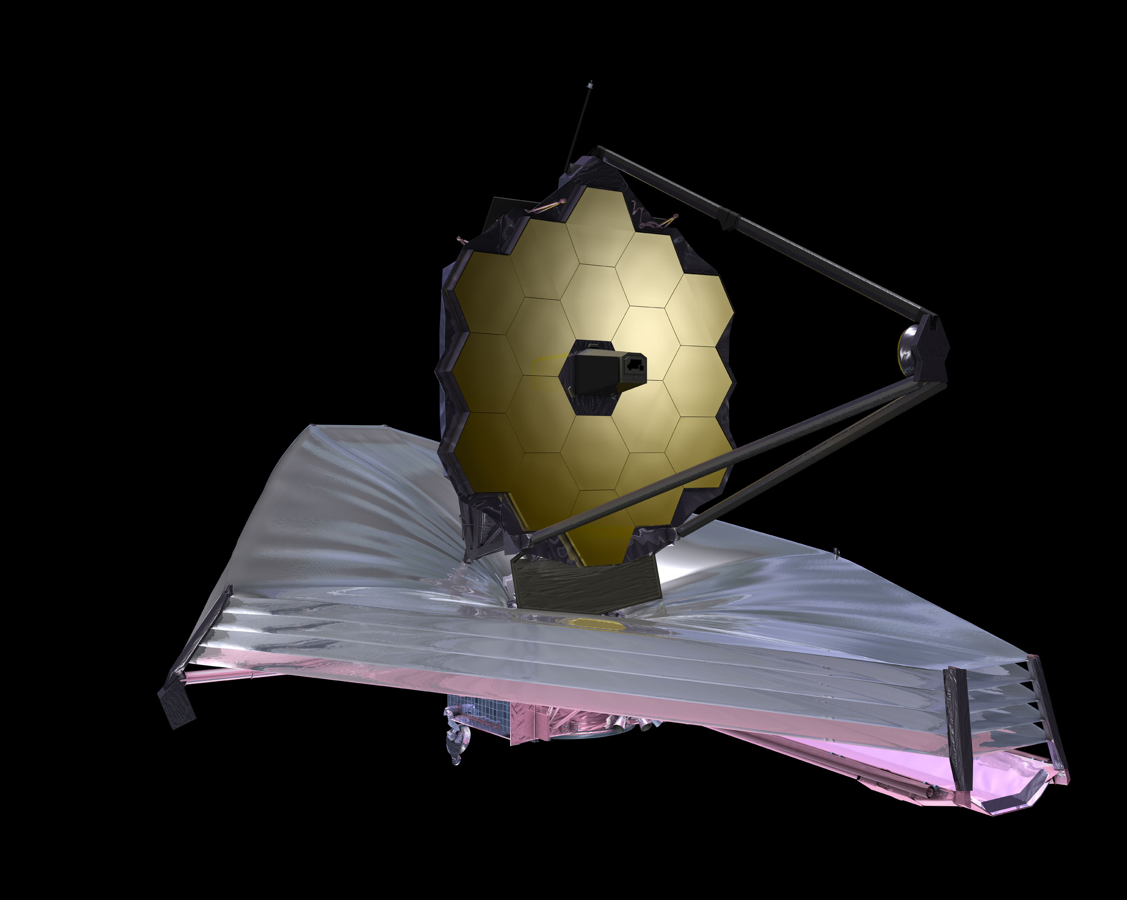

Slide 12
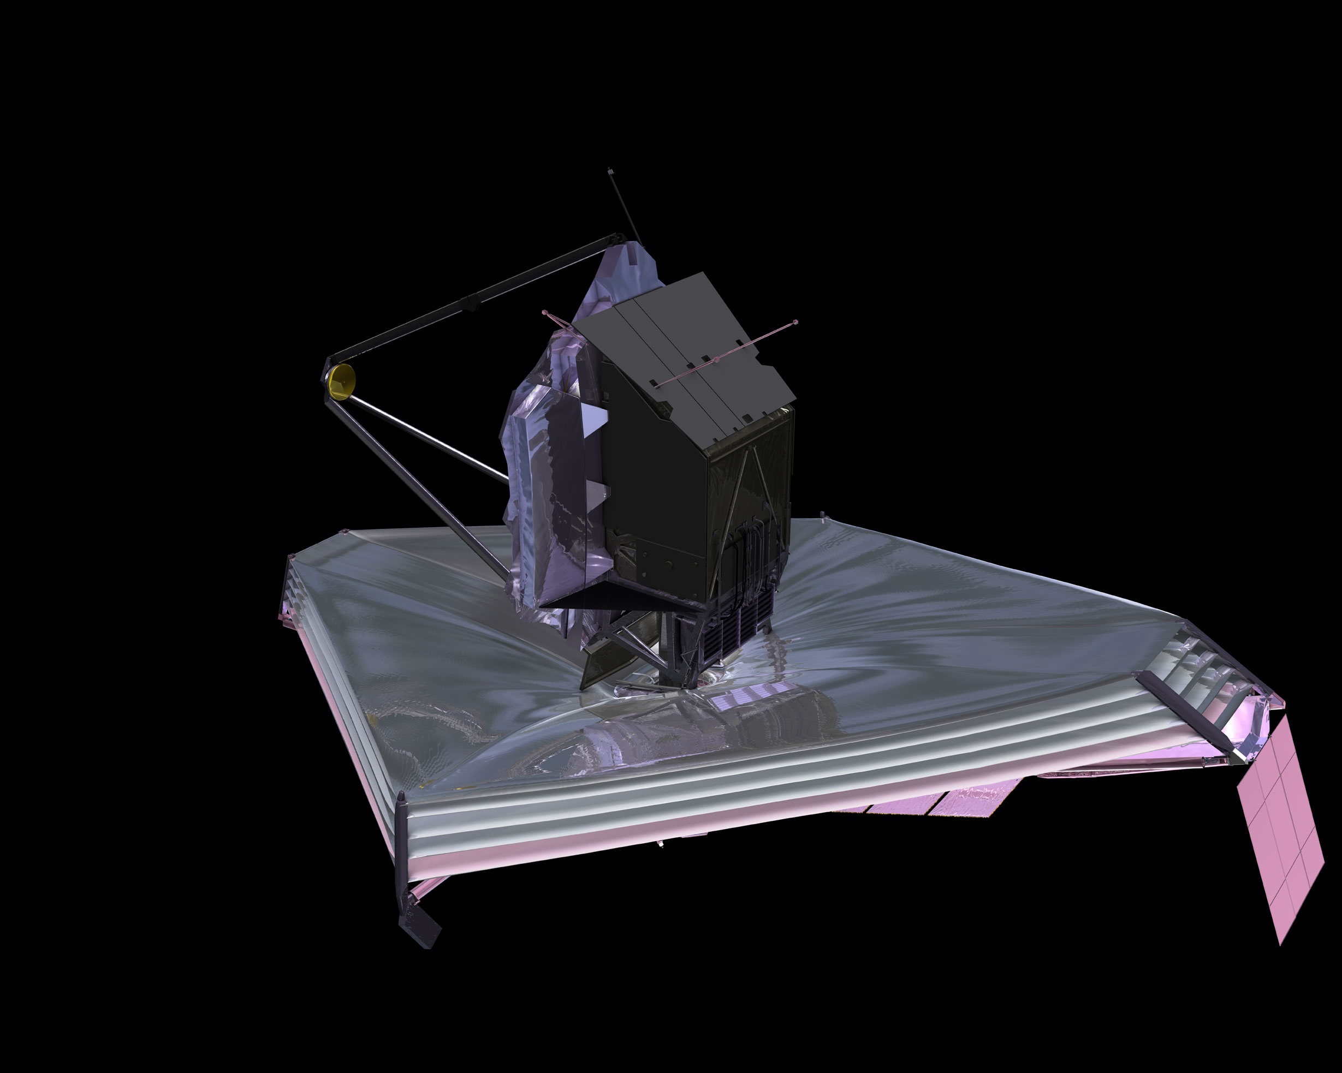

Slide 13
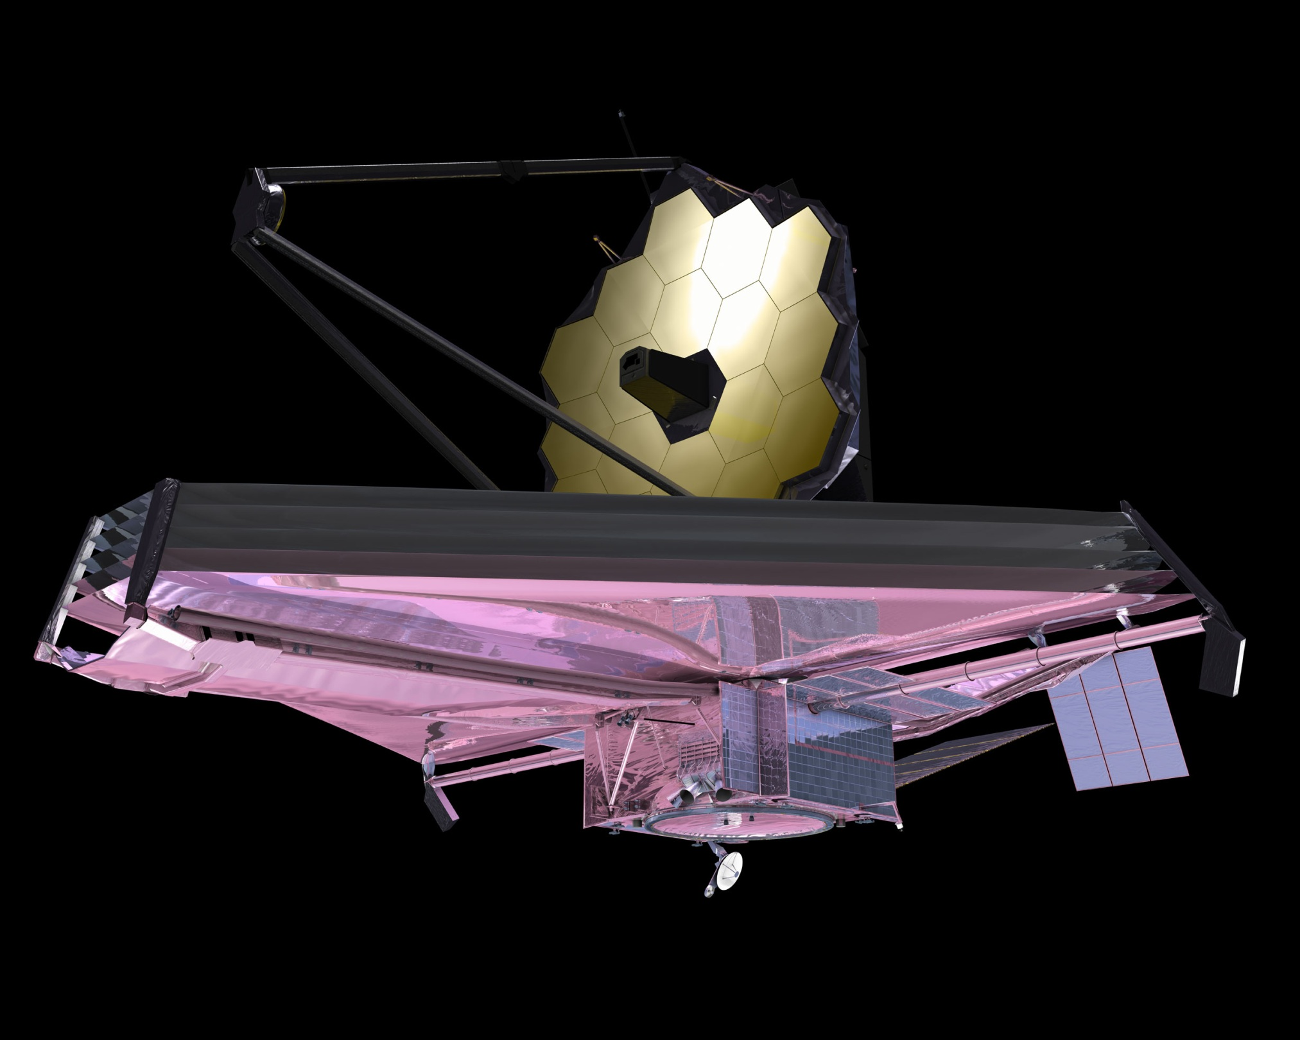

Slide 14
JWST: Origami Gone Awry

Slide 15
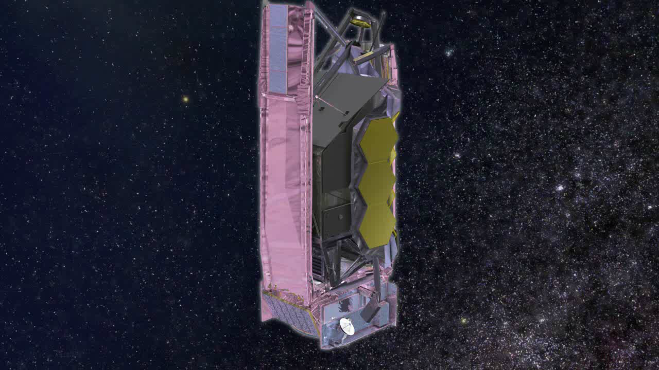

Slide 16
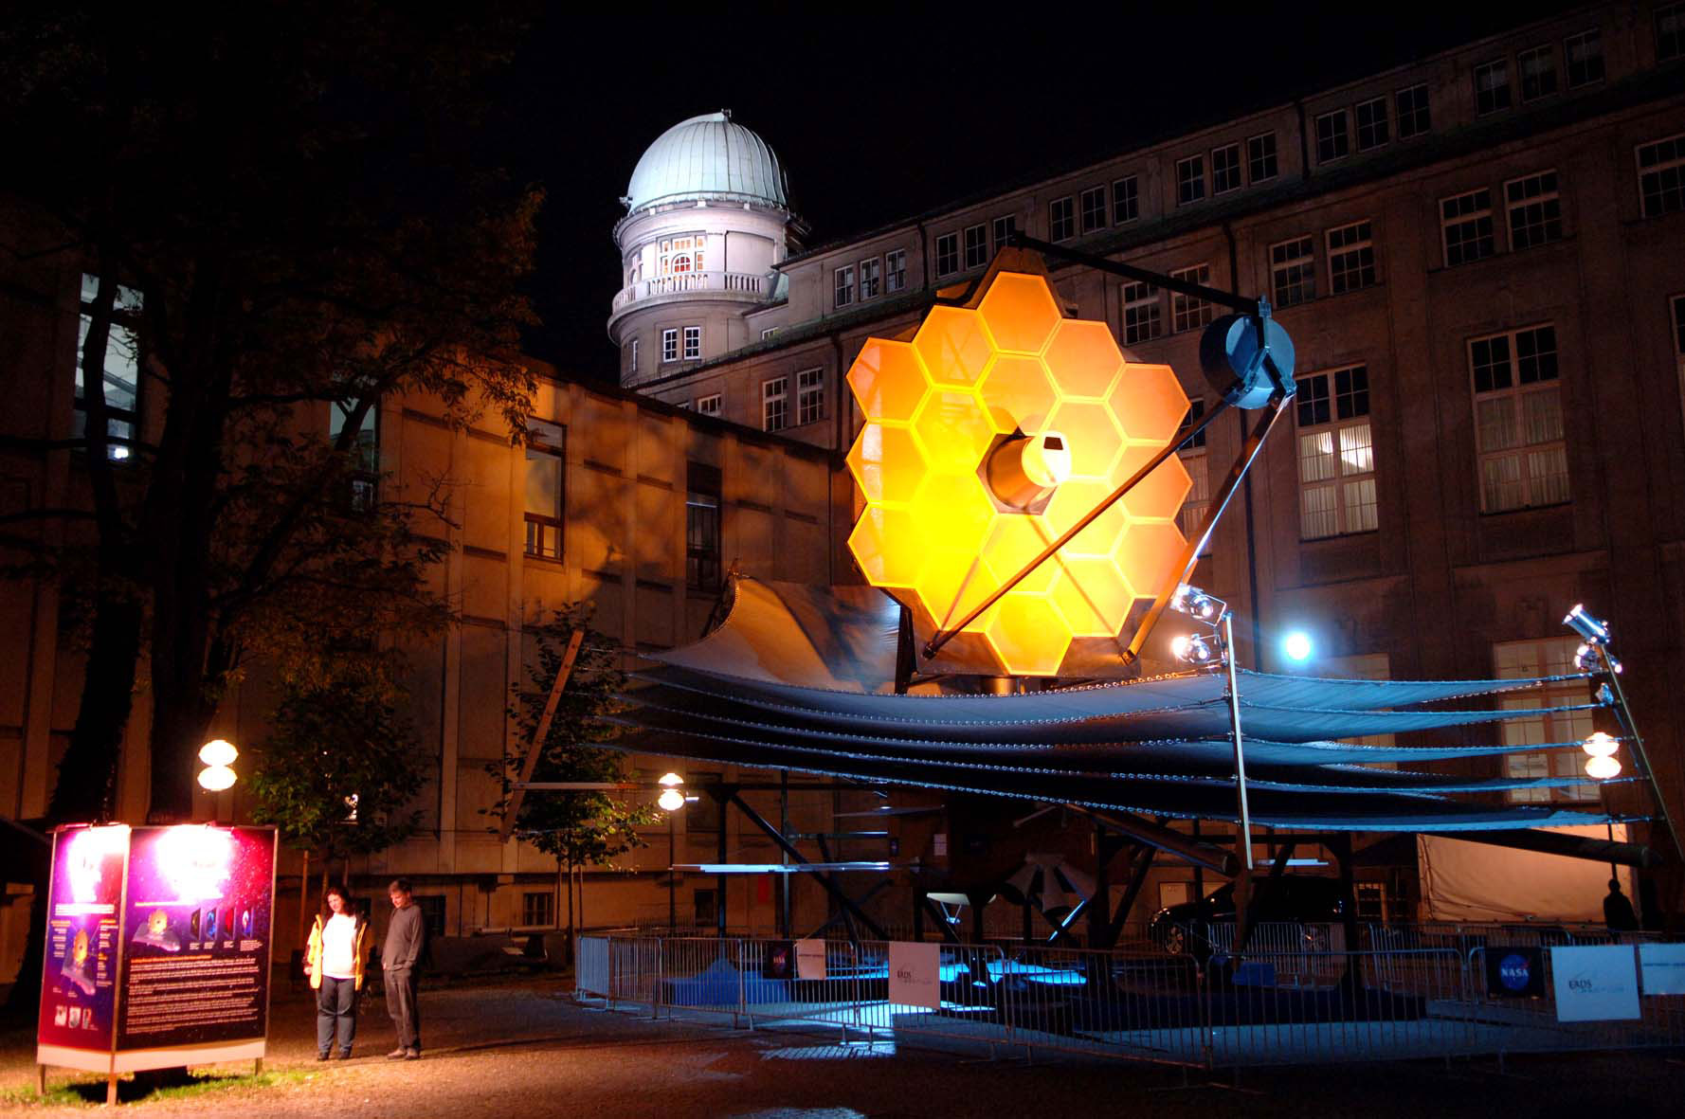

Slide 17
JWST: Science Instruments

Slide 18
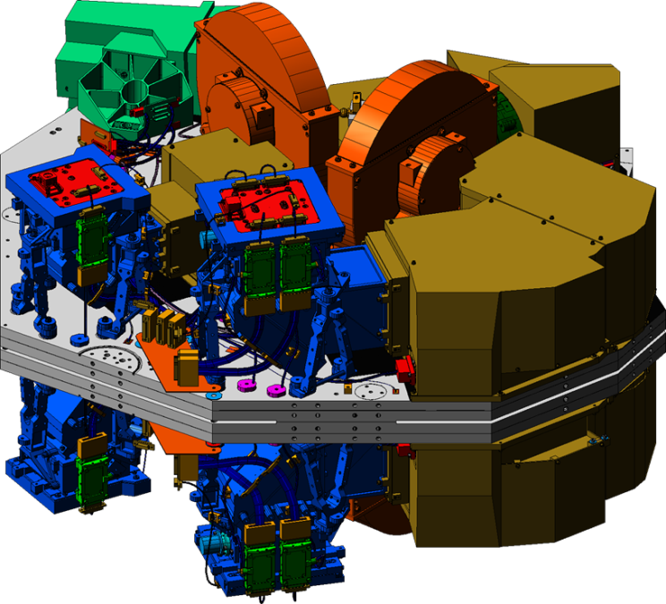
Near-Infrared Camera: NIRCam
Filter imaging from 0.6μm to 5.0μm
Two mirror-image but otherwise identical modules
  Each module has 4 short-wavelength detectors and 1 long-wavelength detector
  Each detector is 2048 x 2048 pixels in size (4Mpix)
  The short- and long wavelength cameras view the same part of the sky
  The two modules view adjacent areas on the sky
Total field of view is 2.2 arcmin x 4.4 arcmin
Will be used for wavefront sensing to adjust the primary mirror segments
NIRCam

Slide 19

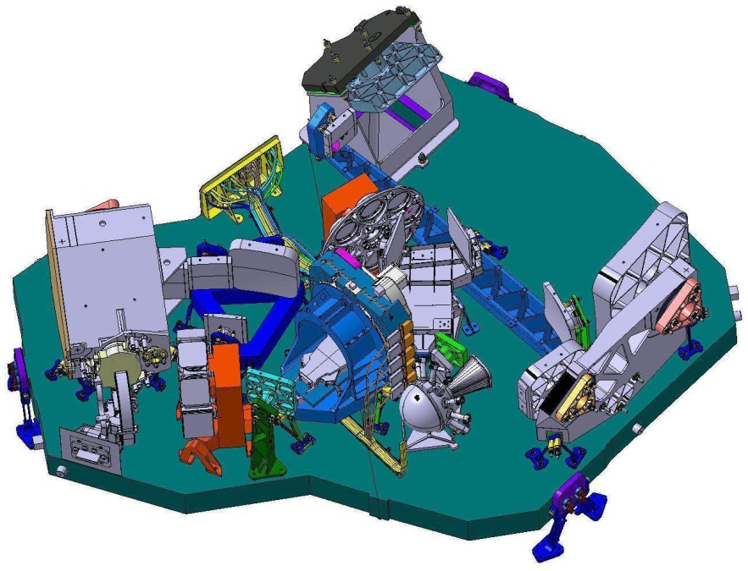
Near-Infrared Spectrograph: NIRSpec
NIRSpec
Provides simultaneous spectroscopy of 100 objects
Field of view is 3 arcmin x 3 arcmin
Low-, medium-, and high-resolution modes
Wavelength coverage is 1.0μm – 5.0μm
Micro-shutter array of 730 x 342 shutters, individually commandable to open or close
Two 2048 x 2048 pixel detectors

Slide 20
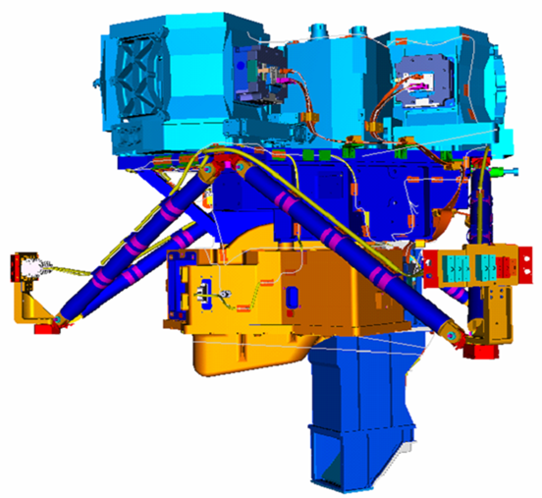
Mid-Infrared Instrument: MIRI
Imaging and spectroscopy from 5.0μm to 28.5μm
  Low resolution spectroscopy from 5.0μm to 10μm
  Medium- to high-resolution from 5.0μm to 28.5μm
Three 1024 x 1024 pixel detectors
Detectors operate at ~6K
  Passive cooling to ~40K by sunshield
  Active cooling via a cryocooler system to 6K
  MIRI optics are cooled to very near 6K, too
MIRI

Slide 21
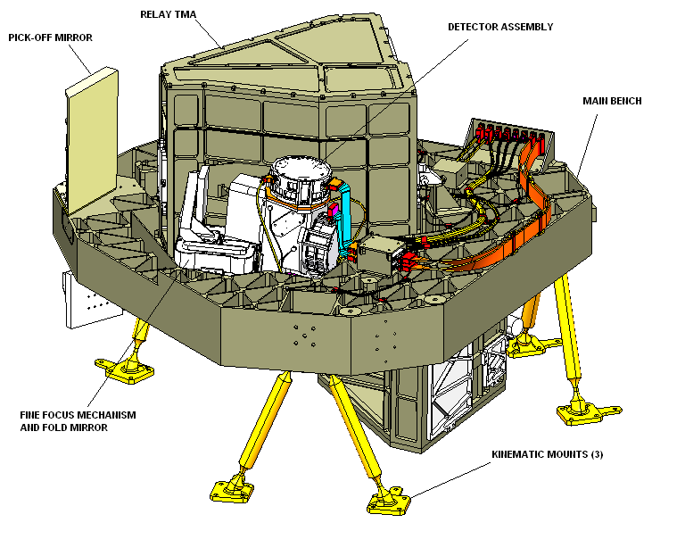
Near-Infrared Imager and Slitless Spectrograph: NIRISS
Part of the Fine Guidance Sensor
Single 2048 x 2048 pixel detector
Wavelength range is 0.8μm to 5.0μm
Field of view is 2.2 arcmin x 2.2 arcmin
Interferometric imaging for exoplanets
Low resolution spectroscopy
  Defocussed mode to allow observing bright stars
FGS/NIRISS

Slide 22
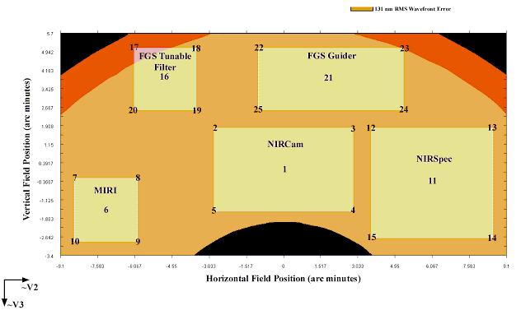
JWST: Focal Plane

Slide 23
JWST: Orbit

Slide 24
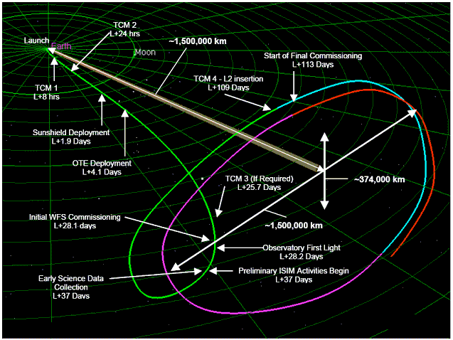

Slide 25
JWST: Future

Slide 26
2013 - 2015: ISIM Integration and Test
2015 - 2016: Flight optics integration
2016 - 2017: Telescope plus ISIM Testing
2017 - 2018: Observatory Testing
2018: Launch!
2018 - 2023: Primary mission
2023 - 2028: Extended mission

Slide 27
JWST Fun Facts
JWST is approximately the size of a tennis court
The sunshield provides an equivalent “SPF” of 1.2 million for the telescope
Each mirror segment is ground and polished so its figure error is less than 20 nm across its surface. On a relative scale, if the mirror were to be enlarged to the size of the continental United States, this is equivalent to smoothing out its highest point, Mount Whitney at 14,500 ft, to a height of about 2 inches.
When taking an image, the Observatory has a pointing instability of less than 3.7 milliarc-seconds. This would be like painting a 5 ½ inch diameter circle on your friend’s helmet in New York City with a laser tag gun in Los Angeles.
There is nearly a 500 deg F temperature difference between the bottom of the sunshield and the top
Each Beryllium mirror segment starts out at a weight of 273 kg (600 lb). Precision machining removes 93% of the weight so the final segment weighs only 20 kg (44 lb).

