Slide 1
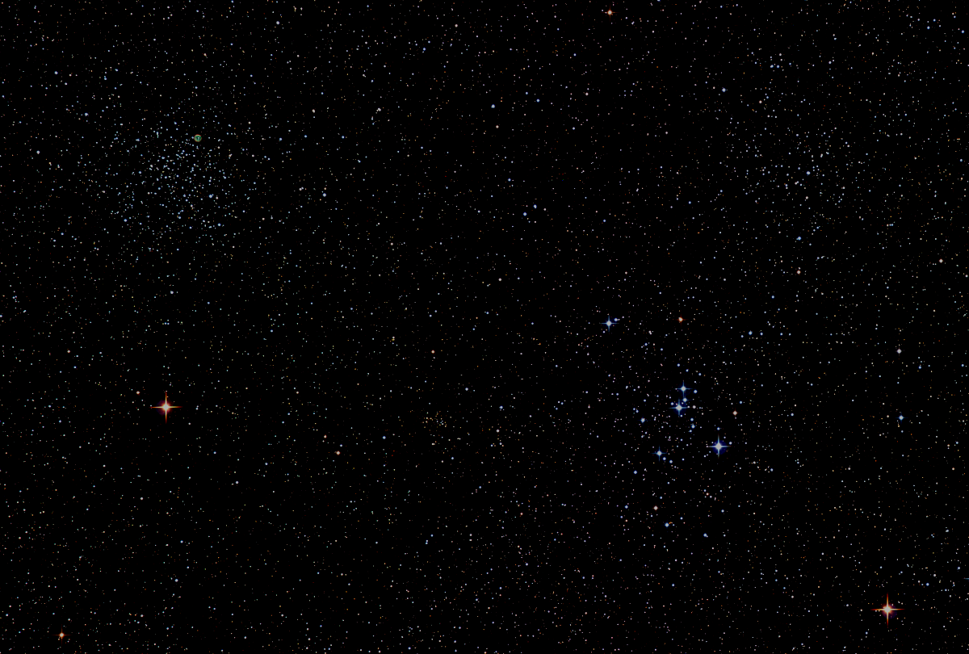

Howard
Astronomical
League
February 19th, 2015

Slide 2
Introductions
Name and where were you when this star light has most recently reached us:
Alpha Centauri...4.4 ly
Eta Cassiopeiae...19.4
Zeta Herculis...35.2

Slide 3
Upcoming club activities

Slide 4
Star Parties and public outreach!
February 16 - 22
Winter Star Party, Scout Key Florida
March 19 - 22
Chaos Star Party, Staunton, VA
March 21
Members Only
March 28
Public Star Party

Slide 5
The Observatory Report
Rotation motors and wiring
Electrical wiring
Shutter Motor
The Watson Telescope
Planning for observatory layout

Slide 6
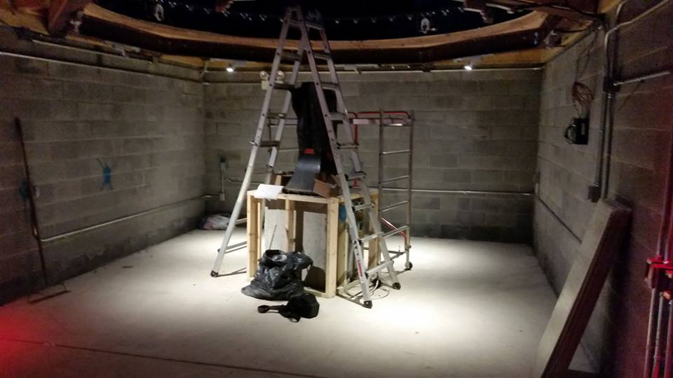
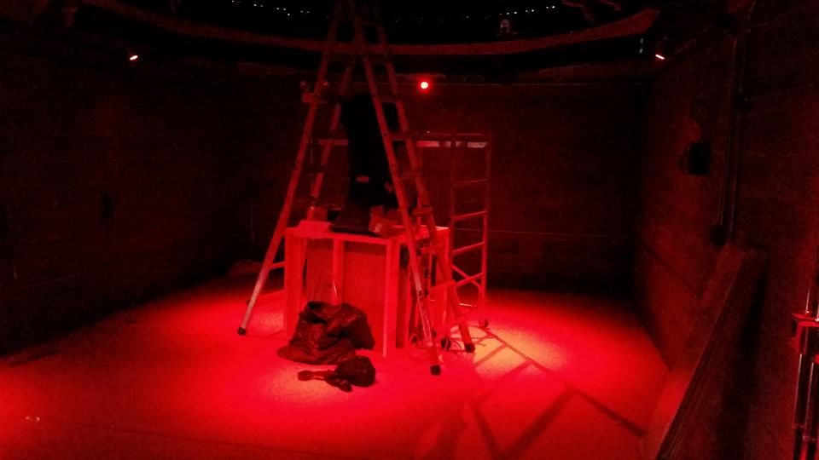

Slide 7
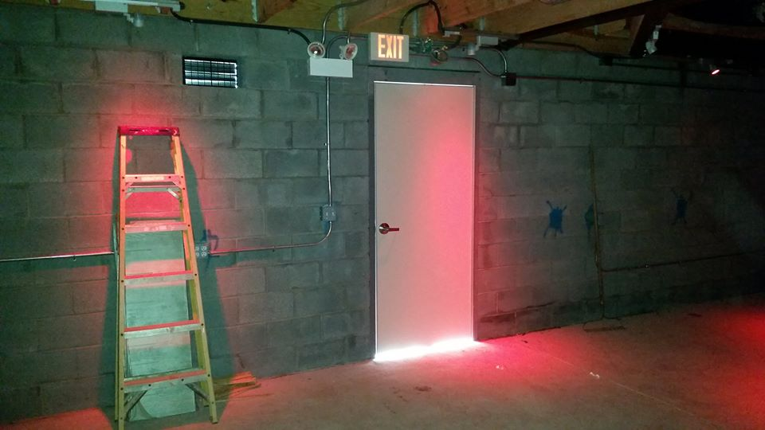
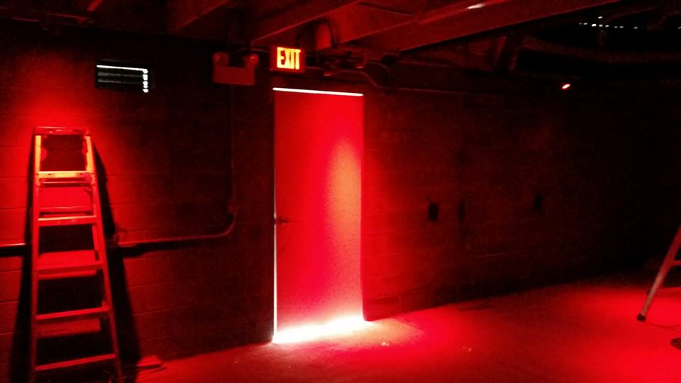

Slide 8
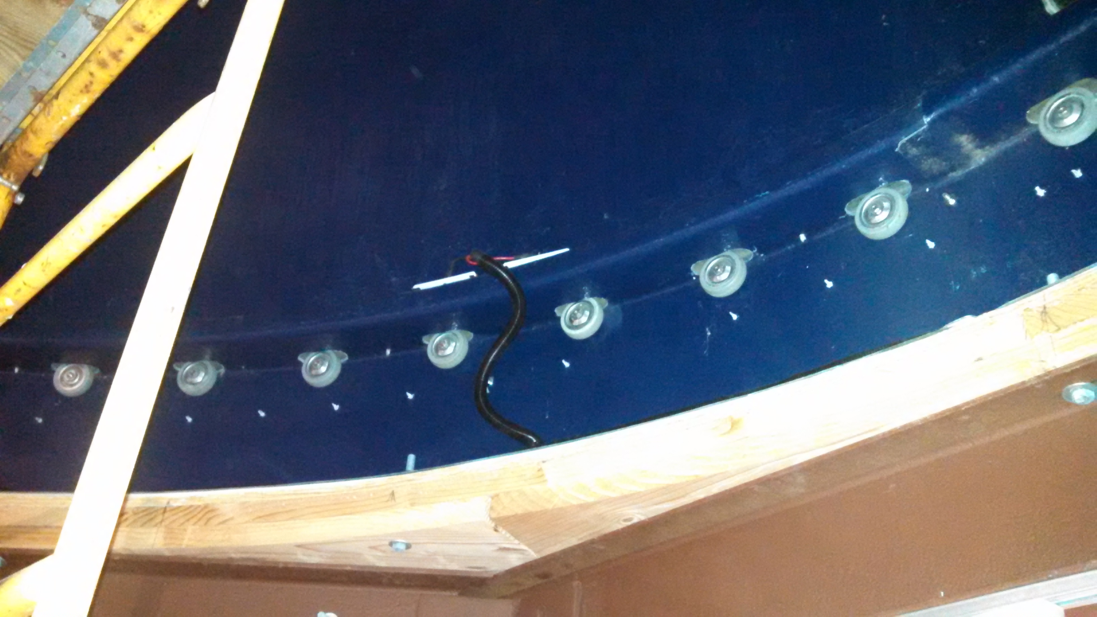

Slide 9
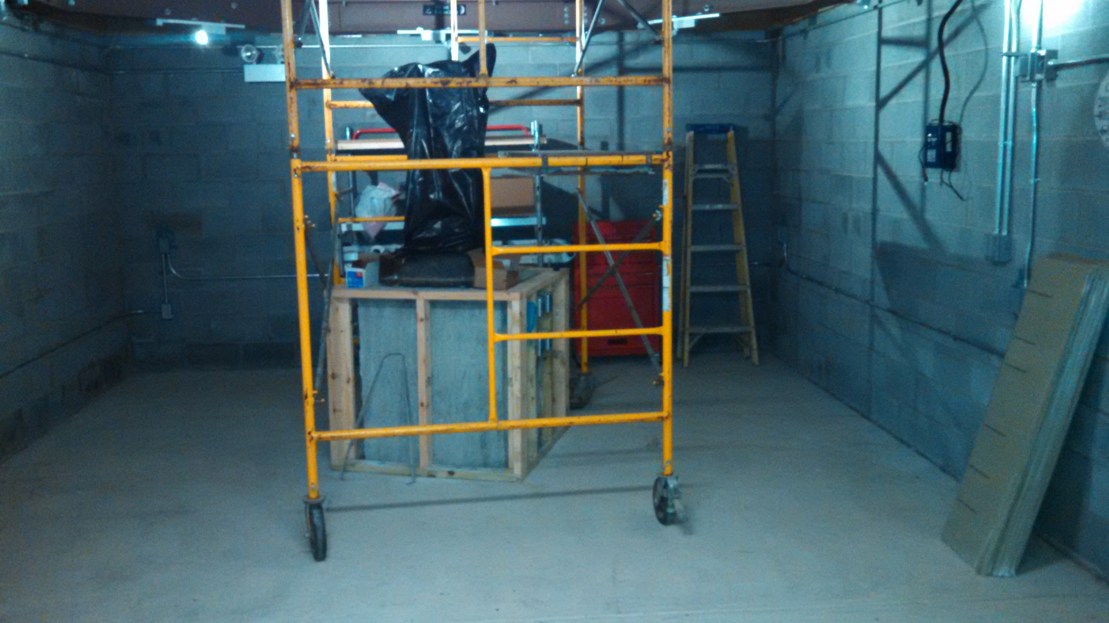

Slide 10
Member’s astrophotos and sketches

Slide 11
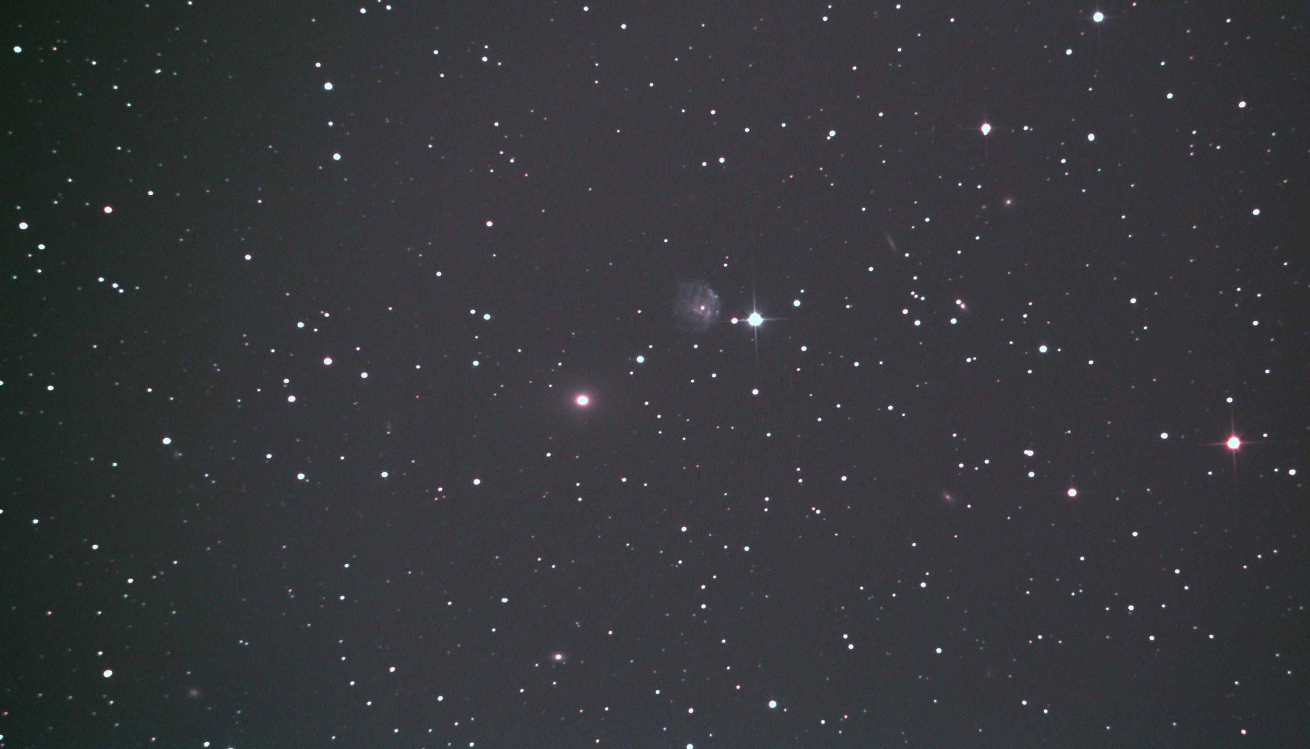
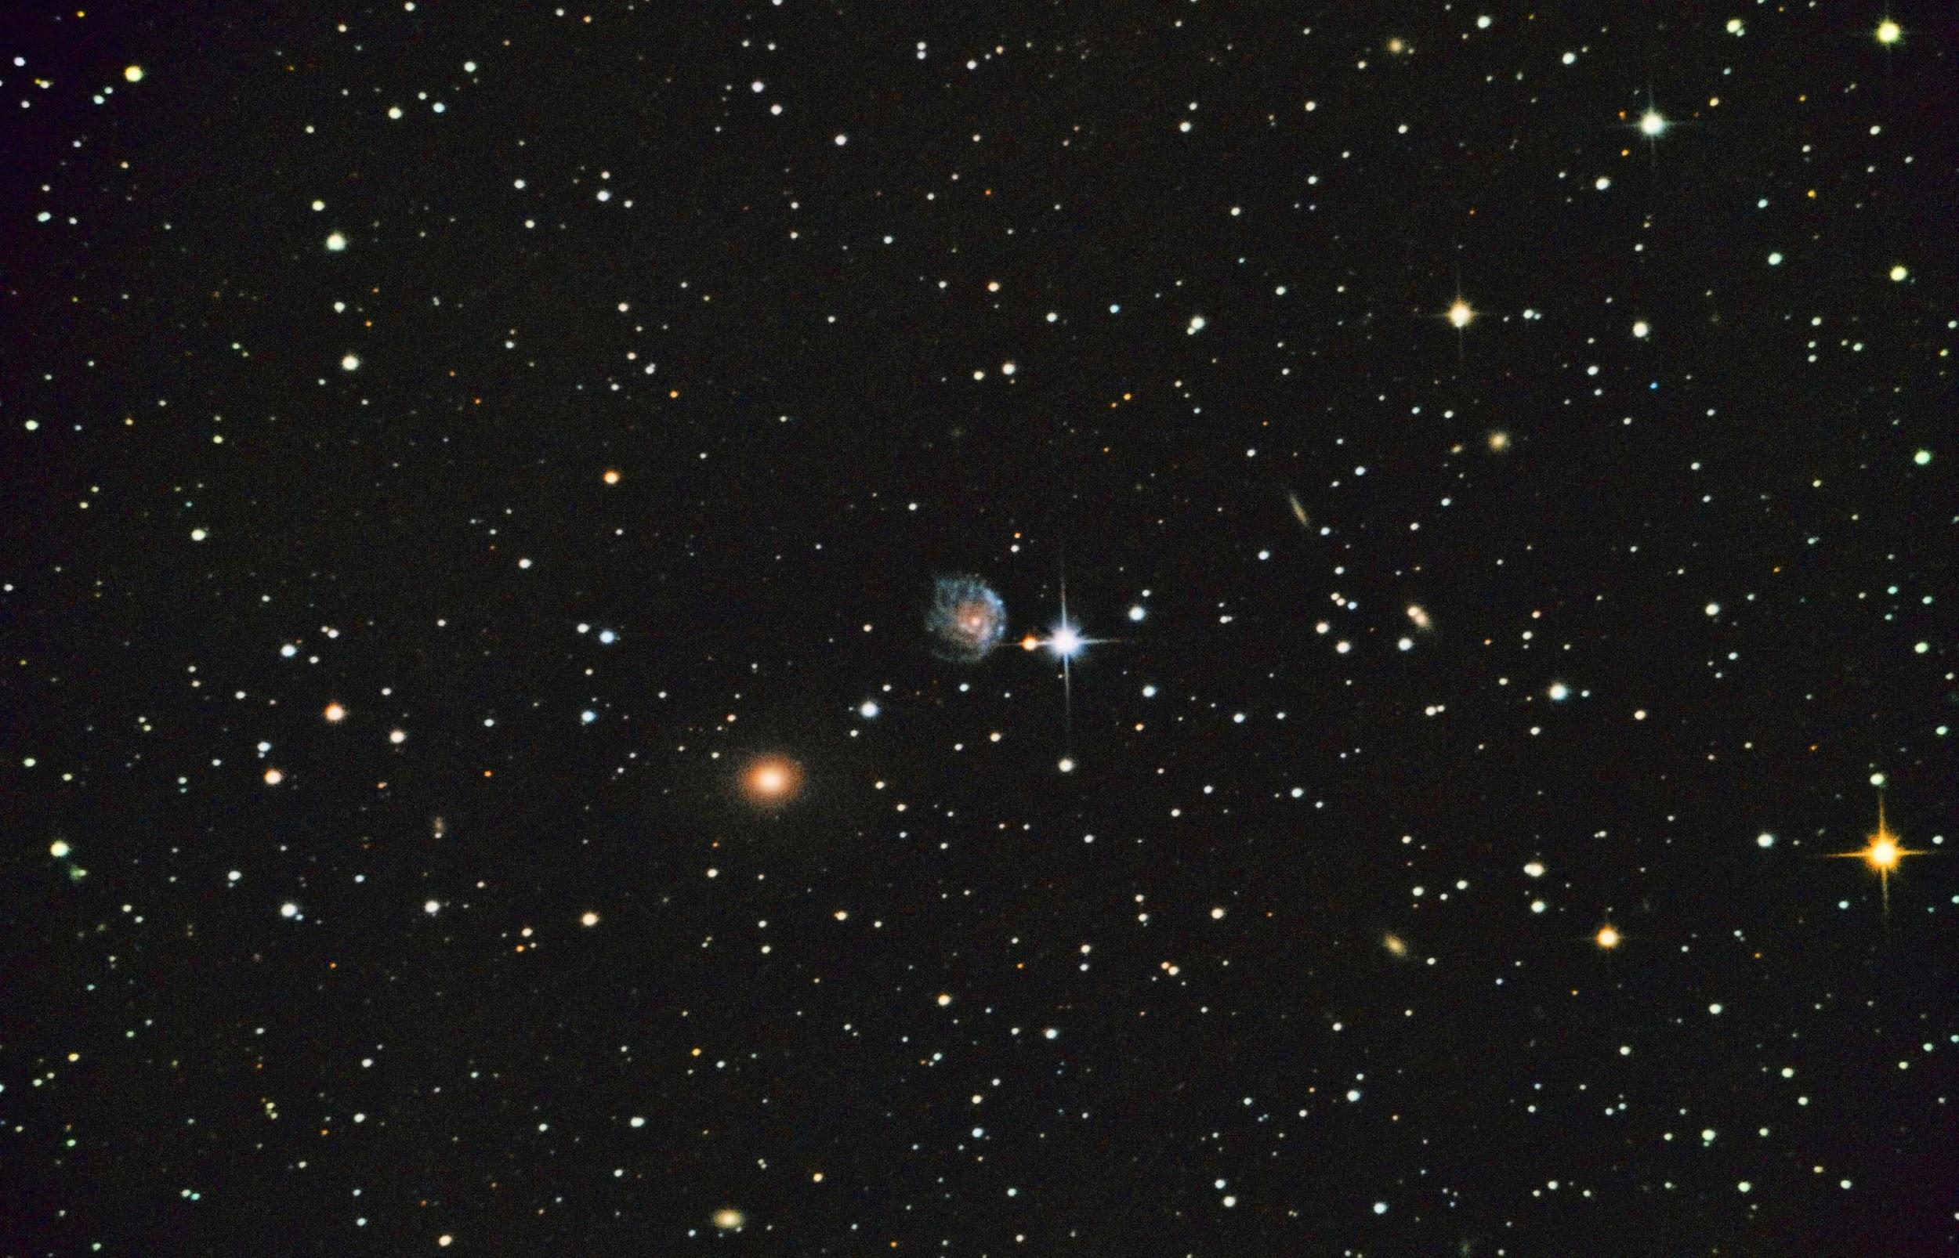
Chris Miskiewicz
ARP 114 (NGC 2276 (ARP 25) & 2300)

Slide 12
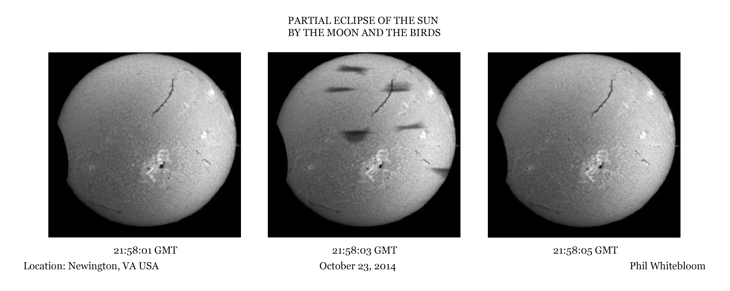
Phil Whitebloom

Slide 13
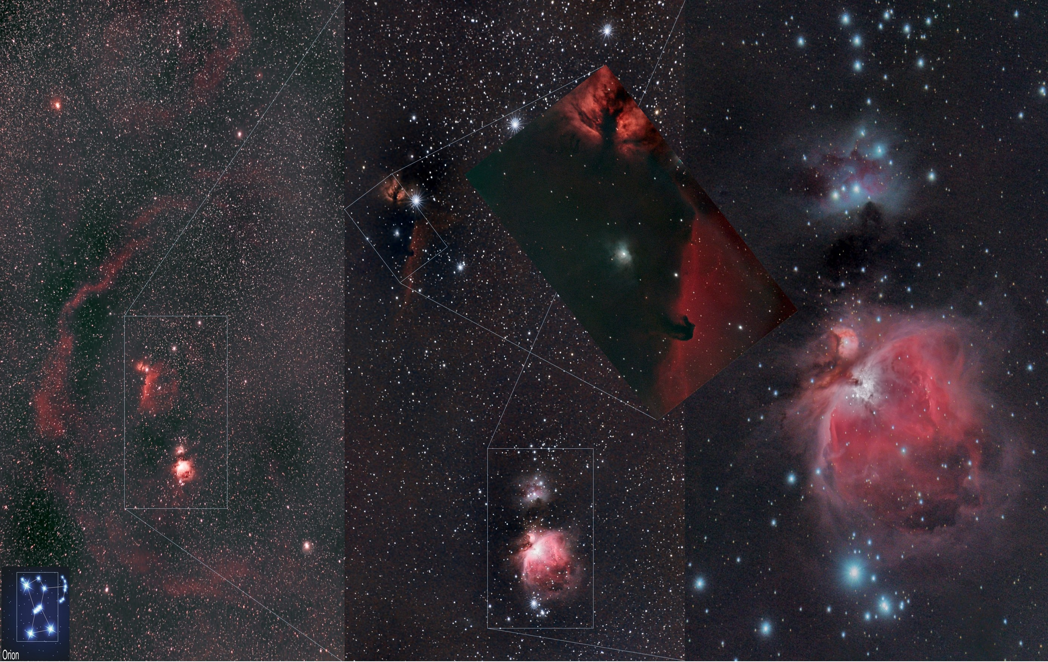
Victor Sanchez

Slide 14
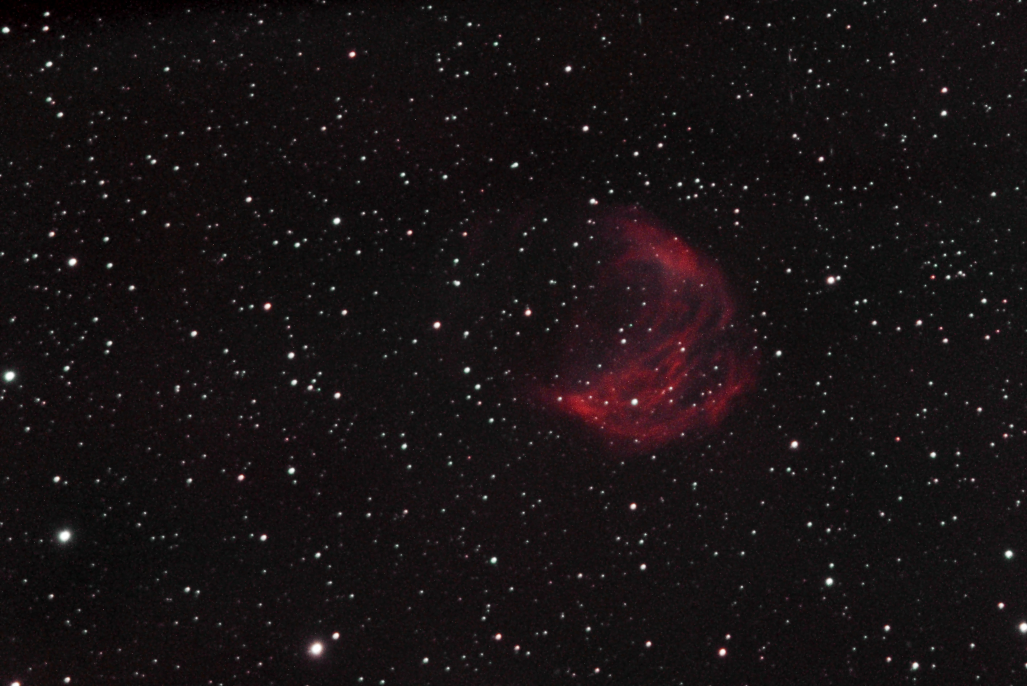
Victor Sanchez

Slide 15
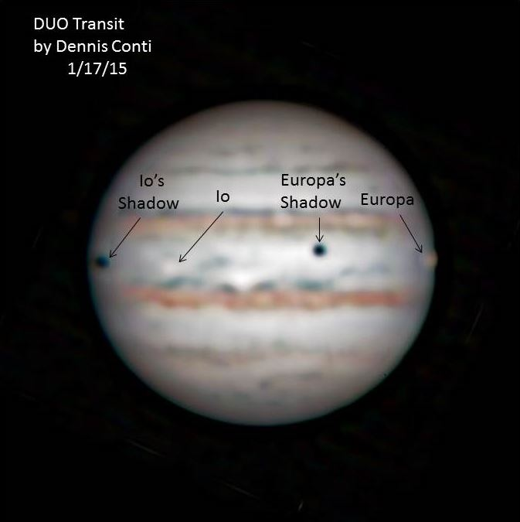

Slide 16
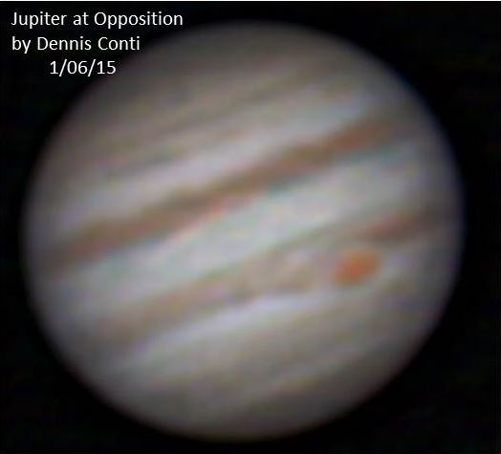

Slide 17
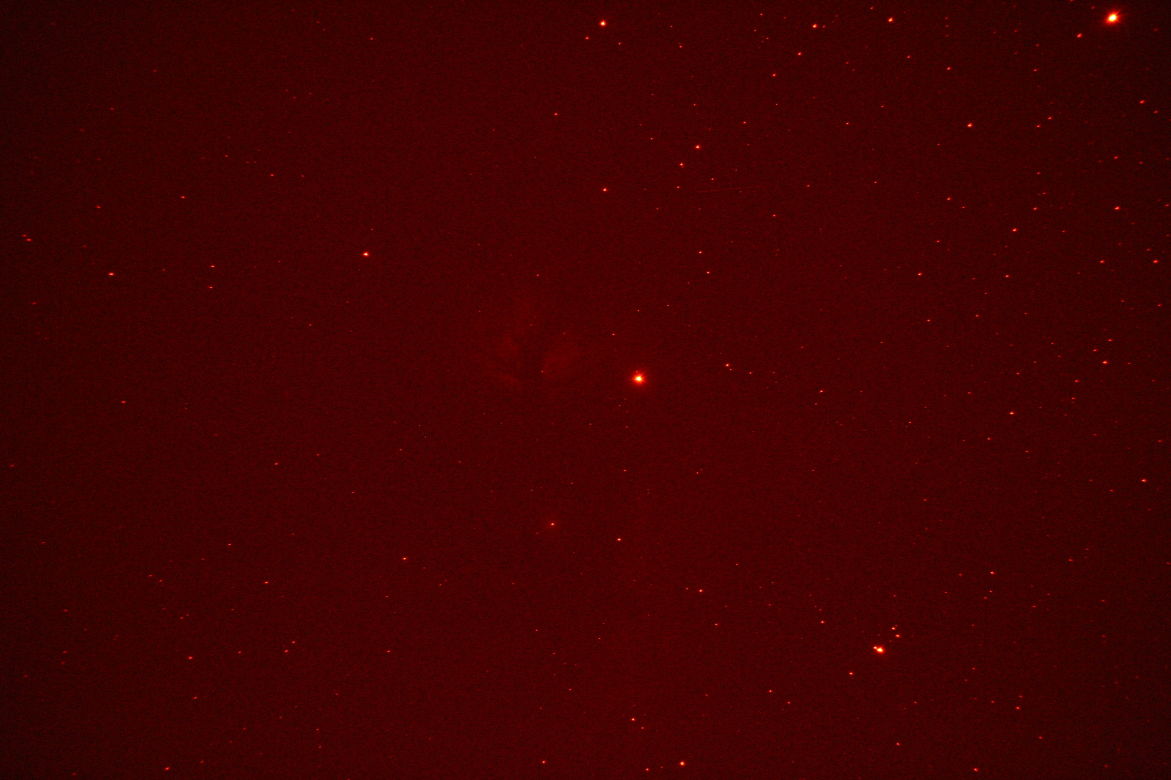
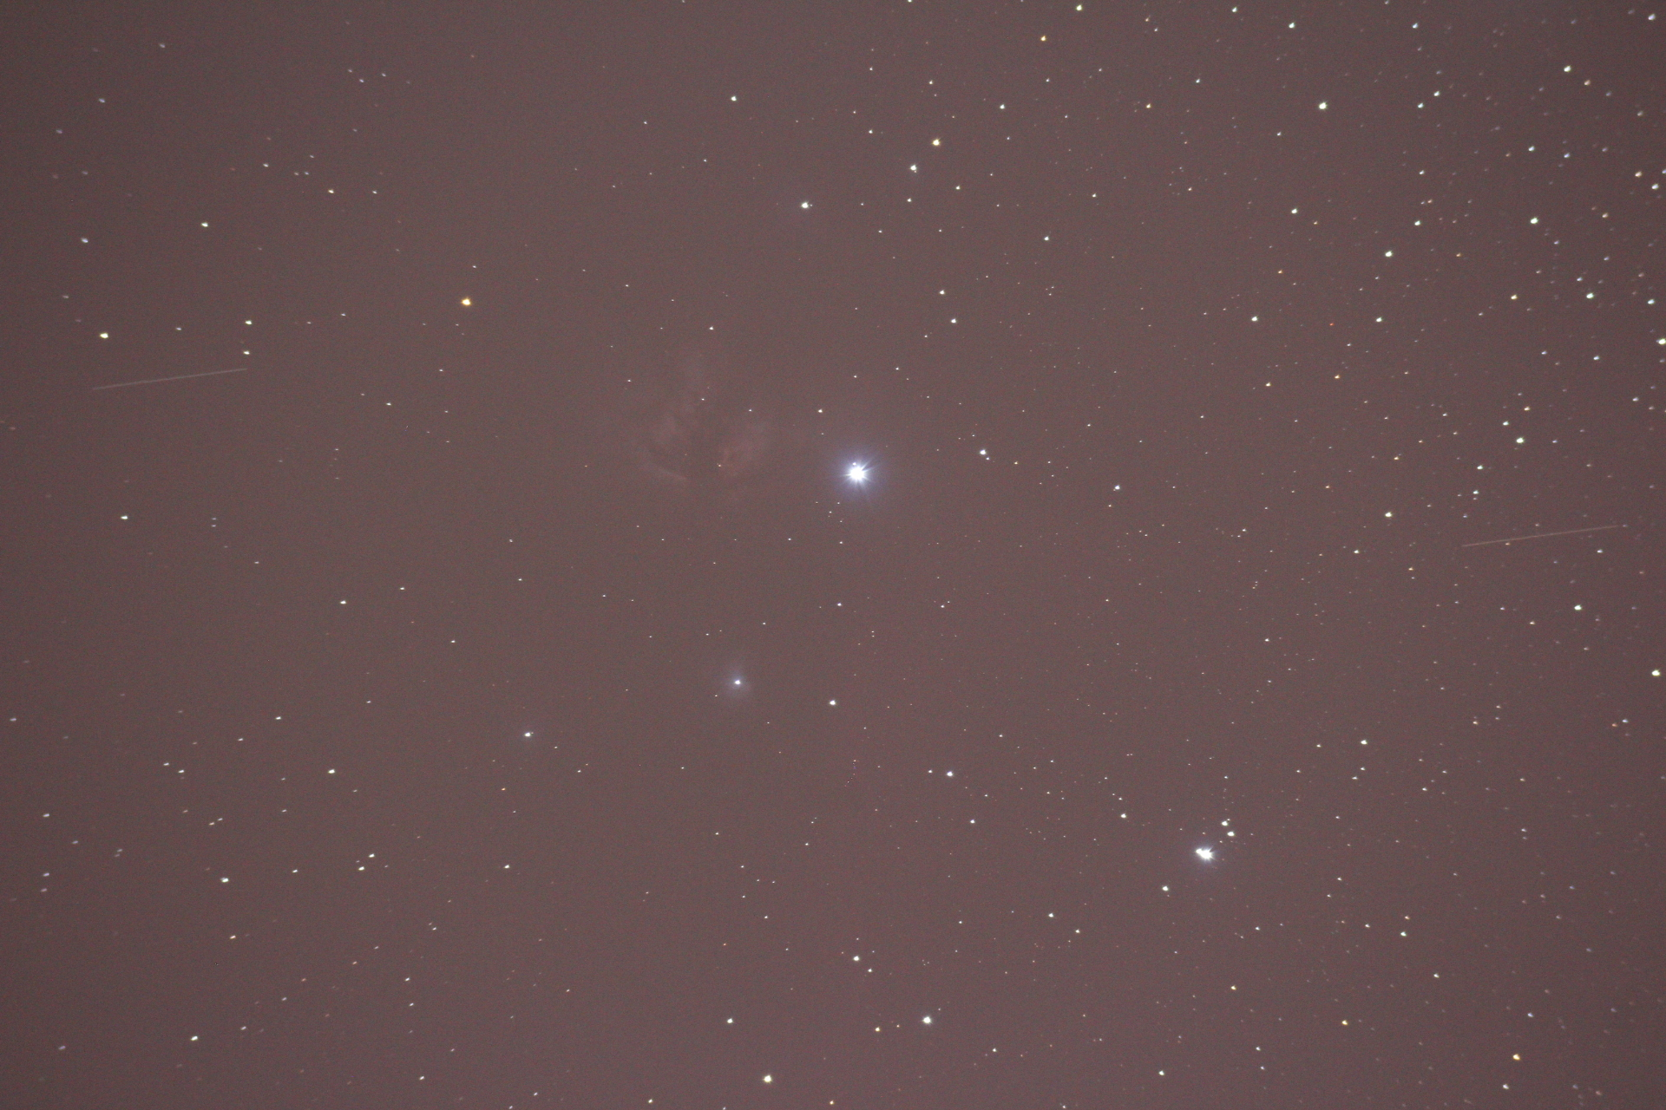
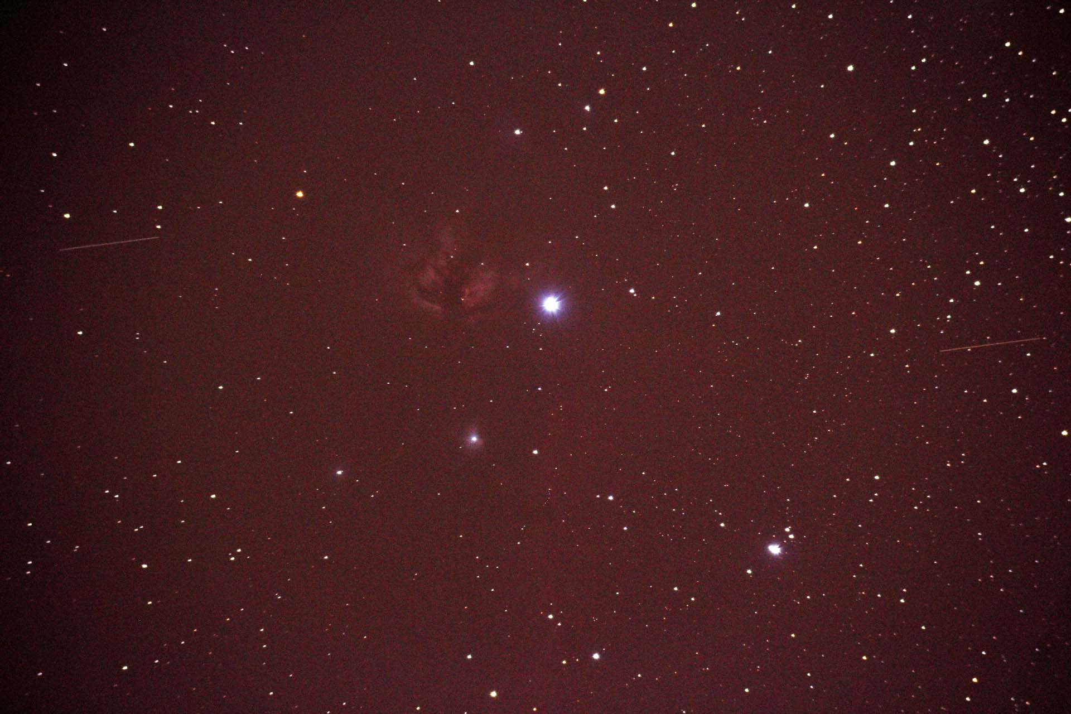
Garry Ingle

Slide 18
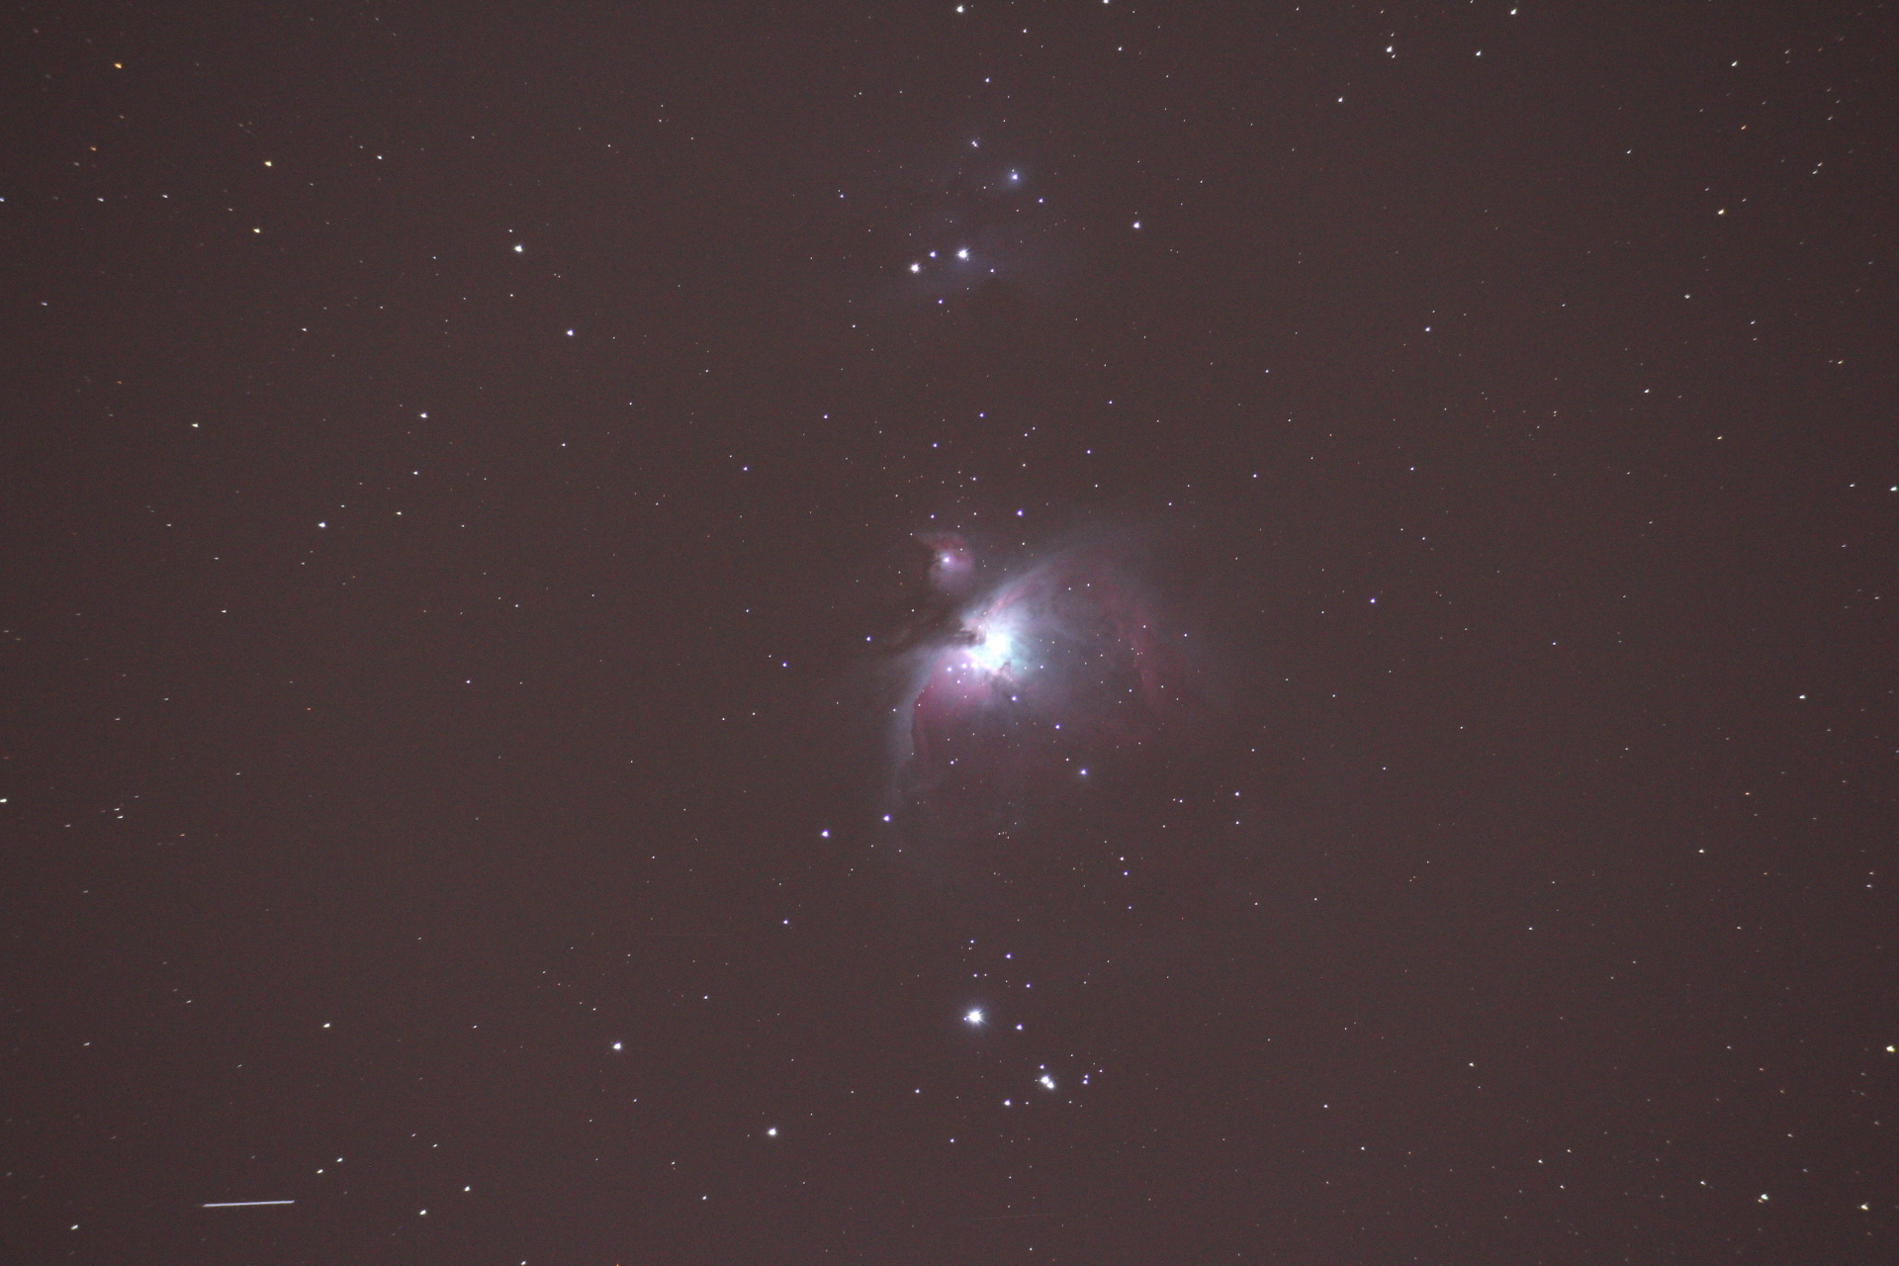
Garry Ingle

Slide 19
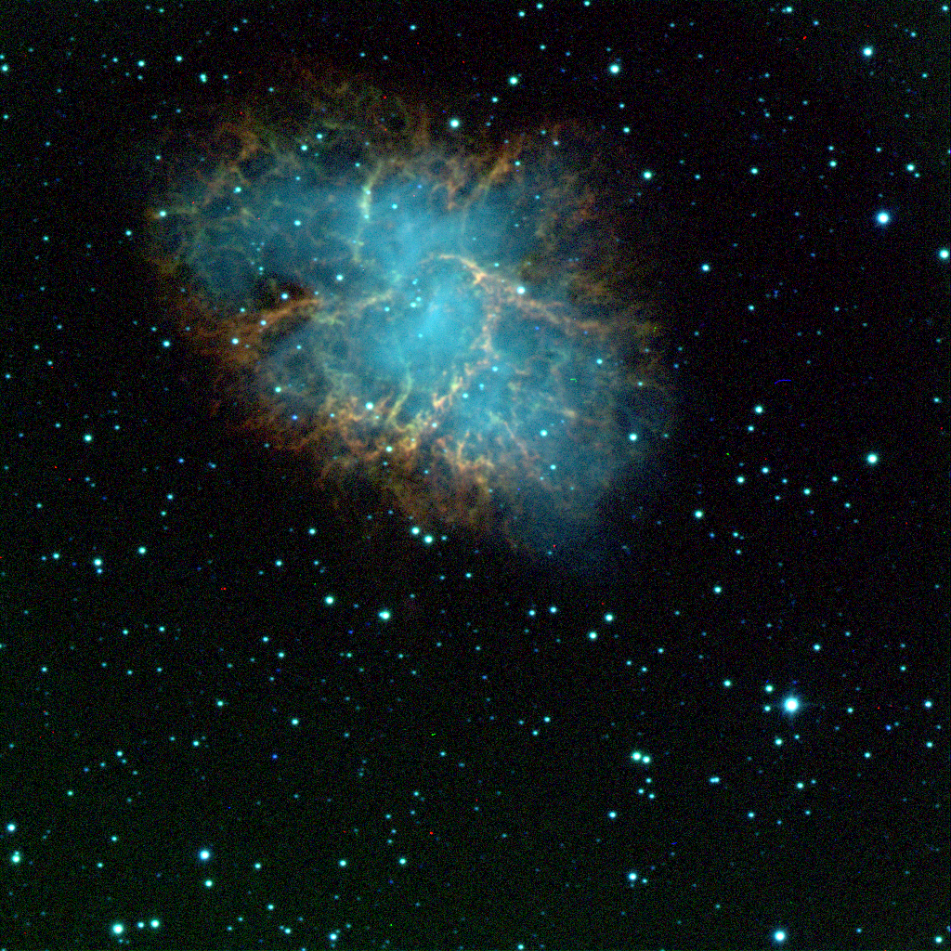
Joel Goodman

Slide 20
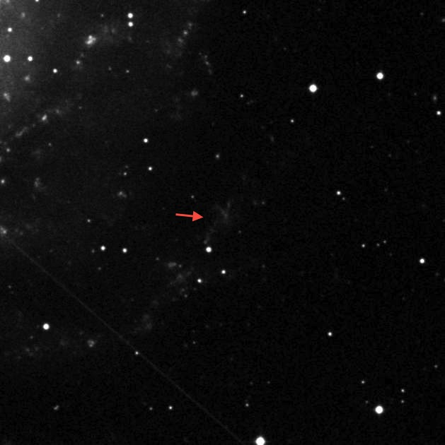
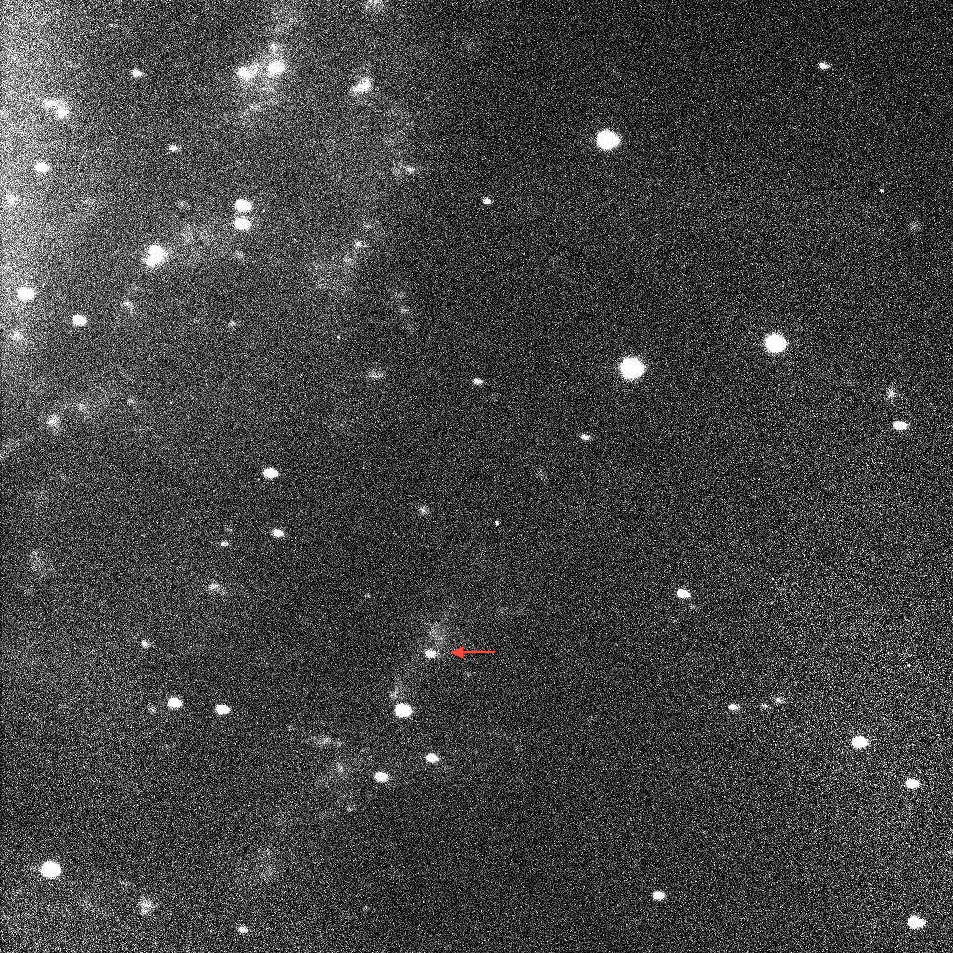
Joel Goodman

Slide 21
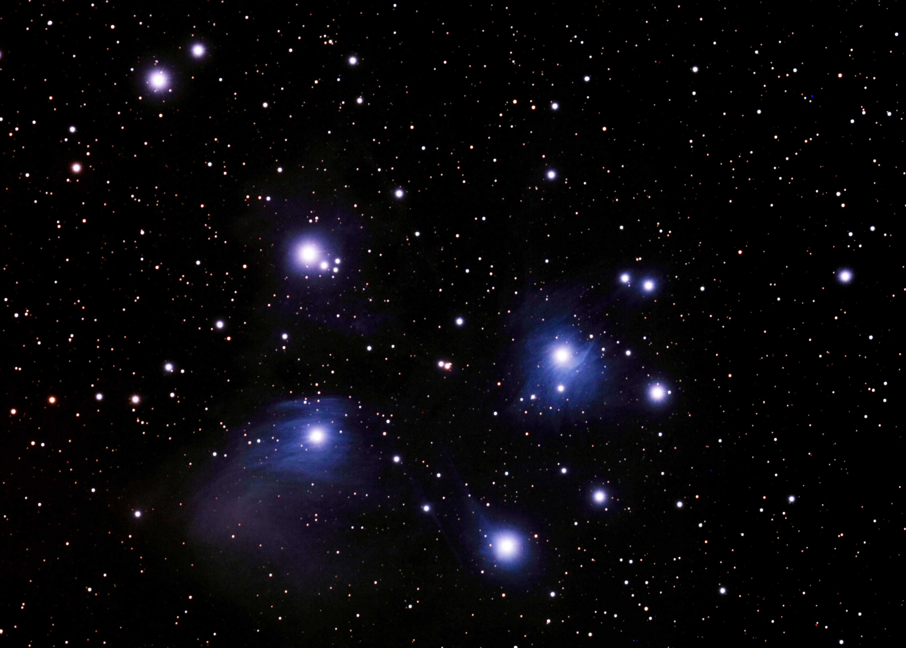
James Stack

Slide 22
Suggested Observing

Slide 23
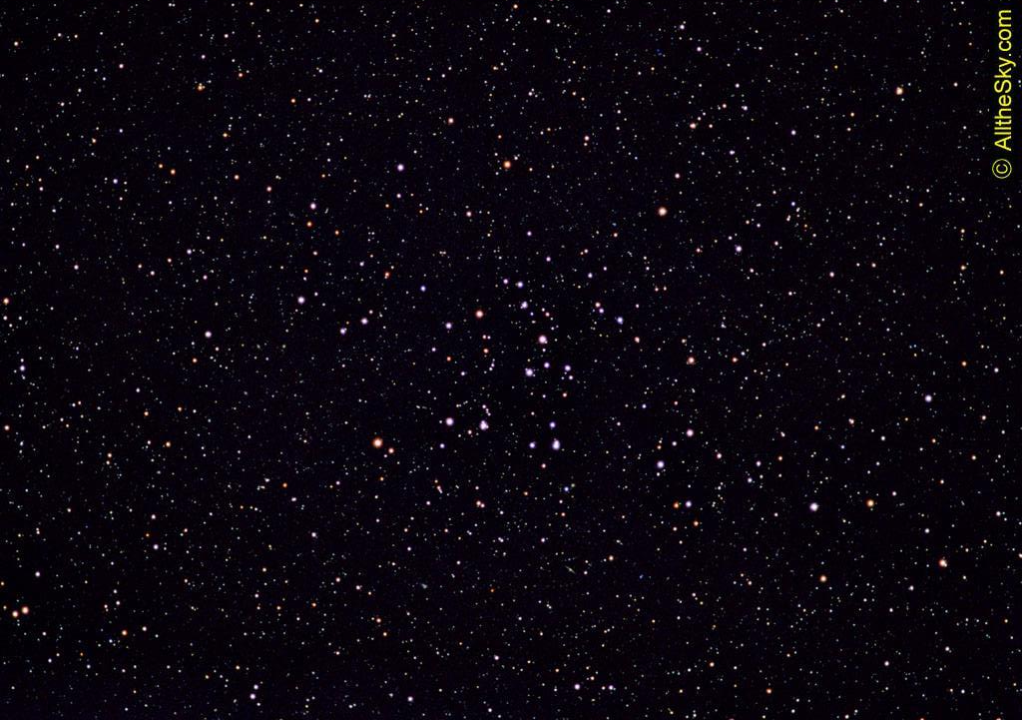
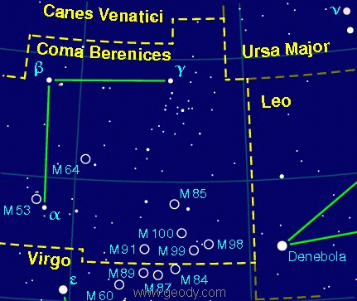
Coma Star Cluster (Melotte 111)
Located near galaxies NGC 4559, NGC 4565, and NGC 4494.
-288 light years from Earth
-7° by 5° area of the sky
-Good binocular target or if you are lucky to be in a dark sky to see a handful of the cluster’s stars nake eye.

Slide 24
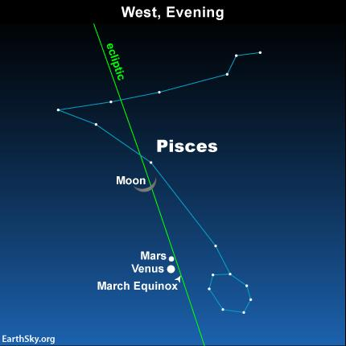
Mars and Venus 1/2° apart on February 21
Look West, 1 hour after sunset.
Venus shines at a mag -3.9 with Mars only around +1.2

Slide 25
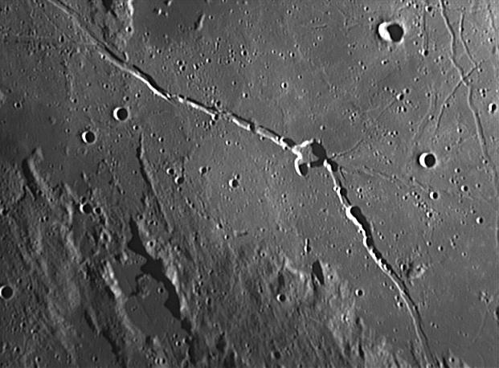
Crater Hyginus and Rima Hyginus
Hyginus is a crater caldera formed from after a volcanic eruption and later land collaspe.
Hyginus is split by a long narrow depression, Rima Hyginus, from Northwest to Southeast for about 220 kilometers.
http://www.astrosurf.com/viladrich/astro/moon/closeup/hyginus-C14.jpg

Slide 26
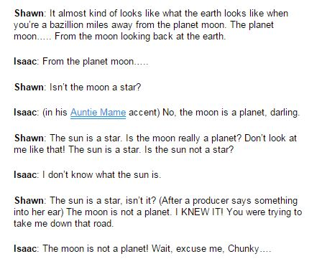
Sad Moments for Science
From our pop culture file!

Slide 27
This
is
Why
we do
Outreach!

Slide 28
Average distance from Earth to Moon 238,900 miles or 384,400 km.
A natural satellite, or moon, is a celestial body that orbits another body (a planet, dwarf planet, or small Solar System body), which is called its primary, and that is not artificial.
A planet is a celestial body moving in an elliptical orbit around a star.
The sun, a star, is a mass of incandescent gas, a gigantic nuclear furnace where hydrogen is built into helium at a temperature of millions of degrees.
My Very Eager Mother Just Served Us Nine Pizzas or Mercury, Venus, Earth, Mars, Jupiter, Saturn(the one with the rings) Uranus, Neptune, and Pluto.

Slide 29
Inner/outer Club Clubs

Slide 30
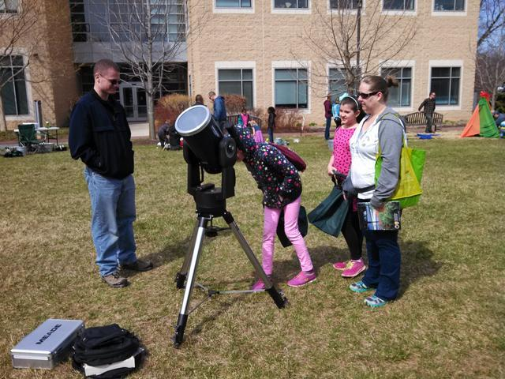
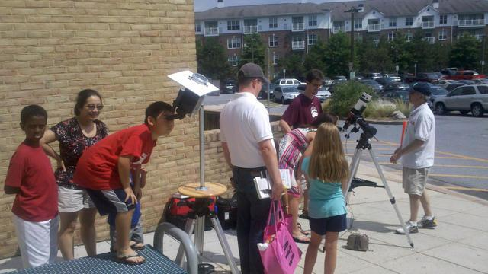
HAL Outreach Club
Help organize and maintain continual science outreach for our area.
Why do outreach? Did you see the videos?
Support request from our community
Earn hours for The Astronomy League’s Outreach Observing Program

Slide 31
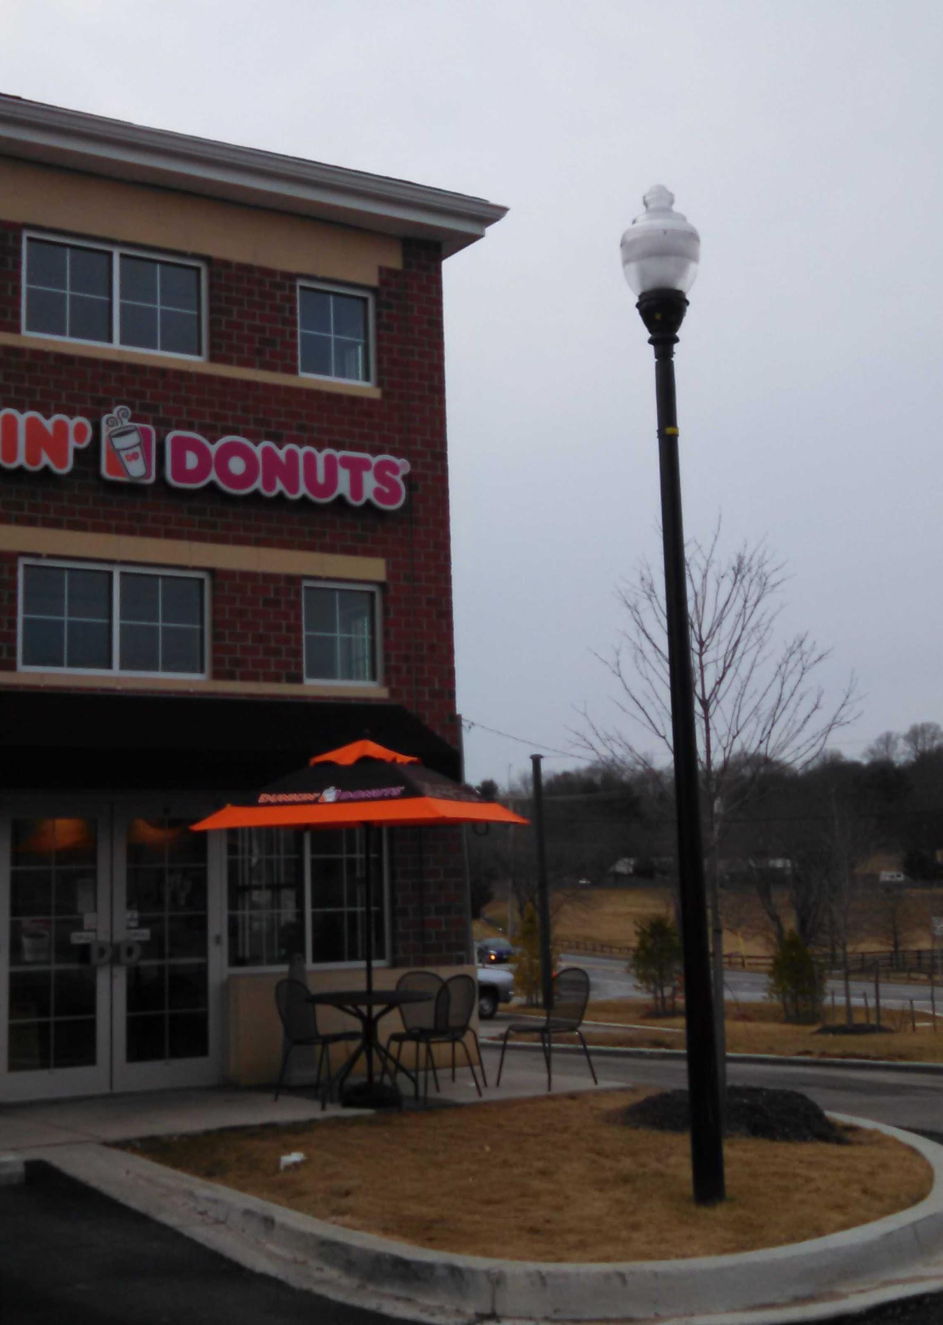
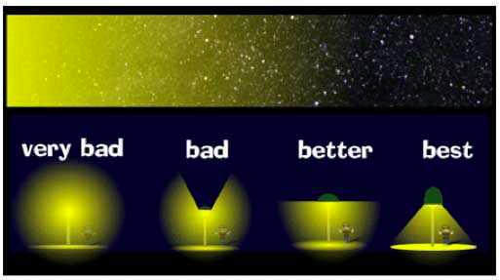
Dark Sky Group
Support the greater area to understand and help prevent light pollution.
Provide a watchful eye for potential light pollution issues for our local area.
Support dark sky awareness for the area close to the Alpha Ridge and Carrs Mill.
Review observing areas.

Slide 32

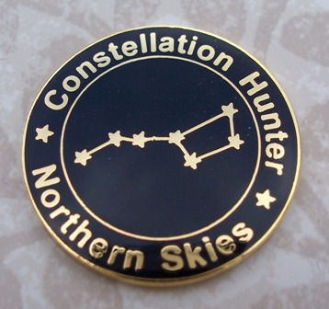
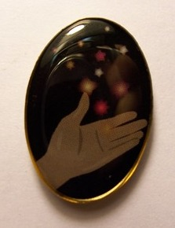
Astronomy League Observing Programs
Program already created
More exposure and more viewing
The Go To Rule

Slide 33
Other ideas
Imaging
Sketching
Product Review with an objective editor

Slide 34
The
Return
of
Chris Todd

Slide 35
Thank You!
Next month’s planning meeting is on Monday, March 2, 2015
@ 7:00 PM
The general monthly meeting is on
March 19, 2015
@7:00 PM
Meeting theme:
The History of HAL and Watson

